Slide 1


Slide 2


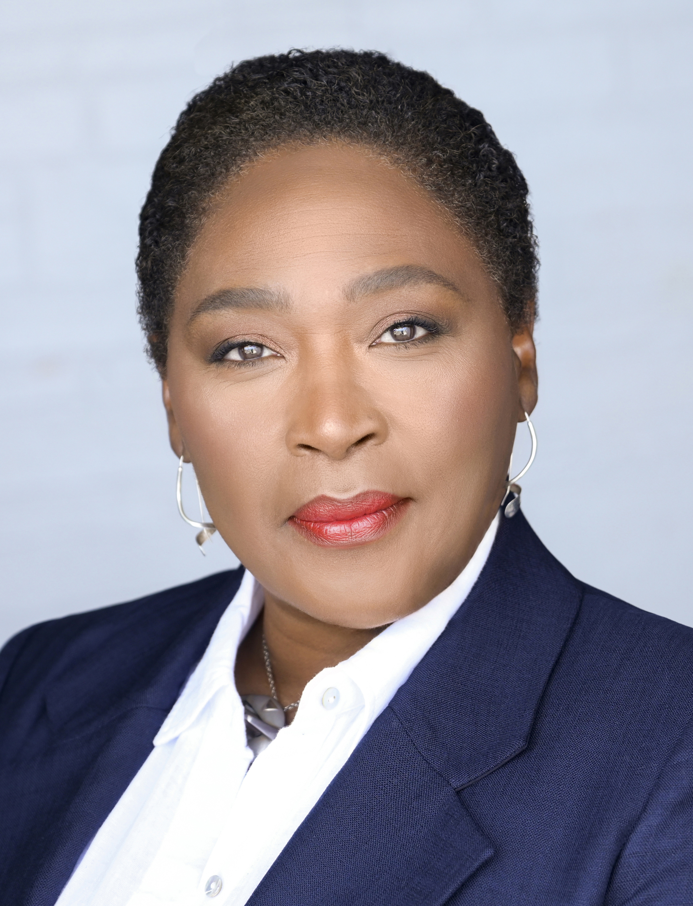
Dr. Desirée Cox, MD, MPhil, PhD is a Rhodes Scholar, medical doctor, creative artist, and internationally respected thought leader in future health and regenerative medicine. Educated at McGill University (Canada), Oxford University (UK) and Cambridge University (UK), Dr. Desirée is the Founder and CEO of The HEALinc and The HEALinc Future Health Innovation Summit (www.healincsummit.com). She is also the CEO of ArtRegen, CEO of the Biotech R&D company BioPep and an Affiliate member of Rutgers University, Graduates Studies Faculty, New Jersey, USA. She is the first Rhodes Scholar from The Bahamas and the first woman Rhodes Scholar from the British Caribbean. She lives in the USA and The Bahamas.
As an innovator, her career in the UK, Europe, North America, The Bahamas, and Latin America has spanned clinical medicine, academia, research and development, regulatory sciences, and the design, development, and implementation of high–impact health and social enterprises. Dr. Cox is a thought leader in future health innovation with 20+ years in the healthcare space and an impressive, rare and unique range of skills and capacities integrating the sciences and the arts. Her experience in healthcare consulting includes consulting for biotech companies and major pharmaceutical companies, including Amgen, GSK and Novartis, on pipeline therapeutic products and medical devices.
In October 2017, she was honored by Oxford University as one of six alumni to have their portrait hung in the Great Hall at Pembroke College. She was one of 5 recipients of the 2019 International Advocacy Action Award at the World Stem Cell Summit in Miami, Florida. She was also a presenter at the 2018 Vatican ‘Unite to Cure’ Conference.
Since 2014, she has been spearheading the development of a regulatory system and ecosystem in The Bahamas for accelerated patient access to stem cell, regenerative medicine and other future health technologies manufactured in the US and Europe, Latin America and Asia. At the 40th Independence Celebrations in 2013, the Bahamas Government honored Dr. Cox by issuing a 70-cent stamp into circulation bearing her photograph.
Dr. Desirée Cox, MD, MPhil, PhD
CEO and Founder, The HEALinc
Affiliate Faculty Member, Rutgers University, New Jersey, USA
Chair of the Joint National Stem Cell Ethics Committee (NSCEC) and National Medical Ethics Committee of The Bahamas
www.healincsummit.com

Slide 3
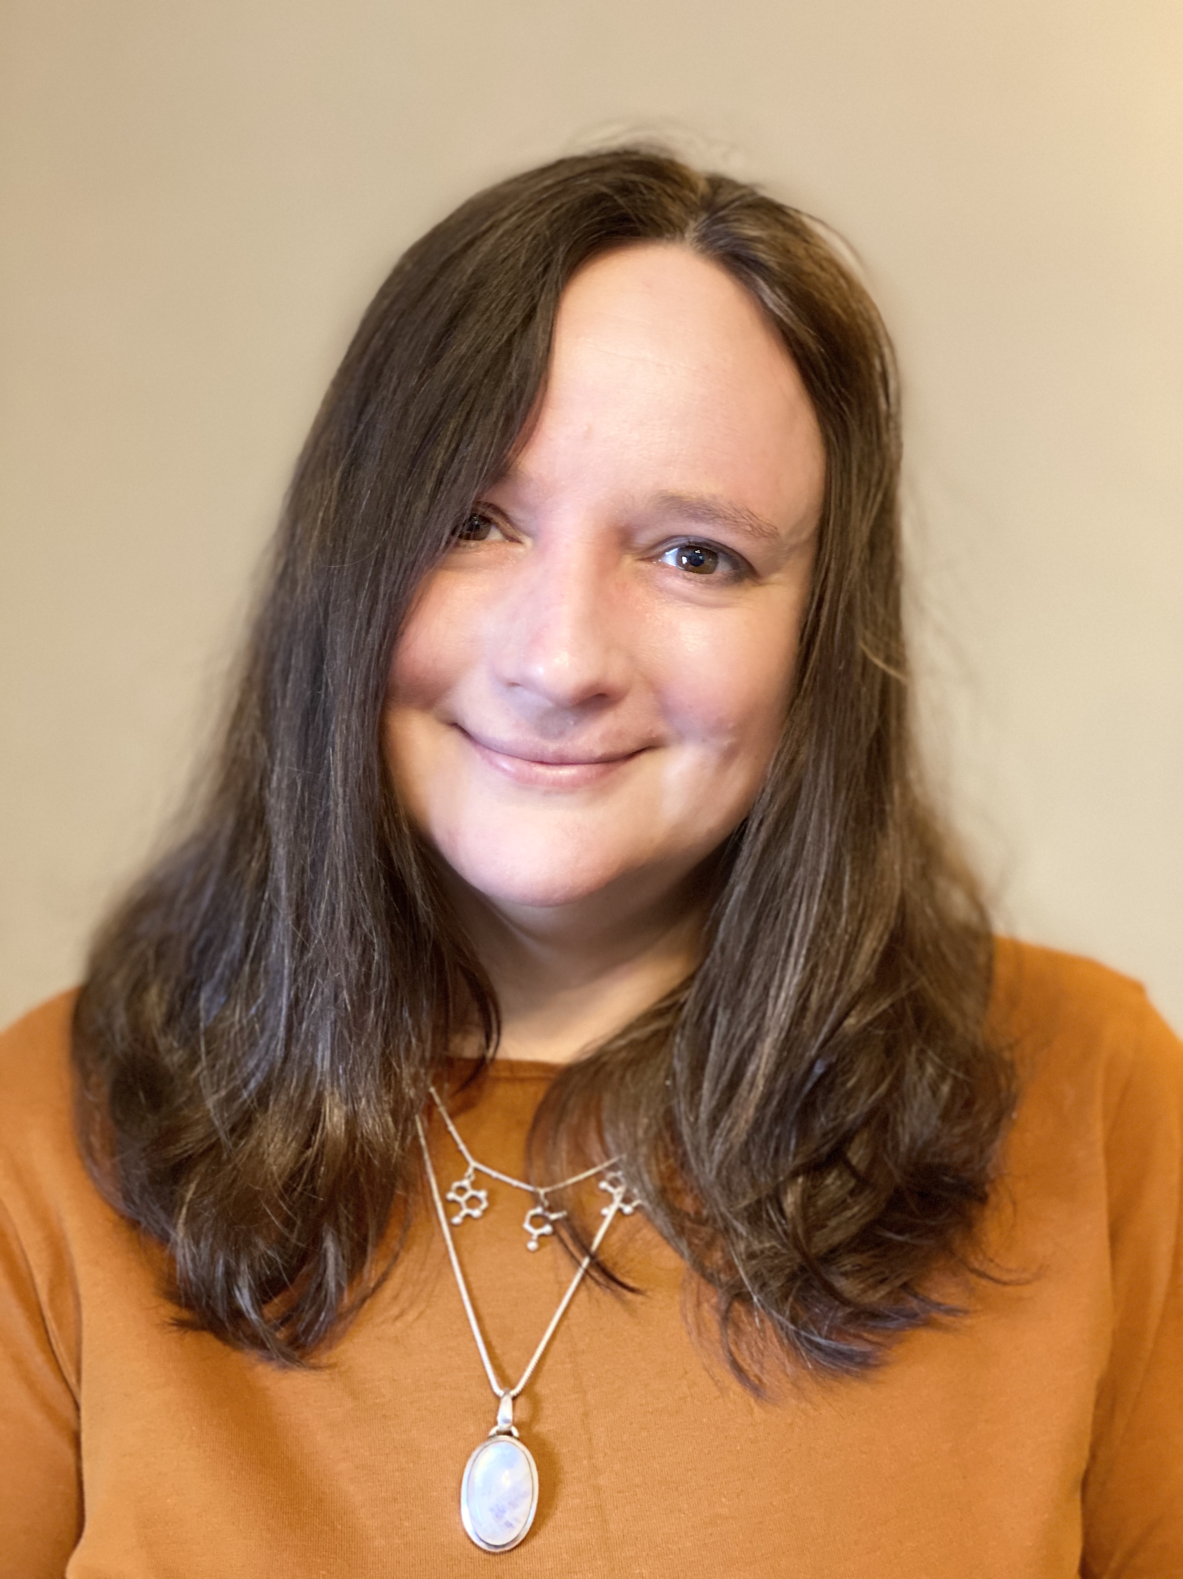
Professor Lorna Harries is co-founder, director and Chief Scientific Officer at SENISCA Ltd., a spin out company from the University of Exeter Medical School, founded on the back of 10+ years of academic research from the Harries lab. Lorna gained her PhD from University College London in 1994 and holds a personal chair in Molecular Genetics at the University of Exeter Medical School. Lorna also heads the Exeter Animal Free Research Centre of Excellence (ARC 2.0) funded by Animal Free Research UK. The Harries lab have interests in -omics approaches to the study of ageing and age-related disease processes in humans, and her work takes a genes to systems approach, ranging from ‘big data’ analyses to detailed individual molecular analysis of particular genes. Her team were the first to report dysregulation of alternative splicing as a new, and druggable, hallmark of ageing; a finding which is now being developed as the basis for a new generation of interventions to treat the underpinning causes, not just the symptoms, of age-related chronic disease.
Lorna Harries, PhD
Co-Founder, Director and CSO, SENISCA Ltd.
www.healincsummit.com

Slide 4
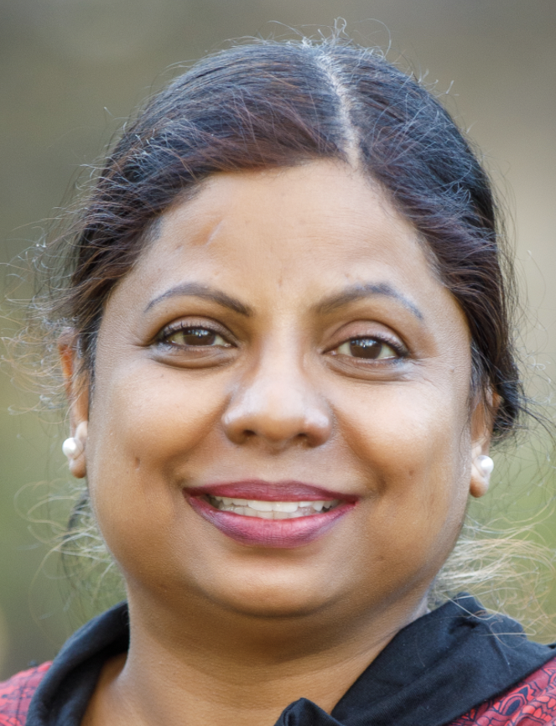
Dr. Jyothi Devakumar is a scientist, entrepreneur, and lifelong longevity enthusiast. She holds a PhD in biotechnology, and her postdoctoral work was in in-vivo delivery systems. She has worked in various sectors of the industry, including working as part of a contract research organization liaising with several Ivy League pharma companies in the drug discovery space, as a scientific founder and CSO of two startups, and as a consultant in the regenerative medicine and longevity space. In the investing space, she has been a venture consultant, principal biologist and partner for a mid-sized venture fund. She is currently associated with the Longevity Tech Fund group of companies as the Chief Science Officer and partner. She has served on several scientific advisory boards and editorial boards, and she brings in scientific expertise, business strategy, and management experience with a multicultural, multi-country background.
Dr. Jyothi Devakumar, PhD
Professor of Health Research Methods, Evidence and Impact, McMaster University
www.healincsummit.com

Slide 5
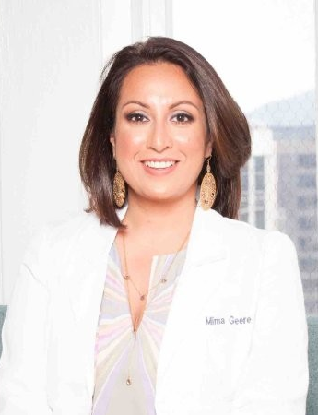
Dr. Mima Geere, MD has over 20 years of experience as a scientist, researcher, and licensed medical doctor in the fields of Functional Medicine, Nutrition, and Laboratory Science. She is certified by the Institute of Functional Medicine and is researching trauma and toxins’ role on the body’s psycho-neuro-endocrine-immune system.
Dr. Geere obtained her medical degree at the University of Vermont and her master’s in nutrition at Columbia University. Her training includes Post Sophomore Fellowship in Pathology at Stanford, followed by her residency training at the University of California San Francisco in clinical laboratory medicine. She also completed a 1-year fellowship in Clinical Informatics and is now conducting a post-doctorate researching Environmental Toxins utilizing advanced small ion technology Mass Spectrometry.
Dr. Geere’s leadership roles include Executive Medical Director for JumpstartMD and Genova Diagnostics and CMO for 100plus labs. She was also a consultant in medical education at the Institute for Functional Medicine, the largest accredited training body for functional medicine. She is trained and certified in Ayurvedic Health through Deepak Chopra’s Perfect Health Program and the Mount Madonna Institute of Ayurveda, and she served as staff physician at Dr. Chopra’s Mind Body Medicine Clinic.
Dr. Geere’s approach is evidence-based and precise. She meets her patients where they are and builds trust as they embark on their journey into health and healing together. Her medical method is scientific, evidence-based, and targeted while utilizing the best of holistic medicine and mind-body medicine to optimize health and longevity.
Mima Geere, MD, MS, IFMCP
Founder, Mimansa
www.healincsummit.com

Slide 6
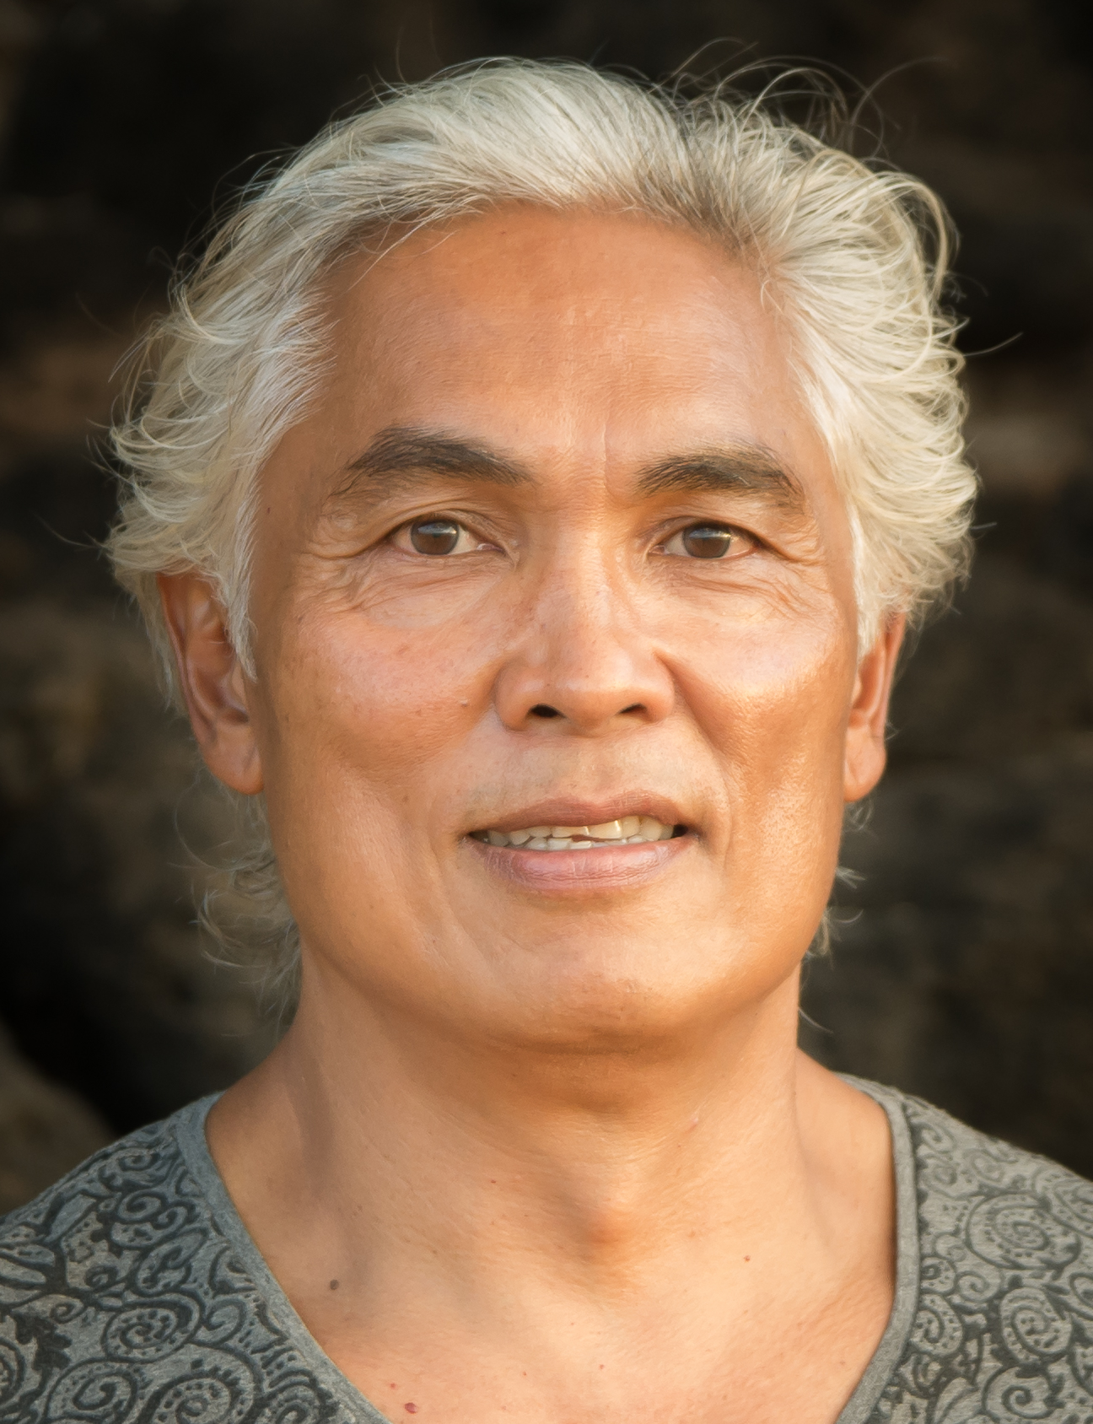
Compton Rom has an M.S., in Microbiology from Michigan State University and a Medical School education from the University of Michigan. He has spent the last 28 years researching microbes, consciousness, and how indigenous foods and their ecology of microflora helps stave off disease, detoxify the body, and increase life span.
He has conducted research for major biotech and pharmaceutical companies and has applied the rigor of the way drugs are evaluated and studied to natural whole food-based extracts.
The mission of his company, Ascended Health, is to develop effective plant based extracts into a bio- intelligent format that is eco harmonic to the body through the processing of microbes from longevity zones, with the infusion of intention and conscious vibrational frequency.
With a background based in western scientific research and almost thirty years study of indigenous healing methodologies, Compton Rom has created unique blends of live, whole earth natural remedies for the expansion of consciousness and regeneration of the body. His products at AscendedHealth.com include food supplements, beverage elixirs and whole body oils for a holographic approach to our health.
Compton Rom has a medical school education from the University of Michigan and a M.S. in Microbiology from Michigan State University. His current interest lies in the utilization of ancient soil-based microbes (proteobacteria) as an addition to our diet. These microbes occupied the guts of our ancestors and may hold a key to long-lost regenerative factors when fermented using superfoods and sprouted grains. His products include the fermented byproducts of soil microbes from volcanoes on Japan, Hawaii, Vanuatu, Guatemala, Patagonia and the tundras of Siberia and Alaska. These beneficial microbes could represent the future of medicine, with the potential to treat a variety of diseases in humans and animals, and expand consciousness.
Compton Rom
Founder, Ascended Health
www.healincsummit.com

Slide 7
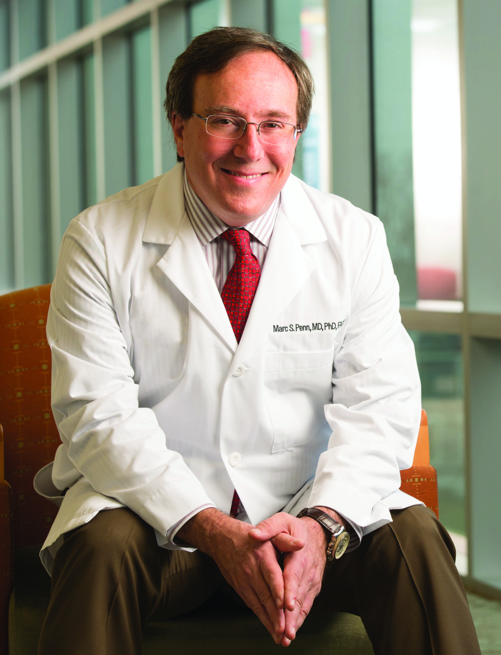
Dr. Marc Penn is a renowned Cardiologist who has helped pioneer and commercialize several important innovations in his field, while establishing two parallel careers as an inventor and healthcare investor. Currently, Dr. Penn is a practicing cardiologist and director of research at the Summa Health Heart and Vascular Institute (Akron, Ohio), as well as director of the Institute’s Cardiovascular Medicine Fellowship. He is also professor at Northeast Ohio Medical University where he leads the Skirball Laboratory for Cardiovascular Cellular Therapeutics (Rootstown, Ohio).
From 2000–2011, Dr. Penn was a cardiologist at the Cleveland Clinic, where he was recognized as one of the top 50 doctors in the history of the center. During that time, he served as the director of the Coronary Intensive Care Unit, the Experimental Animal Laboratory, the Bakken Heart–Brain Institute and the Center for Cardiovascular Cell Therapy. From 2008–2010, he also served as the senior medical director for Emerging Businesses.
Dr. Penn’s research has led to important discoveries in diagnostics and drug delivery systems for the treatment of cardiovascular disease as well as new strategies to optimize gene and stem cell therapy for regeneration of myocardial tissue and neuromodulation of cardiac function.
He is also an active inventor who has generated intellectual property in the fields of diagnostics, biologics and devices which has been licensed by numerous companies. In 2006, he was named Innovator of the Year at the Cleveland Clinic and he was also the co–founder and CMO of Cleveland HeartLab, which was acquired in 2017 by Quest Diagnostics.
Marc S. Penn, MD, PhD, FACC
Director of Research and Cardiovascular Medicine Fellowship, Summa Cardiovascular Institute
www.healincsummit.com

Slide 8

www.healincsummi.com

Slide 9
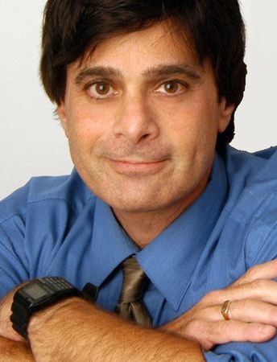
Evan Snyder earned his M.D. and Ph.D. jointly at the University of Pennsylvania and studied psychology, philosophy, and linguistics at the University of Oxford (Balliol College). He completed residencies in pediatrics and neurology and a clinical fellowship in Neonatology at Children’s Hospital-Boston, Harvard Medical School, where he also served as Chief Resident in Medicine and then in Neurology. Concurrently, he was a postdoctoral research fellow in the Department of Genetics. In addition to going onto the clinical faculty there in both Neonatology and Neurology (becoming the country’s first to be dual-boarded in those specialties), he also started his independent lab where he helped define the basic and translational properties of stem cells (particularly neural). He was recruited to the Sanford Burnham Prebys Institute in La Jolla to found a Center for Stem Cells & Regenerative Medicine and help build the stem cell program in California. Regarded as one of the “Fathers” of the stem cell field, he’s been elected to the Association of American Physicians and to the American Institute of Medical & Biological Engineering. He served two terms as Chairman of the FDA’s Cell, Tissue, & Gene Therapy Advisory Committee (after helping found the FDA/NIH Stem Cell Working Group) and presently chairs the SAB of NIH’s Genetic Disease Biobank. He’s a Diplomate of the Health Leadership Academy. His biography is included in Ashwal’s Child Neurology: Its Origins, Founders, Growth & Evolution.
Dr. Evan Y. Snyder, MD, PhD, FAAP
Professor & Founding Director of the Center for Stem Cells & Regenerative Medicine
Sanford Burnham Prebys Medical Discovery Institute & Sanford Child Health Research Center
Biomedical Sciences Graduate Program; Steering Committee, Medical Scientist Training Program; Physician, University of California-San Diego
www.healincsummit.com

Slide 10
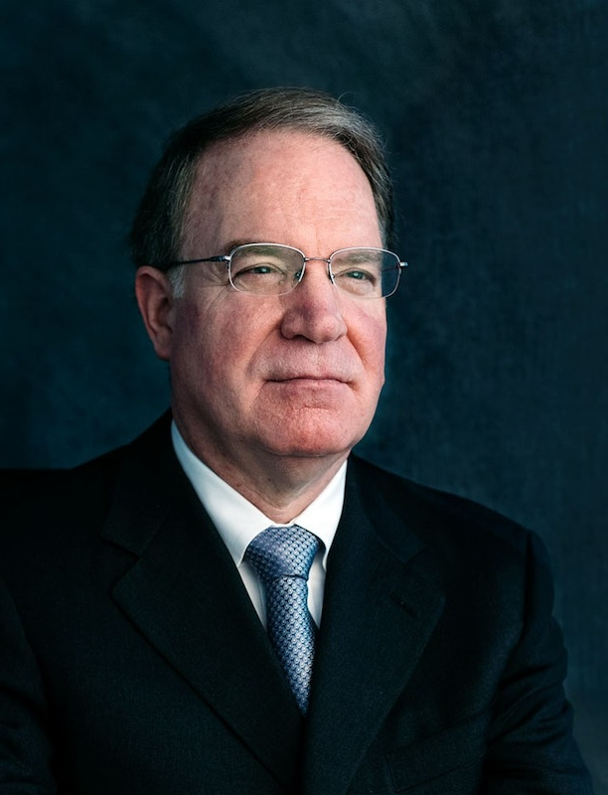
Dr. Foley received his Doctor of Medicine degree from UCLA in 1979. He completed neurosurgery residency training at UCLA in 1985.
Following residency, Dr. Foley served in the United States Army Medical Corps as Assistant Chief of Neurosurgery at Brooke Army Medical Center, Chief of Neurosurgery at Tripler Army Medical Center, and Chief of Neurosurgery at Walter Reed Army Medical Center, where he was also the chairman of the neurosurgical residency training program.
In 1992, Dr. Foley left the military and joined Semmes-Murphey Clinic and the Department of Neurosurgery at UTHSC. In addition to a full-time spine surgery practice, he is actively involved in research in minimally invasive spine surgery, image-guided spinal navigation, robotics, spinal biomechanics, clinical outcomes, and disc regeneration. He has over 200 scientific publications to his credit, has lectured at more than 600 scientific meetings and educational workshops, and has been a visiting professor and invited lecturer at numerous universities in the US and abroad. In addition, Dr. Foley has been issued 178 U.S. patents; his inventions include tubular retractors for minimally invasive spinal surgery, methods and devices for image-guided surgery, minimally invasive spinal fixation using screws with percutaneous extenders, bullet-nosed and expanding interbody implants, and methods for deriving and using discogenic cells. In recognition of his accomplishments, Dr. Foley was presented with the American Association of Neurological Surgeons Cushing Award for Technical Excellence and Innovation in Neurosurgery in 2019.
Kevin T. Foley, MD, FAANS, FACS
Professor of Neurosurgery, Orthopedic Surgery, and Biomedical Engineering, University of Tennessee Health Science Center, Memphis Chairman, Semmes-Murphey Neurologic and Spine Institute, Memphis, Tennessee Chief Medical Officer and Founding Board Member, Discgenics
www.healincsummit.com

Slide 11
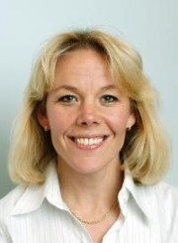
Dr. Katarina Le Blanc is a Professor of Clinical Stem Cell Research at Karolinska Institute, Division of Clinical Immunology and Transfusion Medicine, Stockholm, Sweden. She received her MD from the Karolinska Institute, in 1993 and her Ph.D. in 1999. In 2002 she became a certified specialist in haematology. Her main research interest is mesenchymal stem cells, haematopoietic stem cell transplantation and immunology. She is the recipient of several awards. Dr Le Blanc is co-director of the Wallenberg Institute for Regenerative Medicine, co-director of the Strategic Research Foundation for Stem Cells and co-director for Karolinska Institute Theme Centre for Stem Cells. She is Chair, Research and Education, Hematology Center, Karolinska University Hospital.
She is a member of several international and national committees, advisory boards and scientific meetings. She has mentored many trainees, PhD students and post docs. She currently has over 100 peer-reviewed publications and review articles.
Katarina Le Blanc, MD, PhD
Professor of Clinical Stem Cell Research, Karolinska Institute
www.healincsummit.com

Slide 12
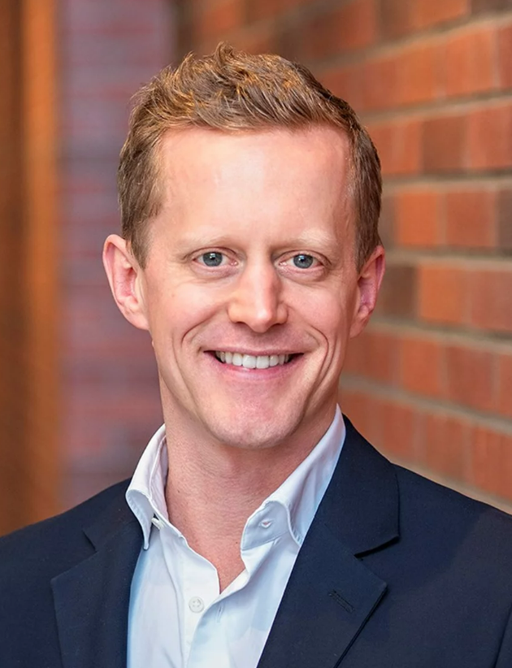
Mattias Bernow is a medical doctor, entrepreneur, and the Chief Executive Officer (CEO) of the Swedish impact start-up Cellcolabs. He holds a double degree in Medicine from the Karolinska Institute, and an MSc degree in Business and Management from Stockholm School of Economics. Mattias spent his early professional career practicing medicine at the Karolinska University Hospital as an emergency clinic physician. During this time, he also worked at the Boston Consulting Group as a Management Consultant. In 2016 he co-founded Doctrin AB, Sweden’s, most prominent patient facing digital tool for physical healthcare providers. At Doctrin he served as inter alia Chief Commercial Officer and Chief Implementation Officer. Since 2021, Mattias is the CEO at Cellcolabs, the Swedish manufacturer of high-quality Mesenchymal Stromal Cells (MSCs), who’s goal it is to disrupt healthcare as we know it by providing affordable access stem cells for research and treatments.
Mattias Bernow, MD
CEO, Cellcolabs
www.healincsummit.com

Slide 13
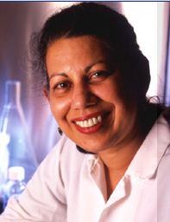
Dr. Pranela Rameshwar is a professor of Medicine, Hematology-Oncology, Rutgers New Jersey Medical School. She received a B.S. degree from the University of Wisconsin- Madison, Ph.D. from Rutgers University and postdoctoral training in hematopoiesis.Dr. Rameshwar’s laboratory is involved in translational research of stem cell cellular delivery of drugs, aging, breast cancer dormancy, cancer stem cells, hematopoiesis and immunology of mesenchymal stem cells. Dr. Rameshwar is active in mentoring and education. She has authored over 200 publications, which include original articles, reviews, editorials and book chapters. She has also edited books. Dr. Rameshwar is also involved in teaching. She initiated a certificate program in Stem Cell Biology and directs four graduate level courses in stem cell biology. Dr. Rameshwar is also a university Master Educator. She is an active member of several grant review panels both nationally and internationally. She has given numerous invited seminars both nationally and internationally. Dr. Rameshwar is editor in chief, associate editor and editorial board member of several journals.
Dr. Pranela Rameshwar, BS, PhD
Professor of Medicine, Hematology-Oncology, Rutgers New Jersey Medical School
www.healincsummit.com

Slide 14
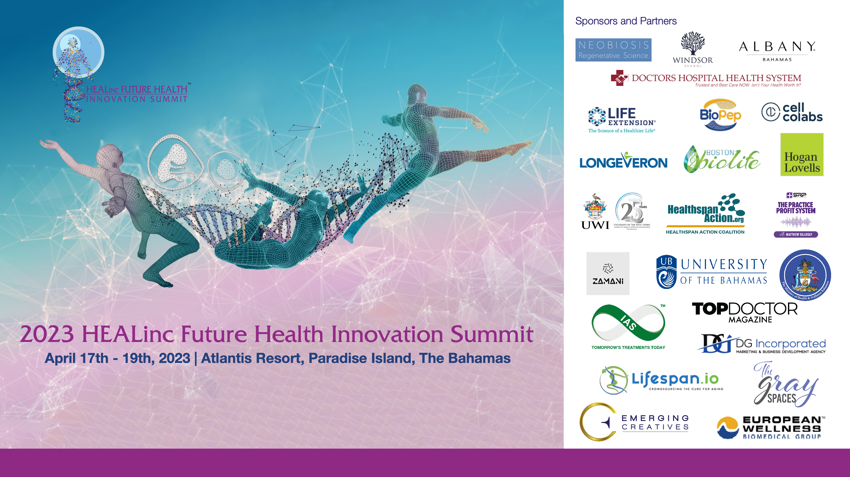

Slide 15
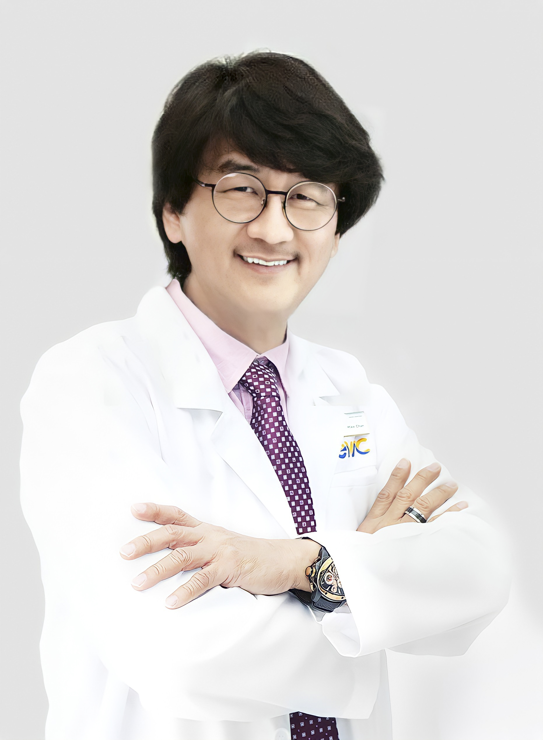
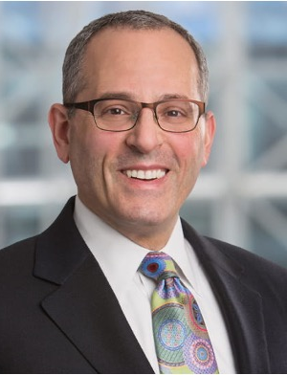
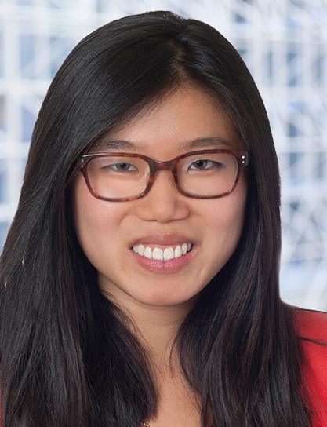
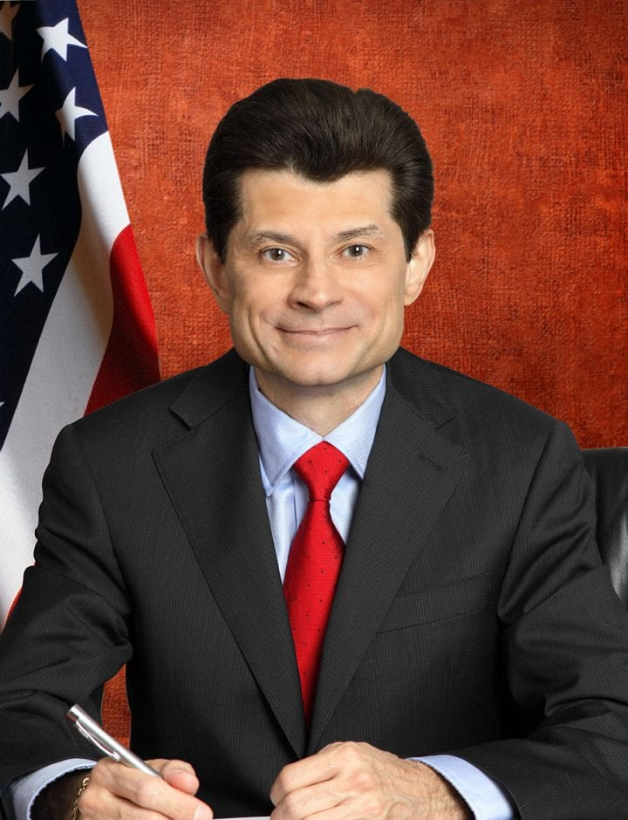
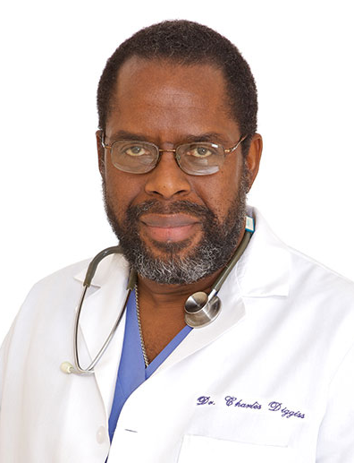
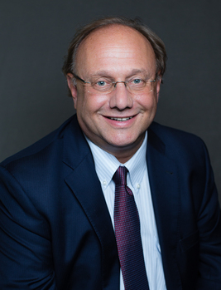
Panel: Regenerative Futures & Regulatory Considerations
Panelists
Professor Mike Chan
Mike Druckman
Sally Gu
Bill Faloon
Chair
Dr. Charles Diggiss
Dr. Evan Snyder
Dr. Steve Gerst
www.healincsummit.com

Slide 16
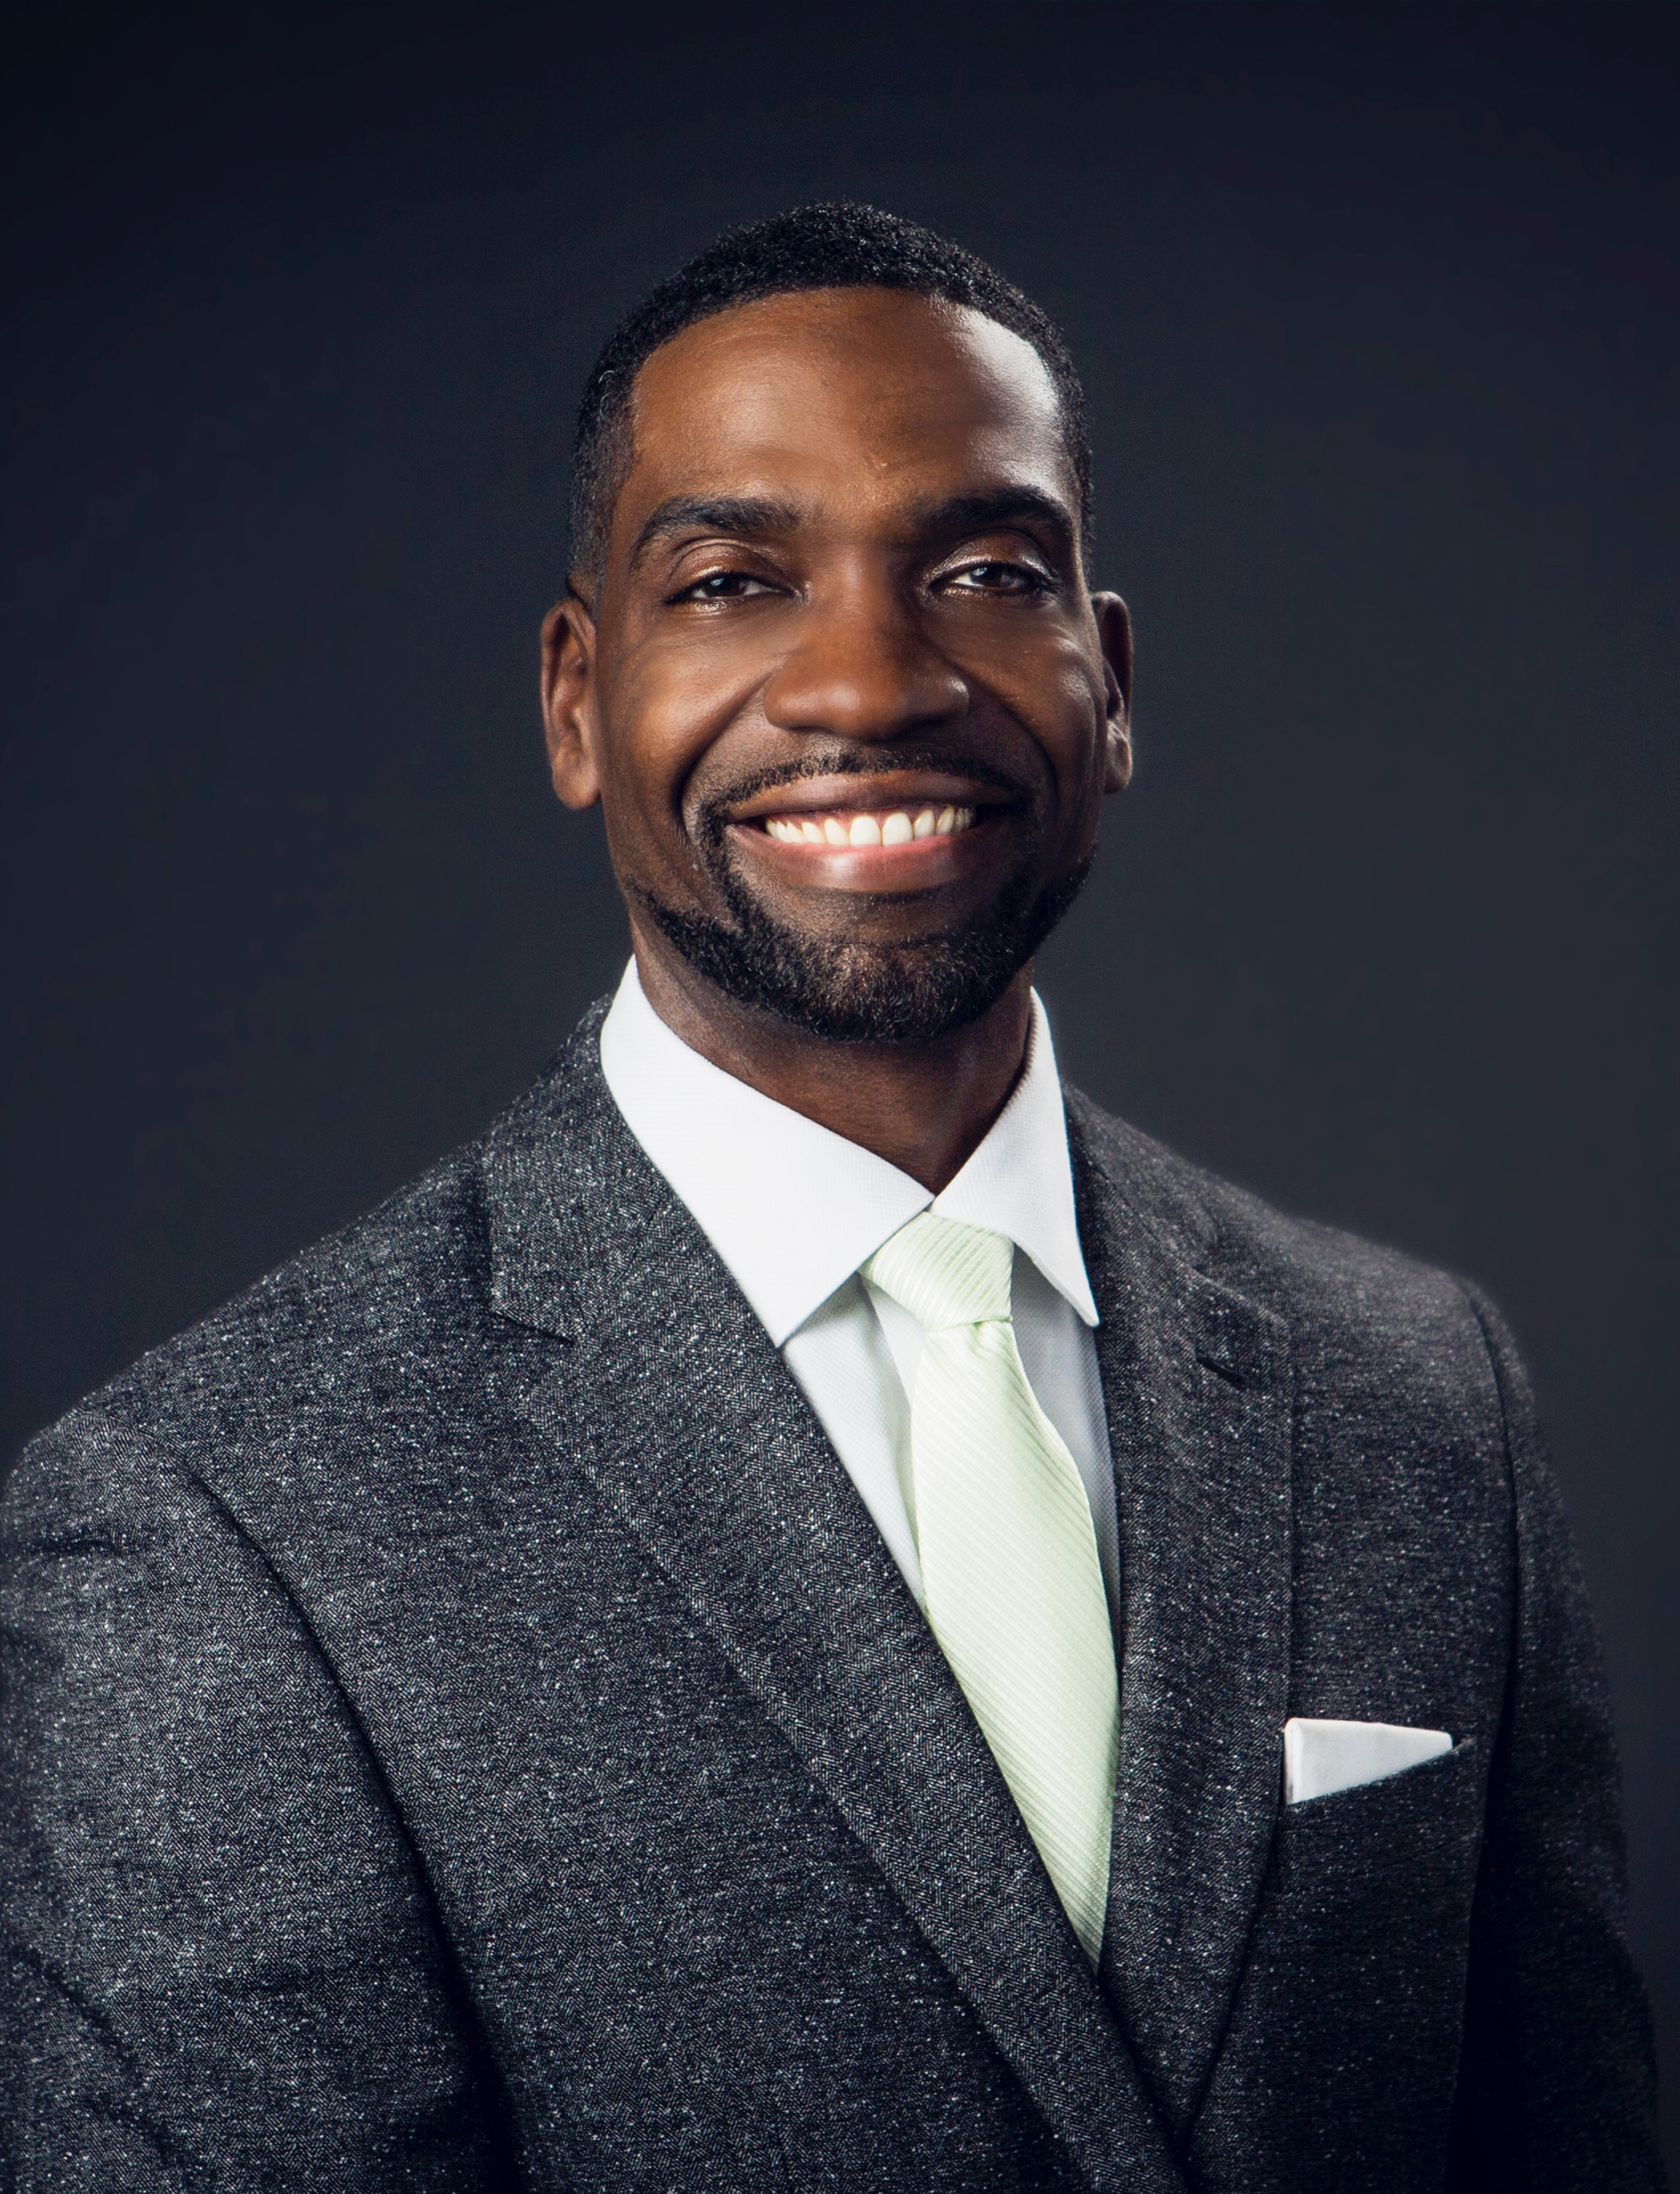
Chris has spent the last 22 years helping individuals reach their most important financial goals. In 1999, Chris started his own financial services practice, and since then, has traveled the U.S. working with athletes, key executives and minorities. Chris specifically focuses on the areas of individual and corporate Life Insurance, Disability Income Insurance, Investments, Tax Reduction Strategies, Retirement Income Optimization and Pension Maximization.
Chris donates his time and efforts to many organizations. He serves on the Board of Directors for the Urban League, Naperville’s ALIVE youth center, IAMABEL foundation and is also part of the United Way’s Young Community Leaders. He volunteers for the Big Brothers/Big Sisters organization and YMCA; he spent four years on the board of the SAME Network of Chicago’s RUSH Medical Center focused on diversity and integration with a S.T.E.M. focus for minority medical students. In 2013 Chris was nominated to the National Basketball Retired Players Association (NBARPA) Chicago chapter and served as a Board member; while again qualifying for the Court of the Table of Million Dollar Round Table. He is now considered a Lifetime member of the highly esteemed MDRT.
Chris is a lifelong advocate of diversity and inclusion. He served as President for the Board of Directors for NAIFA Chicagoland (National Association of Insurance and Financial Advisors) & serves on NAIFA’S groundbreaking national committee, the Diversity and Inclusion Task Force. He was recently nominated as a National Trustee on the National Board of NAIFA. He travels nationally, speaking on the impact of equity and inclusion to diversity groups such as NMA, SNMA, LMSA, CCPA, GAMA, LAMP, ITKAN, MDRT, and NAIFA. In 2020 Chris was awarded NAIFA’s prestigious Impact Award and was appointed by NAIFA’S National President -Tom Michael to serve as a national trustee for the industry’s largest association for insurances professionals focused on advocacy and education.
Christopher Gandy, LACP
Founder, Midwest Legacy Group, LLC
www.healincsummit.com

Slide 17
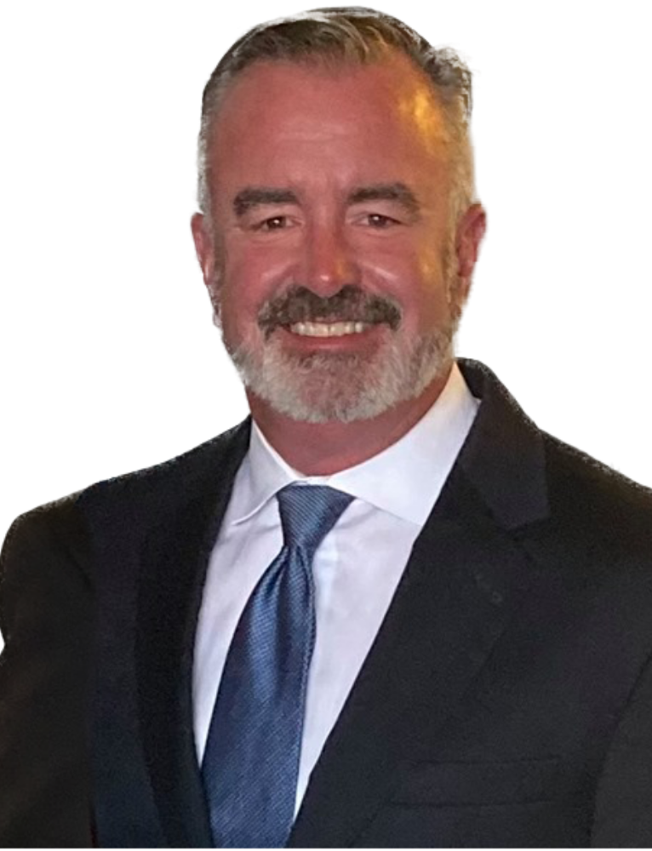
Matt was exposed to the world of cash medical services in 2013. By 2014, he launched The Carolina Men’s Clinic where he was General Managing Partner and CEO of the Carolina’s #1 provider of men’s sexual health solutions, specifically erectile dysfunction, premature ejaculation, penile enhancement and low testosterone.
Matt grew the company from a start-up to 3 locations in 3 cities within 18 months, doing 6.5 million a year. He sold his interest in those 3 locations in November of 2017. Today, Matt owns interest in 6 medical practices nationwide. He has helped his clients make an additional $100 million in new revenues since 2017.
Today, Matt helps doctors escape insurance-based care through growing a cash practice and focusing on med spa, anti-aging, sexual health, regenerative health and other cash-based procedures. He has 3 kids – Meghan, Andrew and Colin – a son-in-law Kyle, 2 step-kids, 3 spastic dogs and 1 amazing wife, Katie.
In his spare time, Matt plays golf, reads marketing books, cheers on the LSU Tigers and figures out ways to grow businesses.
Matthew J. Gillogly
CEO, SRP Medical Marketing
www.healincsummit.com

Slide 18
Mike chairs the firm’s Cell, Tissue, and Gene Therapies Working Group, a cross-disciplinary team that advises companies in this emerging space on the evolving regulatory and business challenges they face. Mike and the team work closely with companies developing stem cells, cord blood, placental tissues, gene therapies, proteins, and other cellular products to help people with serious health problems.
Mike also advises companies with a full range of regulatory challenges involved in investigating new drugs, biologics, and combination products, obtaining FDA approval for those products, and in promoting, selling, and distributing them. His experience also includes the Drug Supply Chain Security Act, pharmacy compounding, expanded access/compassionate use clinical trials, orphan drug exclusivity, and precision medicine and companion diagnostics.
While in the FDA Office of the Chief Counsel, Mike also advised on medical countermeasures. He served on the FDA’s Pandemic Influenza Planning and Preparedness Team, and helped draft guidance on pandemic and seasonal flu vaccines and a regulation on Strategic National Stockpile product labeling. In his years at the firm, Mike has advised on Emergency Use Authorizations, select agents and toxins and Dual Use Research of Concern (DURC), and various issues involving vaccines and other products.
Mike Druckman, US, LLP
Partner, Hogan Lovells
www.healincsummit.com

Slide 19
Sally uses her experience and understanding of the complex US regulatory landscape to counsel clients in the regenerative medicine industry on strategies for development, approval, marketing, and distribution of regenerative medicine therapies. She has extensive experience in guiding clients through the investigational new drug (IND) and marketing application processes, as well as handling post-approval compliance issues such as advertising and promotion, patient access strategies, and good manufacturing practices. Sally advises companies on a range of regulatory challenges and opportunities, including expedited program designations, advanced manufacturing, complex supply chain distribution, Emergency Use Authorization, government investigation and enforcement, and use of real-world evidence and patient-generated health data in regulatory decision-making.
Sally Gu
Senior Associate, Hogan Lovells LLP
www.healincsummit.com

Slide 20
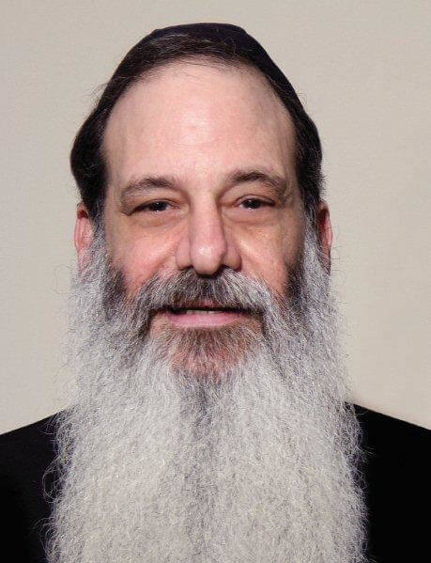
Dr. Holder is the first American to receive the Albert Schweitzer Prize in Medicine from the Albert Schweitzer-Gesellschaft, Austria. 1992 Chiropractor of the Year by The Florida Chiropractic Association, and Florida Chiropractic Society Researcher of the Year in 1995. Dr. Holder is Adjunct Professor, St. Martin's College, Milwaukee; held appointment to the faculty at the University of Miami, Center for Addiction Studies and Education, and held appointment as post graduate faculty at numerous chiropractic colleges including National College, Life College, Life West and Parker College. Executive Board Member and Treasurer of the Council on Chiropractic Practice.
He is the developer of Torque Release Technique®, discover and developer of the Foundation Point System and Addiction Axis Line in Auriculotherapy, President/Co-Founder of the American College of Addictionology and Compulsive Disorders, which trains and board certifies professionals in the field of addiction worldwide and is Director/Founder of Exodus Treatment Center, a 350 bed addiction facility located in Miami, Florida, Director/Founder of Exodus Israel Addiction and Research Center, Jerusalem, Israel.
Dr. Jay Holder
ACACD & Holder Research Institute
www.healincsummit.com

Slide 21
www.healincsummi.com

Slide 22
Dr. Jeff McNairy, Psy.D., M.P.H. is the Chief Medical Officer at Rythmia Life Advancement Center in Costa Rica. He has worked in the mental health field for over 25 years in Los Angeles, California as well as in Hawaii. Dr. Jeff’s specialties include working with patients who have addictions and trauma, as well as those who suffer from acute psychiatric conditions. Dr. Jeff was the previous Administrative Director of Passages, Malibu, a well-known drug and alcohol rehabilitation facility. He has also managed and worked within various medical arenas at the UCLA Medical Center, Department of Health in Hawaii, and conducted therapy in psychiatric hospitals as well as a variety of outpatient settings. Dr. Jeff is committed to bringing the ancient healing tool of plant medicine to the Western World in a manner that is safe, regulated, and extremely effective.
Dr. Jeff McNairy, PsyD, MPH
Chief Medical Officer, Rythmia Life Advancement Center, Costa Rica
www.healincsummit.com

Slide 23
Dr. Desirée Cox, MD, MPhil, PhD is a Rhodes Scholar, medical doctor, creative artist, and internationally respected thought leader in future health and regenerative medicine. Educated at McGill University (Canada), Oxford University (UK) and Cambridge University (UK), Dr. Desirée is the Founder and CEO of The HEALinc and The HEALinc Future Health Innovation Summit (www.healincsummit.com). She is also the CEO of ArtRegen, CEO of the Biotech R&D company BioPep and an Affiliate member of Rutgers University, Graduates Studies Faculty, New Jersey, USA. She is the first Rhodes Scholar from The Bahamas and the first woman Rhodes Scholar from the British Caribbean. She lives in the USA and The Bahamas.
As an innovator, her career in the UK, Europe, North America, The Bahamas, and Latin America has spanned clinical medicine, academia, research and development, regulatory sciences, and the design, development, and implementation of high–impact health and social enterprises. Dr. Cox is a thought leader in future health innovation with 20+ years in the healthcare space and an impressive, rare and unique range of skills and capacities integrating the sciences and the arts. Her experience in healthcare consulting includes consulting for biotech companies and major pharmaceutical companies, including Amgen, GSK and Novartis, on pipeline therapeutic products and medical devices.
In October 2017, she was honored by Oxford University as one of six alumni to have their portrait hung in the Great Hall at Pembroke College. She was one of 5 recipients of the 2019 International Advocacy Action Award at the World Stem Cell Summit in Miami, Florida. She was also a presenter at the 2018 Vatican ‘Unite to Cure’ Conference.
Since 2014, she has been spearheading the development of a regulatory system and ecosystem in The Bahamas for accelerated patient access to stem cell, regenerative medicine and other future health technologies manufactured in the US and Europe, Latin America and Asia. At the 40th Independence Celebrations in 2013, the Bahamas Government honored Dr. Cox by issuing a 70-cent stamp into circulation bearing her photograph.
Dr. Desirée Cox, MD, MPhil, PhD
CEO and Founder, The HEALinc
Affiliate Faculty Member, Rutgers University, New Jersey, USA
Chair of the Joint National Stem Cell Ethics Committee (NSCEC) and National Medical Ethics Committee of The Bahamas
www.healincsummit.com

