Slide 1


Slide 2


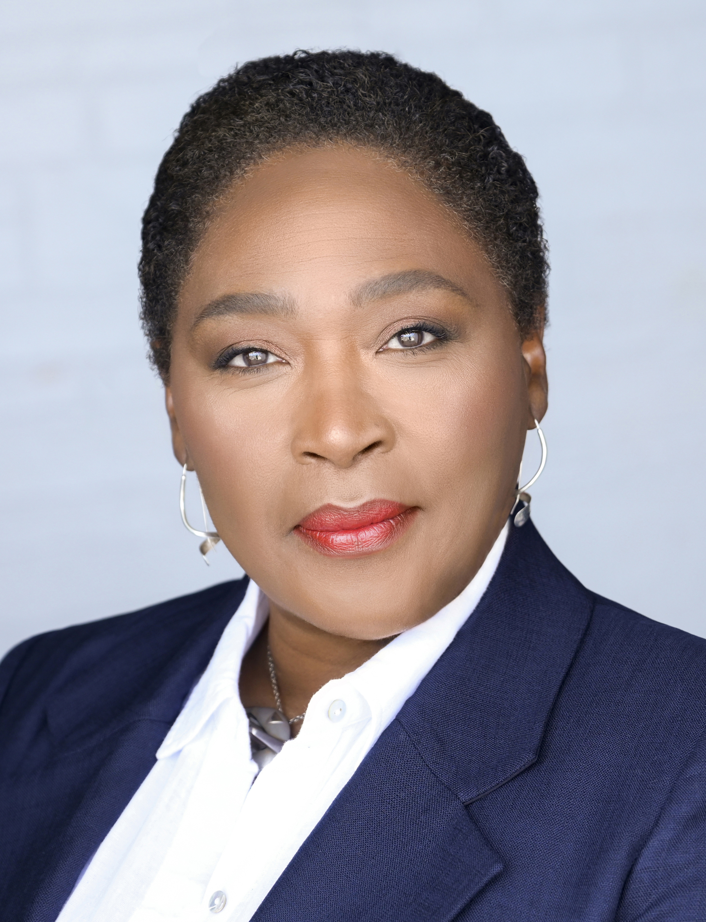
Dr. Desirée Cox, MD, MPhil, PhD is a Rhodes Scholar, medical doctor, creative artist, and internationally respected thought leader in future health and regenerative medicine. Educated at McGill University (Canada), Oxford University (UK) and Cambridge University (UK), Dr. Desirée is the Founder and CEO of The HEALinc and The HEALinc Future Health Innovation Summit (www.healincsummit.com). She is also the CEO of ArtRegen, CEO of the Biotech R&D company BioPep and an Affiliate member of Rutgers University, Graduates Studies Faculty, New Jersey, USA. She is the first Rhodes Scholar from The Bahamas and the first woman Rhodes Scholar from the British Caribbean. She lives in the USA and The Bahamas.
As an innovator, her career in the UK, Europe, North America, The Bahamas, and Latin America has spanned clinical medicine, academia, research and development, regulatory sciences, and the design, development, and implementation of high–impact health and social enterprises. Dr. Cox is a thought leader in future health innovation with 20+ years in the healthcare space and an impressive, rare and unique range of skills and capacities integrating the sciences and the arts. Her experience in healthcare consulting includes consulting for biotech companies and major pharmaceutical companies, including Amgen, GSK and Novartis, on pipeline therapeutic products and medical devices.
In October 2017, she was honored by Oxford University as one of six alumni to have their portrait hung in the Great Hall at Pembroke College. She was one of 5 recipients of the 2019 International Advocacy Action Award at the World Stem Cell Summit in Miami, Florida. She was also a presenter at the 2018 Vatican ‘Unite to Cure’ Conference.
Since 2014, she has been spearheading the development of a regulatory system and ecosystem in The Bahamas for accelerated patient access to stem cell, regenerative medicine and other future health technologies manufactured in the US and Europe, Latin America and Asia. At the 40th Independence Celebrations in 2013, the Bahamas Government honored Dr. Cox by issuing a 70-cent stamp into circulation bearing her photograph.
Dr. Desirée Cox, MD, MPhil, PhD
CEO and Founder, The HEALinc
Affiliate Faculty Member, Rutgers University, New Jersey, USA
Chair of the Joint National Stem Cell Ethics Committee (NSCEC) and National Medical Ethics Committee of The Bahamas
www.healincsummit.com

Slide 3
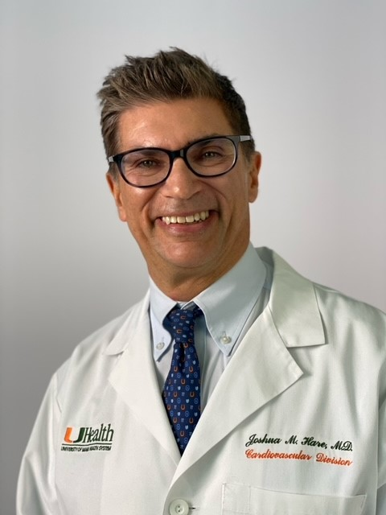
Dr. Joshua Hare is Chief Sciences Officer, Senior Associate Dean for Experimental and Cellular Therapeutics, Director of the Interdisciplinary Stem Cell Institute (ISCI), and Louis Lemberg Professor of Medicine at the University of Miami Miller School of Medicine. Dr. Hare is a practicing cardiologist and an expert in cardiovascular medicine, specializing in heart failure, myocardial infarction, inflammatory diseases of the heart, and heart transplantation. He is an internationally acknowledged pioneer in the field of stem cell therapeutics for human heart disease, and evaluates patients from all over the world for participation in clinical trials of this new experimental therapy.
Dr. Hare is the director of the Interdisciplinary Stem Cell Institute, an Institute devoted to basic scientific and translational work in the field of stem cell therapy and regenerative medicine. The Institute houses 70 faculty members and 15 independent research groups. Dr. Hare led the first randomized allogeneic mesenchymal stromal cell (MSC) clinical trial for patients with myocardial infarction and has served as Principal Investigator of three major NHLBI programs that advance cell-based therapy. He has pioneered the use of allogenic MSCs for multiple disease areas. Under his leadership and in partnership with many faculty across the University of Miami campus, ISCI now has active programs in cancer biology, cardiology, aging, neonatology, skin diseases, bone diseases, neurologic diseases, ophthalmology, and a program devoted to the ethics of stem cell therapy.
Dr. Hare has published nearly 400 original research articles, editorials, and review articles, and is the recipient of four active grants from the National Institutes of Health, three of which are active R01’s. He holds 27 active Investigational New Drug applications for cell-based therapy in patients with heart disease, including the first in the United States for Idiopathic Pulmonary Fibrosis and Aging Frailty. Dr. Hare is the PI of the UM National Heart Lung and Blood Institute Cardiac Cell Therapy Research Network (CCTRN) center; together these awards fund ~$3M in basic and translational research annually. Under his leadership, ISCI has been awarded $10M from The Starr Foundation and a $26M award from The Soffer Family. Dr. Hare has served in the past as chair of the Cardiac Contractility and Heart Failure study section of the National Institute of Health (NIH) and as a permanent member of the CICS study section, chaired the Stem Cell Working Group of the American Heart Association (AHA), and served as Chair of the AHA Basic Cardiovascular Science Council.
Educated at the University of Pennsylvania (1984), Johns Hopkins University School of Medicine (1988), The Brigham and Women’s Hospital (1994), and Harvard Medical School, Dr. Hare spent 12 years on the faculty at Johns Hopkins University School of Medicine where he rose to the rank of Professor of Medicine and Biomedical Engineering, and Director of the Cardiac Transplant and Heart Failure program in 2004 before joining the faculty at the University of Miami Miller School of Medicine in 2007. Dr. Hare is an elected member of the American Association of Physicians (2011) and the Association of University Cardiologists (2007). Dr. Hare is the inventor of 15 United States patents, and his research discoveries have led to the founding of four biotechnology companies.
Joshua Hare, MD, FACC, FAHA
Professor of Medicine, University of Miami Miller School of Medicine
Co-Founder and Chairman, Longeveron, Inc.
www.healincsummit.com

Slide 4
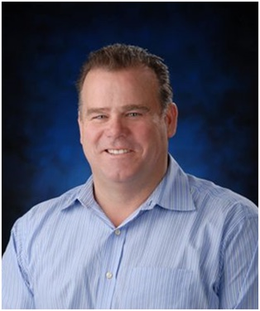
Dr. Jonathan Lakey has had a long interest and research direction in cell and tissue transplantation with a focus on diabetes and islet transplantation. Dr. Lakey graduated from the University of Alberta (BSc, MSc, Ph.D.) and received post-post-doctoral training in Indianapolis and Seattle before returning to establish his research program at the University of Alberta. Dr. Lakey was also the Director of the Comprehensive Tissue Bank. Currently, Dr. Lakey is a Professor in the Department of Surgery and in Biomedical Engineering at the University of California Irvine. Dr. Lakey also served as the Director of the Clinical Islet Program at the University of California Irvine before transitioning to become co-Founder and CSO of Xostem. His contributions and partnership with Dr. James Shapiro led towards the improvement of islet isolation techniques and the development of the “Edmonton Protocol” for patients with Type 1 diabetes, a recognized major advancement in the treatment of diabetes. Dr. Lakey has been awarded research grants and awards for diabetes and transplantation research from the Alberta Heritage Foundation for Medical Research (AHFMR), Canadian Diabetes Association, and the Juvenile Diabetes Foundation International (JDFI). Dr. Lakey values the mentoring of MSc and Ph.D. students in his research laboratory and supported the training of technicians from several research and islet laboratories worldwide.
Dr. Lakey has been recognized locally, nationally, and internationally for his groundbreaking research and innovative technologies. Among his honors, Dr. Lakey is the recipient of the Outstanding Leadership in Science Award from Alberta Science & Technology, Outstanding Achievement Award from the Canadian Diabetes Association, and Studentship Awards from the Canadian Society for Clinical Investigations Trainee Award and Royal College of Physicians and Surgeons. Dr. Lakey was honored with the Meritorious Service Medal (2005) by the Governor-General of Canada. Recently, Dr Lakey’s team was awarded UC Irvine School of Business and Medicine top award competition and UC Irvine Chancellor Award.
Dr. Jonathan Lakey, BSc, MSc, PhD
Professor Emeritus, University of California, Irvine Expert in DM and Regenerative Medicine
www.healincsummit.com

Slide 5
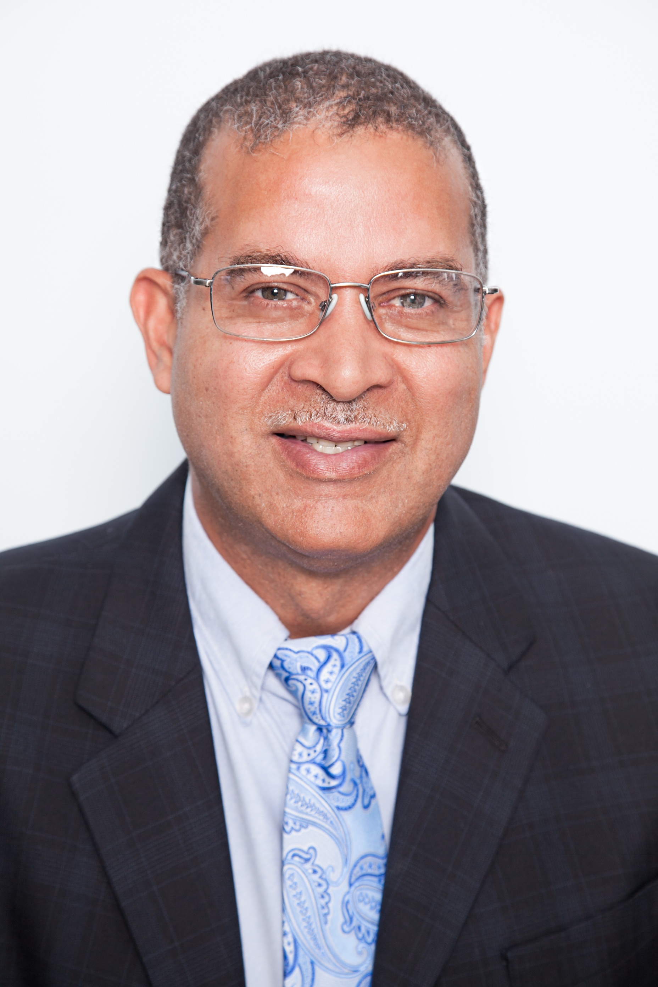
Dr. Neil is a board-certified plastic and reconstructive surgeon. In addition to cosmetic surgery, he performs reconstructive surgeries such as cleft lip and palate, as well as breast reconstructions after mastectomy. He also specializes in hand and maxillofacial surgery.
Graduating from Munro College, Dr. Neil was successful in the Cambridge GCE advanced level examinations in five subjects, including a distinction in chemistry. He was therefore awarded the Stephen Harle Chemistry Prize in 1980. He was then accepted at the University of Windsor in Canada, where he eventually obtained an honors degree in biology and biochemistry. His interest in marine biology gave way to an appreciation for human anatomy, and he therefore found himself applying to medical school.
Dr. Neil attended the University of the West Indies, Mona Campus, Jamaica, and subsequently transferred to the Bahamas in 1989 for a medical internship. His search for additional training took him to SUNY Brooklyn, where he worked in the specialty of OB/GYN and soon developed an interest in trauma surgery. He was accepted into the surgery program at St. Luke’s-Roosevelt Hospital. Dr. Neil worked with the surgical team and emergency room for a year in Freeport, after which he applied and was accepted for plastic and reconstructive surgery training in Richmond, Virginia. There, he was awarded the S. Dawson Theogaraj prize for academic excellence. Dr. Neil now runs a busy plastic and reconstructive surgery office and has served for more than 10 years as the Chief of Surgery at Doctors Hospital in the Bahamas.
Gregory C. Neil, MD
Plastic Surgeon, Bahamas Plastic Surgery Center
www.healincsummit.com

Slide 6
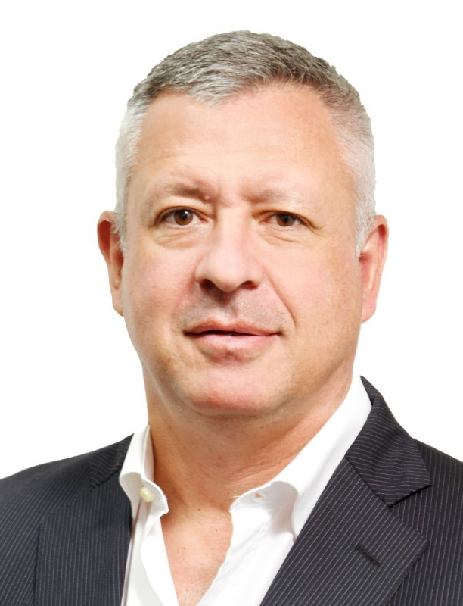
Alejandro Mesples is a gifted Interventional Cardiologist with more than 10,000 endovascular procedures done in coronary and peripheral artery disease. He is accredited by Educational Commission for Foreign Medical Graduates (ECFMG) from United States and member of ESC (European Society of Cardiology) and European Association of Percutaneous Cardiovasc Interventions (EAPCI). He has Medical License in Bahamas and is Interventional Cardiologist at Doctors Hospital, Nassau Bahamas.
Dr. Mesples is an expert in coronary and peripheral arteries revascularization procedures with different medical devices and a world-famous researcher in the use of bone marrow stem cells for the treatment of diabetes and its vascular complications. With more than 300 patients treated with his bone marrow stem cell treatment protocol, and owner of patent WO2010062999 DIABETES CELL THERAPY, he has made important publications in many indexed international medical journals and presented his experience in numerous scientific medical events. As Chief Science Officer (C.S.O.) of Global Cell Med (GCM), Nassau, Bahamas is responsible of Bone Marrow Stem Cells Transplant Research Program in Diabetic Patients, approved by Government of Bahamas as well.
Dr. Mesples obtained his medical degree in Argentina and made his fellowship (AFSA) in Cardiovascular Pathology at Louis Pasteur University – Strasbourg, France (Civil Hospital) and Interventional Cardiology in University of Barcelona, Spain (Hospital of Bellvitge). He was Head of Department of Interventional Cardiology at Public Hospitals in Argentina. Principal investigator of the Ministry of Health of Argentina (INCUCAI) in Stem Cells and Diabetes Protocols. He held positions such as Scientific Advisor, Researcher and Director of Research Units with biological products in Stematix – Houston, Texas (USA), Shenzhen Beike (China), he was Cardiologist in Hospital of San Isidro, Buenos Aires University (2010-15) and Senior Medical Director in Fundación Cencis Panama and Director / owner of Biotech Assistance Corp (Panama), deeply knowing the medical and regulatory environment of Central America and the Caribbean Region. Editorial Board Member on “NorCal Open Access Publications”. In 2018 he was awarded the Annual Prize of the Einsteinium Foundation – Biotechnological Development.
Alejandro Mesples, MD
Interventional Cardiologist, Doctors Hospital
www.healincsummit.com

Slide 7
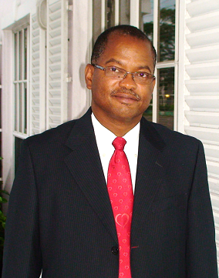
A cardiologist, medical pioneer, healthcare developer, and builder in the Bahamas and Caribbean, Dr. Conville S. Brown has devoted his life to the good health, welfare and service of others. He is the first Bahamian Fellow of the American College of Cardiology (FACC), 3/1994 and the European Society of Cardiology (FESC).
Dr. Brown founded the Bahamas Centre for Heart Disease, Ltd. (the Bahamas Heart Centre) in 1990. As physician-in-chief, he has engineered several firsts for the Bahamas and the Caribbean, including but not limited to: color echocardiography, pacemaker implants, SPECT nuclear cardiology, telemedicine, supported open heart surgery, cardiac catheterization, coronary angiography, angioplasty, stenting, defibrillators and resynchronization therapy.
The Cancer Centre Bahamas – the only American College of Radiation Oncology (ACRO)-accredited cancer center in the world outside the US – was developed by Dr. Brown and colleagues in 2004. Dr. Brown received special honors as “Jones Communications Network’s Civil Society Person of the Year” in 2009, along with the Bahamas Icon Award for Health in 2015 and the Caribbean Cardiac Society Award in 2016. Dr. Brown was featured as one of “The 10 Most Innovative Business Leaders to Follow” in the 99th Issue of The Business Beyond Magazine in October 2021.
Upon the invitation of Prime Minister Baldwin Spencer of Antigua and Barbuda in 2009, Dr. Brown built the Medical Pavilion Antigua – home to The Cancer Centre Eastern Caribbean and the Heart Centre Antigua for The Organization of Eastern Caribbean States – as the OECS’ first sub-regional specialist medical center. Dr. Brown is the founder, developer, owner, and principal of the Partners Interventional Centre, Jamaica (PICJ).
Dr. Conville S. Brown, MD, FACC, FESC
Chairman, President and CEO, The Cancer Centre
www.healincsummit.com

Slide 8


Slide 9
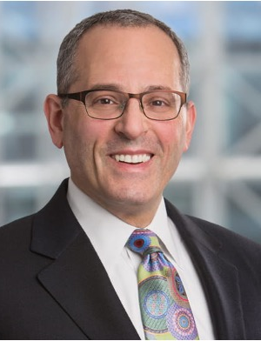
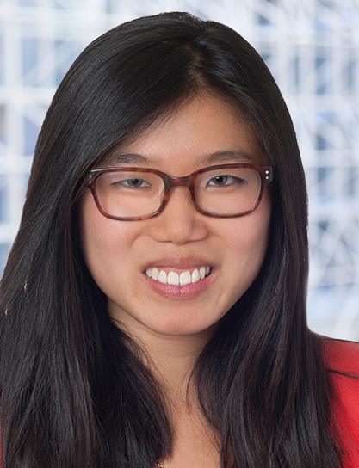
Panel: Curating Regenerative Medicine Ecosystems
Panelists
Dr. Conville Brown
Dr. Gregory Neil
Dr. Alejandro Mesples
Dr. Joshua Hare
Chair
Dr. Desirée Cox
Mike Druckman
Sally Gu
www.healincsummit.com

Slide 10
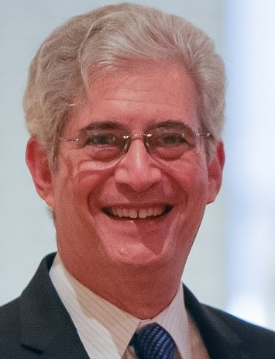
Bernard Siegel is the executive director of the nonprofit Regenerative Medicine Foundation (RMF), with a mission of accelerating regenerative medicine to improve health and deliver cures. Bernie founded and co-chairs the annual World Stem Cell Summit and RegMed Capital Conference, founded and serves editor–in–chief of the peer-reviewed “World Stem Cell Report” (AlphaMed Press).
In 2002, he filed the first court case relating to reproductive cloning and is widely credited for debunking the claim of the group claiming that they cloned the first baby.
As a recognized advocacy and policy expert in the fields of stem cell research, regenerative medicine and related subjects, Bernie works with the leading scientists and patient advocates, raising public awareness and educating lawmakers, the media and public. He is a frequent conference panelist and keynote speaker.
Bernie Siegel, JD
Executive Director, Regenerative Medicine Foundation
HEALinc Future Health Trailblazer Award
www.healincsummit.com

Slide 12
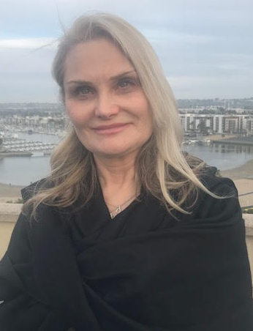
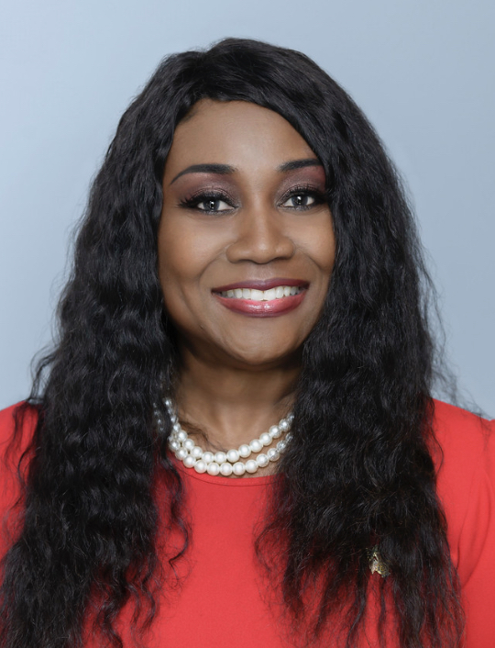
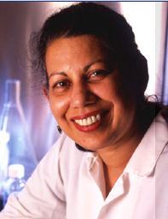
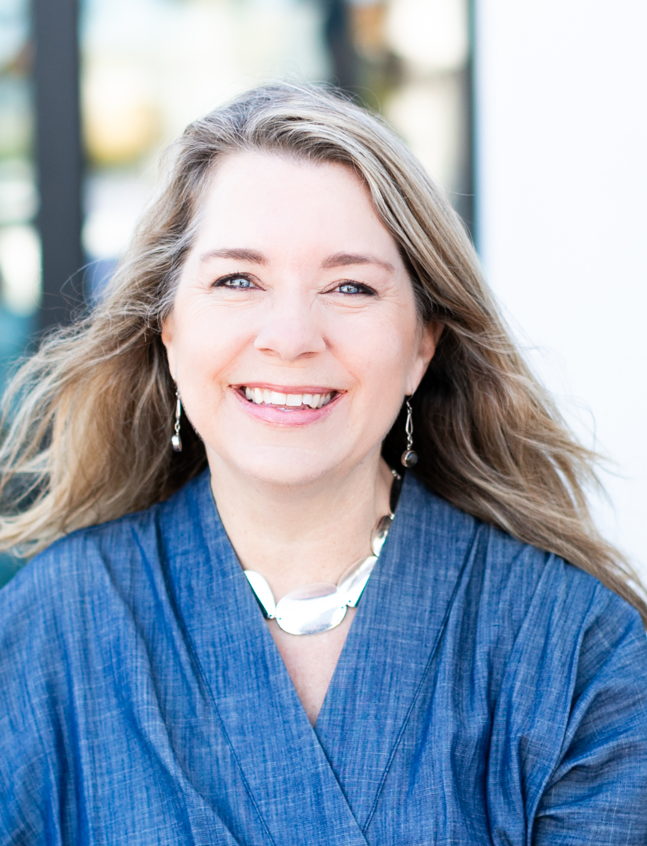
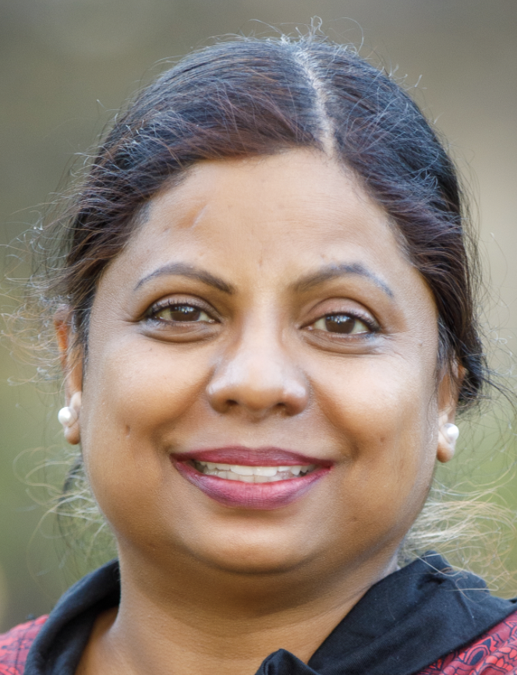
Panel: Women in Biotech
Panelists
Corlette Deveaux
Professor
Pranela Rameshwar
Dr. Cassandra Vieten
Dr. Jyothi Devakumar
Chair
Dr. Caroline Mossesian
www.healincsummit.com

Slide 13
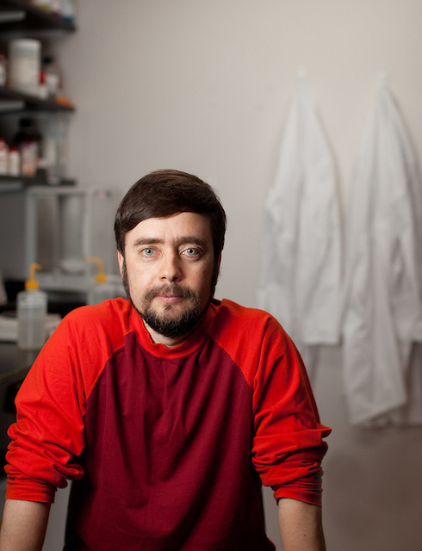
Michael Levin, a distinguished professor in the biology department at Tufts University, holds the Vannevar Bush endowed Chair and serves as director of the Allen Discovery Center at Tufts as well as Associate Faculty at the Wyss Institute at Harvard University. He is also co-editor in chief of the Bioelectricity Journal, founding associate editor of the Collective Intelligence Journal, and serves on the editorial advisory board for the Laterality Journal at Tufts University.
Prior to college, Dr. Levin worked as a software engineer and independent contractor in the field of scientific computing. With an interest in artificial intelligence and unconventional computation, he attended Tufts University to explore the algorithms by which the biological world implemented complex adaptive behavior. After receiving dual B.S. degrees in CS and Biology at Tufts, Dr. Levin earned his PhD from Harvard University. In his post-doctoral training at Harvard Medical School, he began to uncover a new bioelectric language by which cells coordinate their activity during embryogenesis. His independent laboratory uses a combination of developmental biophysics, computer science, and cognitive science to understand the collective intelligence of cells as they build and repair complex anatomies. Applications of their work extend to the repair of birth defects, regeneration of appendages, cancer reprogramming, and new AI architectures based on biological computation.
Dr. Levin’s early work on the molecular basis of left-right asymmetry (Cell 1995) was chosen by the journal Nature as a “Milestone in Developmental Biology in the last century”. His most recent honors include the Scientist of Vision Award and the Distinguished Scholar Award, and recent papers received the Cozzarelli Prize from the National Academies of Science, and the ISAL Outstanding Paper of 2020 Award.
Michael Levin, PhD
Director, Allen Discovery Center at Tufts
Director, Tufts Center for Regenerative Developmental Biology
www.healincsummit.com

Slide 14
Dr. Desirée Cox, MD, MPhil, PhD is a Rhodes Scholar, medical doctor, creative artist, and internationally respected thought leader in future health and regenerative medicine. Educated at McGill University (Canada), Oxford University (UK) and Cambridge University (UK), Dr. Desirée is the Founder and CEO of The HEALinc and The HEALinc Future Health Innovation Summit (www.healincsummit.com). She is also the CEO of ArtRegen, CEO of the Biotech R&D company BioPep and an Affiliate member of Rutgers University, Graduates Studies Faculty, New Jersey, USA. She is the first Rhodes Scholar from The Bahamas and the first woman Rhodes Scholar from the British Caribbean. She lives in the USA and The Bahamas.
As an innovator, her career in the UK, Europe, North America, The Bahamas, and Latin America has spanned clinical medicine, academia, research and development, regulatory sciences, and the design, development, and implementation of high–impact health and social enterprises. Dr. Cox is a thought leader in future health innovation with 20+ years in the healthcare space and an impressive, rare and unique range of skills and capacities integrating the sciences and the arts. Her experience in healthcare consulting includes consulting for biotech companies and major pharmaceutical companies, including Amgen, GSK and Novartis, on pipeline therapeutic products and medical devices.
In October 2017, she was honored by Oxford University as one of six alumni to have their portrait hung in the Great Hall at Pembroke College. She was one of 5 recipients of the 2019 International Advocacy Action Award at the World Stem Cell Summit in Miami, Florida. She was also a presenter at the 2018 Vatican ‘Unite to Cure’ Conference.
Since 2014, she has been spearheading the development of a regulatory system and ecosystem in The Bahamas for accelerated patient access to stem cell, regenerative medicine and other future health technologies manufactured in the US and Europe, Latin America and Asia. At the 40th Independence Celebrations in 2013, the Bahamas Government honored Dr. Cox by issuing a 70-cent stamp into circulation bearing her photograph.
Dr. Desirée Cox, MD, MPhil, PhD
CEO and Founder, The HEALinc
Affiliate Faculty Member, Rutgers University, New Jersey, USA
Chair of the Joint National Stem Cell Ethics Committee (NSCEC) and National Medical Ethics Committee of The Bahamas
www.healincsummit.com

