Slide 1



HEALinc360
2023 HEALinc FUTURE HEALTH SUMMIT
QUALITY OF LIFE AND ACCESS TO FUTURE HEALTH TECHNOLOGIES, NOW!
APRIL 17TH -19TH
ATLANTIS RESORT, PARADISE ISLAND, NASSAU BAHAMAS
https://www.healinc360.com
For previous HEALinc Summits see also https://www.healincfuturehealthsummit.com

Slide 2
WHY
Why does HEALinc exist?

Slide 3

THE FUTURE OF HEALTH is…..
Healthy Longevity | Quality of Life throughout our lifespan |
Regenerative Therapies with no undesirable side effects.

Slide 4
THE FUTURE OF HEALTH IS ALREADY HERE….BUT IT’S
LOCKED IN SILOS ALL OVER THE WORLD (e.g. Biotechs, Laboratories, Schools and Universities, Healthcare Clinics, Communities, and Countries.)
SMOTHERED by outdated thinking styles and systems.
SUPPRESSED by bureaucracies, red-tape and vested interests.
DISCONNECTED from the realities and unmet global health needs of the majority of the world’s populations.

Slide 5
WHAT
What are HEALinc is about, and What do we do?

Slide 6



HEALinc360 ACCELERATES ACCESS TO FUTURE HEALTH FOR EVERYONE,
EVERYWHERE. NOW
HEALinc360 Conclaves, Summits and Online Platform is run by the HEALinc Regenerative Health Institute (501c3 nonprofit). We partner with innovators, industry leaders and benefactors to execute our 3-pronged approach to removing barriers to self-efficacy and enhanced personhood for the benefit of human health and the planet.
Convenings that Connect People, Ideas and Opportunities: Our unique cross-disciplinary and cross-generational HEALinc Future Health Summits in 2018 and 2019 amplify connectivity and global networks in stem cell, regenerative medicine, mind-body and personal wellness. Upgrading to the HEALinc360 hybrid intimate in-person conclaves enhanced by 360 online platform will enhance our global impact.
CONCLAVE, SUMMIT &
ONLINE PLATFORM
Ecosystem for Accelerated Access to Advanced Technologies: For close to a decade, HEALinc360 Founder, Dr Desiree Cox, has been the leader for an ethical system for accelerated access to emerging Regenerative Medicines and advanced longevity technologies. The prototype ecosystem in The Bahamas to be upscaled and networked globally in 2023.
BIOTECH FAST TRACK ACCELLERATED ACCESS ECOSYSTEM
Unleashing the Collective Genius of People Everywhere: Unlocking the collective intelligence about proven resilience, regenerative health and longevity practices from diverse populations inspires innovation; and empowers individuals everywhere to take control of their own health and wellness prior to, through illness, and into healing. Our Bridging-to-the Future program for integrating young STEM students (high-school and college) into our HEALinc Summits and conclaves takes inclusivity to another level.
UNLEASHING COLLECTIVE INTELLIGENCE FOR GLOBAL HEALTH

Slide 7
HEALinc VISION & MISSION
Our 10-year vision is that by 2030 the primary focus of health is on preventing illness, the secondary focus is on reversing illness and the tertiary focus is on treatment; the reverse of the current situation.
Our mission is to:
Advance “Self-care is Healthcare” as the emerging mandate for global health and personal wellness around the world.
Accelerate affordable access to safe and effective regenerative medicines and advanced longevity technologies to anyone, anywhere and at anytime, by cultivating a global network of protected ecosystems for R&D and translational medicine that unleash genius everywhere.
Lead the co-creation of a new story of global health and quality of life for all beings and the planet that is inclusive, engages diverse cultures and technologies, and inspires self-efficacy and enhanced personhood for all.

Slide 8
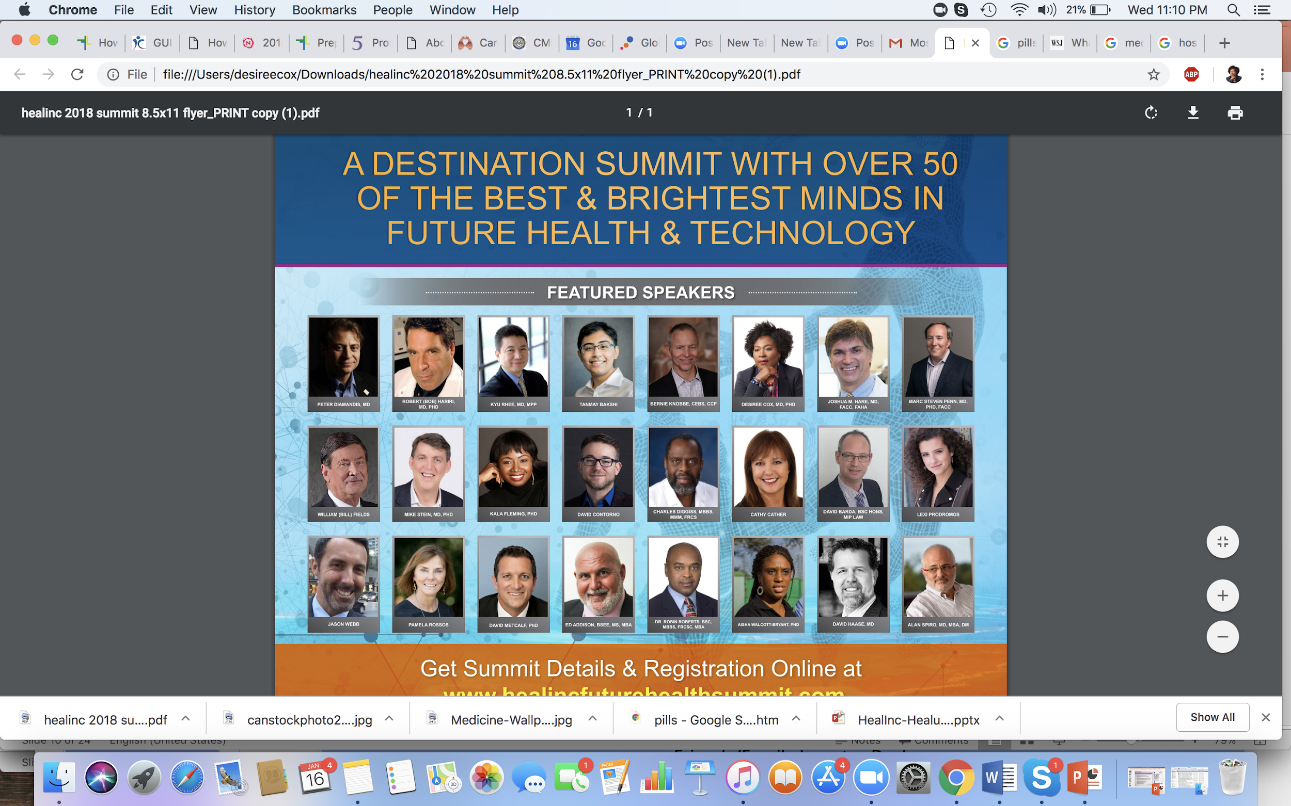

PROVEN MODEL
HEALinc (HEALinc Future Health Innovation Summits) is a global organization founded by a Rhodes Scholar (Dr. Desiree Cox) also a key architect of an innovative ethical model for accelerating global access of regenerative medicines (prototyped in The Bahamas). HEALinc360 leverages the unique commercial advantage of a crucible for global access to safe US manufactured Regenerative Medicines and Advanced Longevity Technologies close to the US. Connecting to a global network of ecosystems for accelerating access of new health technologies for all represents an upgrade for the visionary innovators, healthcare providers and patients we serve.
2018 SUMMIT
2019 HEALinc SUMMIT
:
2018-2019
2013 & 2014 Stem Cell Acts
(Bahamas)
2015-2018
400+ Mainly US Patients treated with Stem Cells
500+ Mainly US Patients treated with Stem Cells
50+ International luminaries | ACCME | 350+ delegates| 80% delegates from US, Europe, Latin America and India | 19 sponsors including Sanford Health, Celularity, Okyanos| Bosarge Family Foundation, THOR, Longeveron | Bridging-the-Future STEM Youth Program with 3D printing
$350K raised in sponsorship
50+ International luminaries |450+ delegates| 80% delegates from US, Europe, Latin America and India | 10 sponsors including IBM, Celularity, Cura Foundation and Longeveron |$25K raised in sponsorship.

Slide 9
HEALinc360 PIVOTING POST-2020
BRIDGING TECHNOLOGIES AND NETWORKS. POISED FOR EXPONENTIAL GROWTH.
2020-2022
Plan. Pivot. Restructure.
2023 HEALinc360 Summit
In-Person & Virtual Hybrid Event
May 2023
2024 and 2025 HEALinc360 Summits
Hybrid Summit events in 2024 and :
In-Person, Virtual and Metaverse
May 2024 and May 2025
Formation of 501c3 non-profit HEALinc Regenerative Health Institute to run HEALinc360 Future Health Innovation Summits, Conclaves, Virtual and Online Platform.
Build HEALinc metaverse
2X Growth in In-Person Convenings per year
10X Growth in virtual attendees
Exponential Growth in Global delegates, networks and impact
Increase in medical tourism for The Bahamas The Bahamas increasingly recognized as prototype regulatory oversight system for accelerating access to safe and effective Regenerative Medicine and Advanced Longevity Technologies.
HEALinc leader in cultivating and networking protected ecosystems globally
Bridging-the-Future Program established as a feeder program to global STEM career opportunities especially for youth based Outside of the US (OUS).
:
20 Speakers |100 person Intimate In-person convening | In-Person conference settings at various local venues. For maximum impact, engagement and medical tourism opportunities | 1000 Virtual attendees ] Virtual Package includes 24/7 on-demand access to video for 9 months after the event |75% Delegates from USA, Canada, Europe, Asia, Africa, Latin America | Virtual Bridging-the-Future Program connecting top local STEM studies globally |10 Sponsors/Partners | Capital raising target 350K

Slide 10
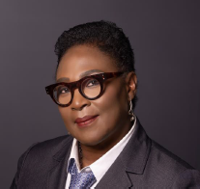
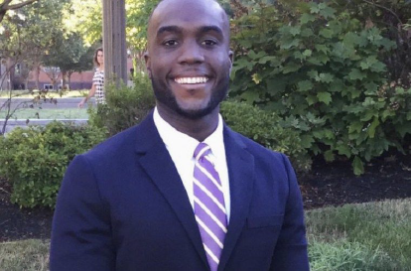
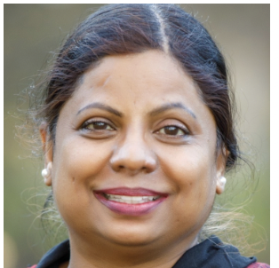
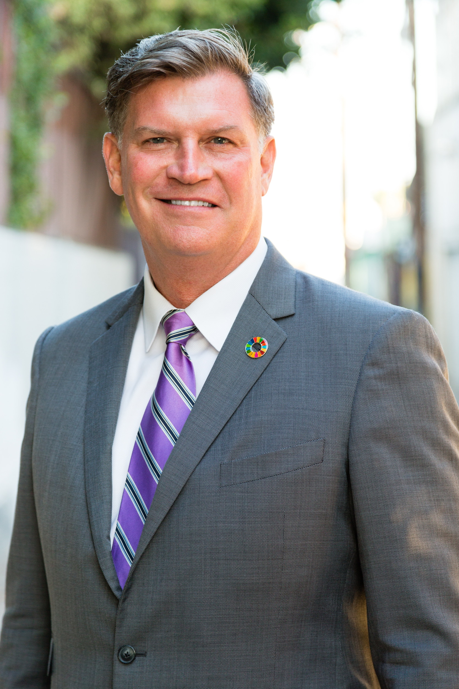
2023 SUMMIT LEADERSHIP TEAM
DESIREE COX, MD, MPhil, PhD
CEO/Founder
Rhodes Scholar, MD-PhD educated at McGill, Oxford, Cambridge Universities. Dr. Desiree is a biotech CEO (BioPep), former university professor, and a thought-leader and Scientific Advisor in the Regenerative Medicine and Longevity Technology Space. 25+ year global healthcare experience in UK, Europe, US. Former university professor and keynote speaker at the Vatican, UN and other major international conferences.
.
CRACHAD LAING, MSc
Lead, HEALinc Bridging-the-Future Program (Global)
Crachad is currently Head of Math and Sciences at Windsor School, Albany. He is Co-Founder of STEMgroup a technology consultancy company and Co-Founder and Program Director at Project Limestone. Following his BS in Civil Engineering and Engineering Management. His passion for STEM and education and his professional journey has led him to education where he has taken his engineering practices to the classroom.
JYOTHI DEVAKUMAR, PhD
Lead, Science and Summit Program Development
Dr. Jyothi Devakumar is a scientist, entrepreneur and Venture Capitalist. She holds a PhD in biotechnology and has worked in various sectors of the regenerative medicine and longevity space and serves on several scientific advisory boards and editorial boards. She combines scientific management experience with a multi-culture multi-country background.
ARNOLD STRONG, Retired US Army Colonel
Chief Communications Officer (CCO)
Arnold Strong is a 30 year military officer, Senior Operations & Communications Strategist, international coalition spokesman for major international operations. Dr Desiree and Colonel Strong Co-Produce the HEALinc Summits and Conclaves.

Slide 11
WHO
Who should attend the 2023 HEALinc Future Health Summit?

Slide 12
2023 HEALinc360 SUMMIT: WHO SHOULD ATTEND?
Scientists/Innovators |Entrepreneurs/Investors | Healthcare Providers |
Scientists/Innovators (US and International) will find out how to increase global access of safe regenerative medicines and longevity technologies not available in the US to patients with unmet needs.
Entrepreneurs/Investors (US and International) will be able to form partnerships with local healthcare professionals to get ahead and create pathway to commercialization of cutting edge health technologes.
Healthcare Providers (Nurses, Doctors etc. local and international) will learn how to better help their patients improve quality of life using the latest, future health cutting-edge technologies many of which are being available in The Bahamas though US companies operating in the translational medicine space. MDs will receive 2 CME credits for attending the Summit.

Slide 13
WHO MAKES THE BAHAMAS PERFECT PLACE TO INVEST IN FUTURE HEALTH TECHNOLOGIES?
HEALinc Summit provides the best networking opportunity for US Regenerative Medicine and Biotech companies to develop partnerships on the ground essential for conducting clinical trials of cutting edge (breakthrough) stem cell and future health technologies.
Scientists, Inventors and Healthcare providers interested in learning how to give their patients access to the latest cutting-edge technologies for meeting their unmet medical needs and improving quality of life.
Learn now to get Bahamas government (Ministry of Health) approval for breakthrough medical technologies not yet available in the US so that patients can get treatments they need in safe, regulated and carefully monitored environment in The Bahamas.
US companies who have been able to gain FDA and EMA approval for new medicines because of data collected on patients treated in The Bahamas due to the safe, regulated and carefully monitored scientific environment in The Bahamas.

Slide 14
WHEN? WHERE?
17th-19th April 2023
Atlantis Resort, Paradise Island,
Nassau, Bahamas

Slide 15
HEALinc360: 2023 SUMMIT THEMES (3 Days)
*Detailed conference agenda available under separate cover
| April 17th -19TH 2023 | 8:30 AM -8:00 PM | Atlantis, Paradise Island, Nassau, Bahamas *350-400 In-Person Attendees. 5000 +Virtual Attendees
Day 1: Healthy Longevity & Regenerative Medicine (Topics include: The Science of Healthy Longevity, Regenerative Medicine and Longevity Biomarkers, Emerging Technologies in Regenerative Medicine and Longevity, Investor Perspectives.)
Day 2: Emerging Technologies for Healthspan and Regenerating Mental Health (Topics include: Psychedelics, Cannabis and CBD, mitigating trauma and stress, integrative treatment approaches for regenerative medicine and longevity technologies for improving mind-body resilience.)
Day 3: Healthspan Action Corridors (Topics include: Regulatory implications for curating protected ecosystems for global patient access to safe future health technologies, Cultivating a global Future Health workforce, and Inspiring the next generation of future health innovators.(2 CME points)

Slide 16
BRIDGING-THE-FUTURE Science Technology, Architecture and Design, Engineering and Math (STEAM) STUDENTS PROGRAM &
HEALinc STEM SCHOLARSHIP
Our HEALinc Bridging-The-Future (HEALinc-BTF) program focusses on Networking, Exposure, Training and Opportunity for top 100 STEM students in The Bahamas (age 10-17) and includes the ’A’ component of the emerging global STEAM movement. The 2023 HEALinc Summit also engages Medical, Nursing and College Students as part of the Healthspan Action Corridor Summit theme.
HEALinc-BTF runs parallel to the Summit and, since 2018 has been a unique selling point of our HEALinc Summits.
From 2023 onwards the program will have a strong virtual component that connects local students to international opportunities during the Summit and in the US and at a tech hub in Africa beyond the 2023 Summit.
STEM students (based locally) will be immersed in the main Summit in person with the adults for select sessions (e.g. Public Lecture on Day 1) and virtually.
Our HEALinc-BTF Director (Mr. Crachad Laing) has developed an exciting series of modules or ‘Quests’ including:
  Design Thinking Methodology
  Programmable Devices and Systems (Electronics & Robotics)
  3D Modelling, Design and Animation
  Rapid Prototyping (Additive and Subtractive Manufacturing)
  Lean manufacturing
  Software development
The HEALinc STEM Scholarship will be launched at the 2023 Summit. The Scholarship recipient will be able to further develop their STEM skills and talents at a STEM summer camp in Silicon Valley in 2023.

Slide 17
HOW?
How to get involved?

Slide 18
2023 HEALinc360 SUMMIT
REGISTRATION PACKAGES
In-Person Attendee (International) | In-Person Attendee (Local) | Virtual Attendee (Local and International)
$300 | $100 | $175
Includes: Admission to all In-Person events Complimentary access to all videos of lectures for 9 months Public Lecture Grand Round Conference dinner | Includes: Admission to all In-Person events Complimentary access to all videos of lectures for 9 months Public Lecture Grand Round | Complimentary access to all videos of lectures for 9 months Public Lecture (RSVP required)
 | * Additional $50 for Conference Dinner. In-Person delegates wishing to attend the conference dinner must complete payment 7 days prior | * Virtual attendees based locally may upgrade to In-Person delegates at any time up to Day 1 of the 2023 Summit

Slide 19
2023 HEALinc360 SUMMIT
SPONSOR/PARTNER/BENEFACTOR OPPORTUNITIES
TITLE SPONSOR/HEALinc PARTNER
Capital contribution valued at 50K+
TITLE/ HEALinc TECHNOLOGY PARTNER
Capital contribution may vary but will be valued at 50K+
This is for global and emerging leaders in Regenerative Medicine and Longevity Tech space in The Bahamas committed to accelerated global access of new medicines. These HEALinc partners’ contributions strengthen and shape the ecosystem through the educational and networking events like our Annual HEALinc Summits.
Slot specific to the partnership area
Recognized as benefactor of the HEALinc STEM Scholarship
5 In-Person slots at Summit lectures (Day 1 and Day 2) complimentary
Booth at all Summit venues 24 months banner advertisement on the HEALinc360 Summit website and online platform
1 Keynote speaker slot (45 mins- only 5 available)
Up to 225 free virtual attendee tickets (includes 9 months access to conference lecture videos)
5 VIP Tickets to the Conference Networking Cocktail Drinks and Dinner (Final Day)
This is a very significant opportunity as our HEALinc technology partner will also be part of our Metaverse vision for 2023 and beyond)
Recognized as benefactor of the HEALinc STEM Scholarship
5 In-Person slots at Summit lectures (Day 1 and Day 2) complimentary
Booth at all Summit venues
24 months banner advertisement on the HEALinc360 Summit website and online platform
1 Keynote speaker slot (45 mins- only 5 available)
Up to 225 free virtual attendee tickets (includes 9 months access to conference lecture videos)
5 VIP Tickets to the Conference Networking Cocktail Drinks and Dinner (Final Day)

Slide 20
2023 HEALinc360 SUMMIT
PARTNER/SPONSOR/BENEFACTOR OPPORTUNITIES
VISIONARY PARTNER (30K)
(Previously Platinum Sponsor)
ECOSYSTEM SPONSOR (20K)
This is for global leaders in Regenerative Medicine and Longevity Tech who are part of The Bahamas ecosystem who wish to deepen their commitment to accelerated access and reach more patients and healthcare providers through HEALinc educational and networking events.
Partnership will be linked to specific to the partnership vision (e.g. Bridging-the-Future Program). We anticipate this being an annual contribution in which the partner will be known as ‘Visionary Lifetime’ partner
Recognized as benefactor of the HEALinc STEM Scholarship
3 In-Person slots at Summit lectures (Day 1 and Day 2) complimentary
Dedicated partner booth at Summit venues
12 months banner advertisement on the HEALinc360 Summit website and online platform
1 Keynote speaker slot (45 mins- only 5 available)
Up to 175 free virtual attendee tickets (includes 9 months access to conference lecture videos)
3 VIP Tickets to the Conference Networking Cocktail Drinks and Dinner (Final Day)
This is for companies and healthcare providers who are already or intending to be part of the regenerative medicine/or longevity technology ecosystem and value the importance of ecosystem strengthening through HEALinc Summit educational and networking events.
3 In-Person slots at Summit lectures (Day 1 and Day 2) complimentary.
Dedicated sponsorship booth at Summit venues
12 months banner advertisement on the HEALinc360 Summit website and online platform
1 Keynote speaker slot (30 mins- only 5 available)
Up to 150 free virtual attendee tickets (includes 9 months access to conference lecture videos).
3 VIP Tickets to the Conference Networking Cocktail Drinks and Dinner (Final Day)

Slide 21
2023 HEALinc360 SUMMIT
SPONSOR/PARTNER/BENEFACTOR OPPORTUNITIES
SILVER SPONSOR (7.5K)
GLOBAL HEALTH BENEFACTOR (5K)
Limited Slots available.
Companies and healthcare providers already part the regenerative medicine/or longevity technology ecosystem in The Bahamas or intending to join the ecosystem will benefit from ecosystem strengthening through HEALinc Summit educational and networking events.
2 In-Person slots at Summit lectures (Day 1 and Day 2) complimentary.
Booth at select summit venues.
Banner advertisement in pre-conference promotion and during the event.
1 TED-Talk speaker slot (20 mins).
Up to 100 free virtual attendee tickets (includes 9 months access to conference lecture videos).
2 VIP Tickets to the Conference Networking Cocktail Drinks and Dinner (Final Day).
Limited slots available
2 In-Person slots at Summit lectures (Day 1 and Day 2) complimentary.
Banner advertisement in pre-conference promo and during the event.
1 Panelist/panel Chair slot.
Up to 75 free virtual attendee tickets (includes 9 months access to conference lecture videos).
1 VIP Tickets to the Conference Networking Cocktail Drinks and Dinner (Final Day).

Slide 22
CONTACT
For more information
Please contact:
Dr. Desirée Cox, MD, MPhil, PhD at: dr.desireecox@gmail.com
Telephone/WhatsApp: (242) 803-9760 (Bahamas)
(347) 844-3076 (USA)

