Slide 1


Intervention Strategies For Reward
Deficiency Syndrome To Establish State of Wellbeing & Human Potential
www.healincsummit.com | (347) 844-3076

Slide 2



Speaker contact information
Dr. jAY M. HOLDER
CELL: 786-368-5900
WebsiteS: ACACD.COM & TORQUERELEASE.COM

Slide 3
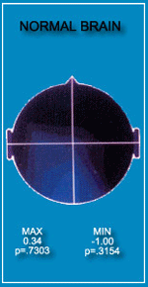

Slide 4
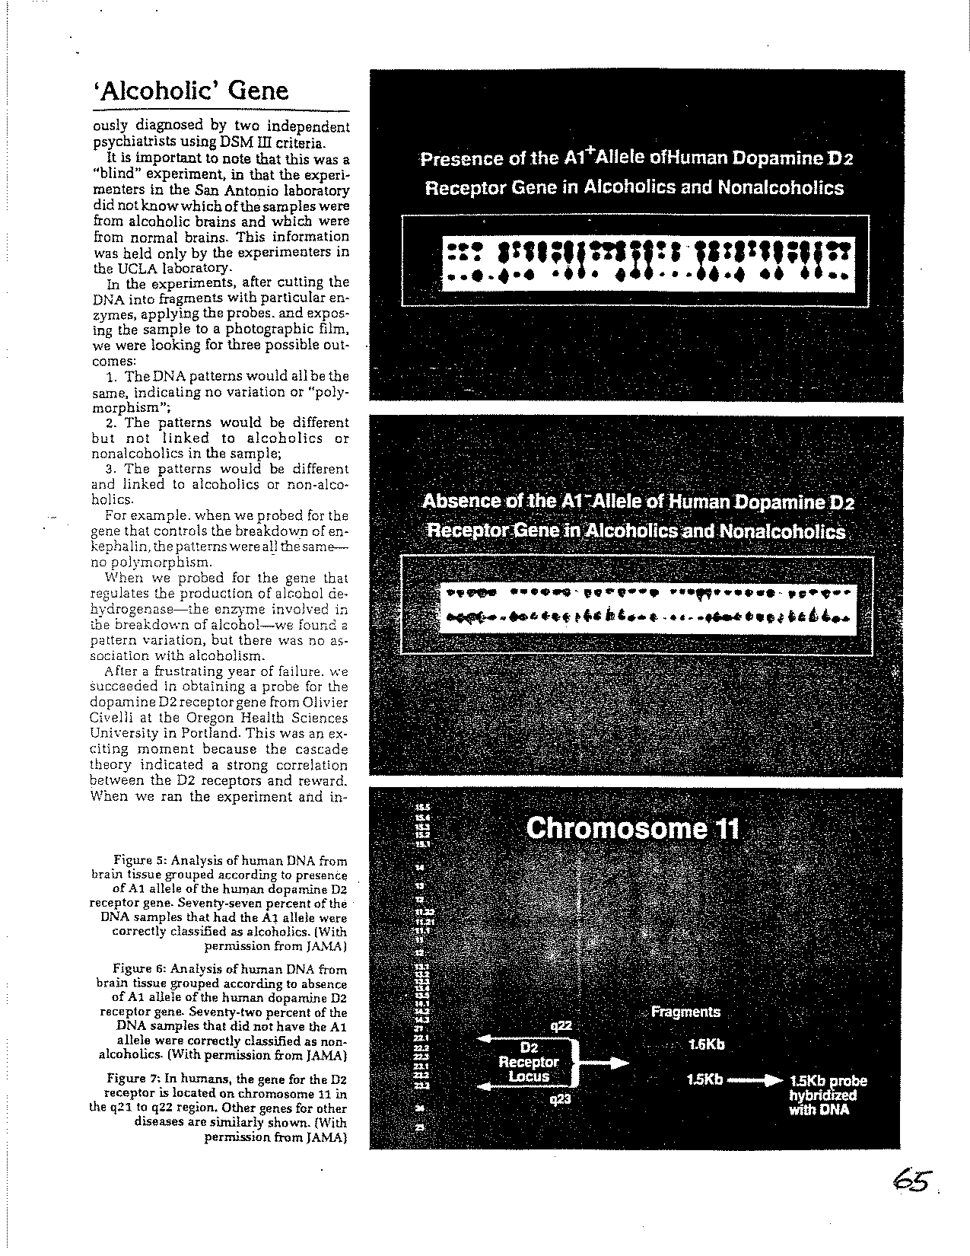

Slide 5
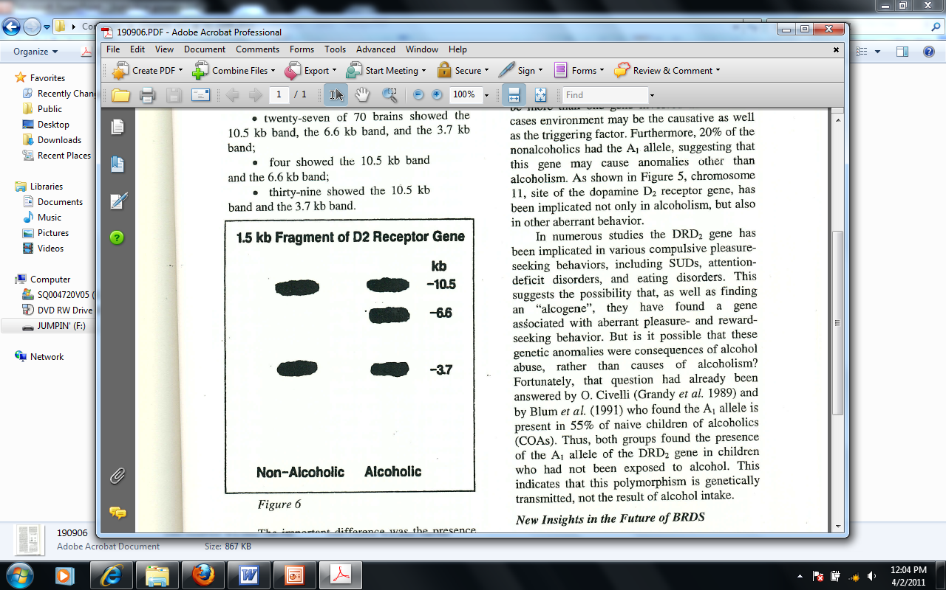

Slide 6
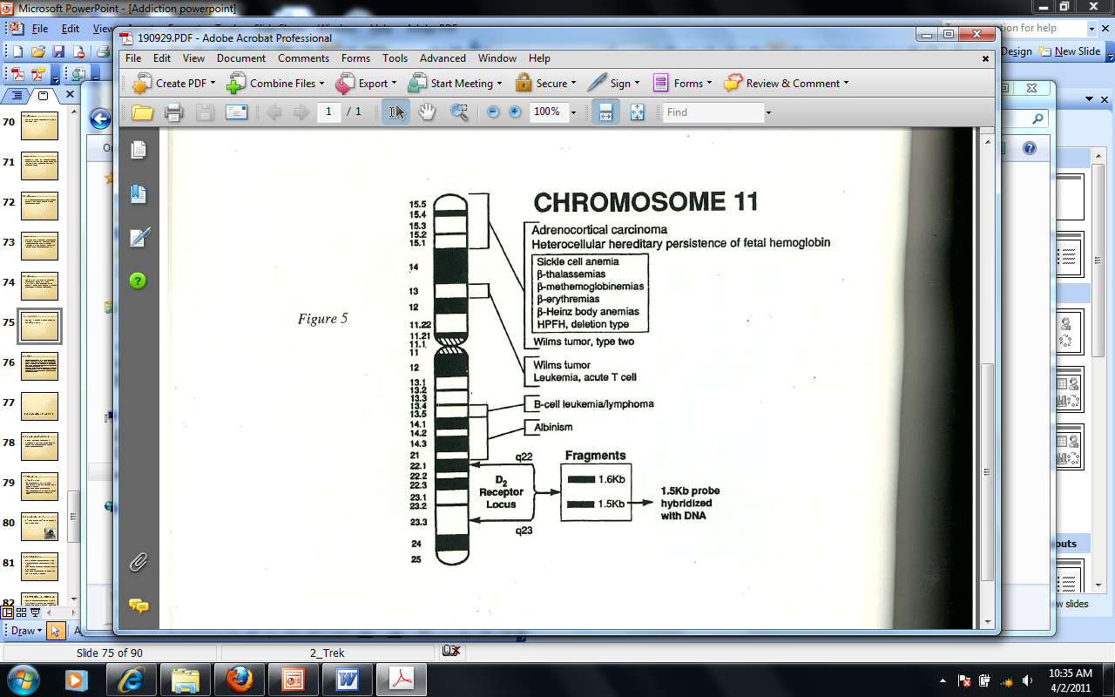

Slide 7
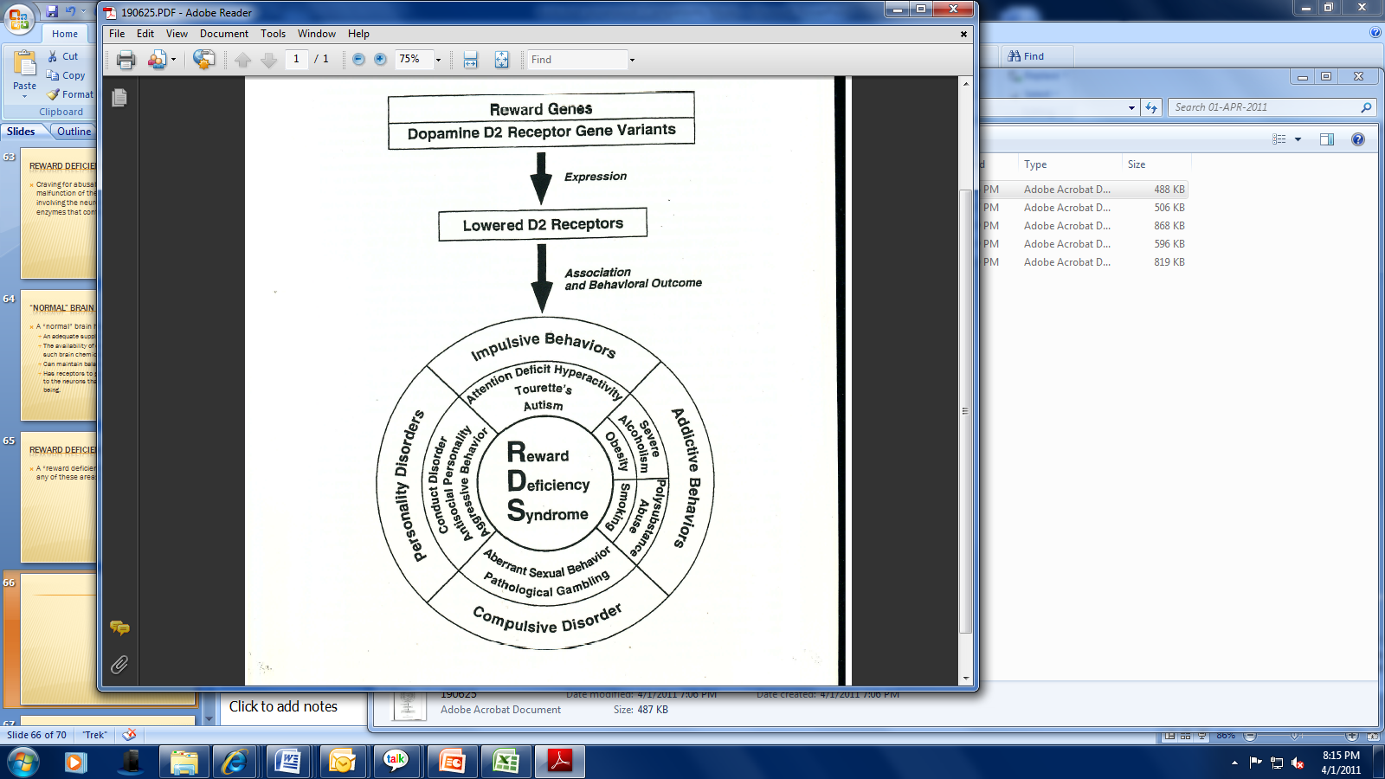

Slide 8
THE 5 ADDICTIONS:
1. WORK
2. FOOD
3. SEX
4. GAMBLING
5. CHEMICALS
EACH IS MULTIFACTORIAL
EACH IS A SYMPTOM
BUT THE DISEASE IS
REWARD DEFICIENCY SYNDROME

Slide 9
BEHAVIORAL DISORDERS
(AFFECTIVE DISORDERS)
ATTENTION DEFICIT DISORDER
LOW SELF ESTEEM
TOURETTE’S SYNDROME
ASPERGER’S SYNDROME
AUSTISTIC SYNDROME
CONDUCT DISORDERS
ANTI-SOCIAL PERSONALITY DISORDERS
LEARNING DISORDERS
HYPERACTIVE DISORDERS
DEPRESSION
ANXIETY

Slide 10
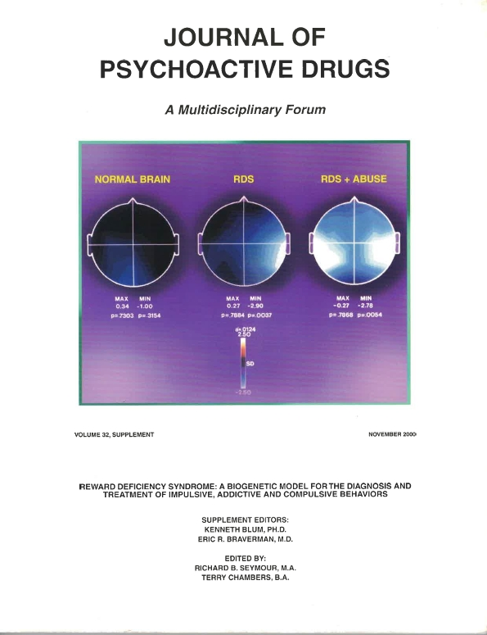

Slide 11
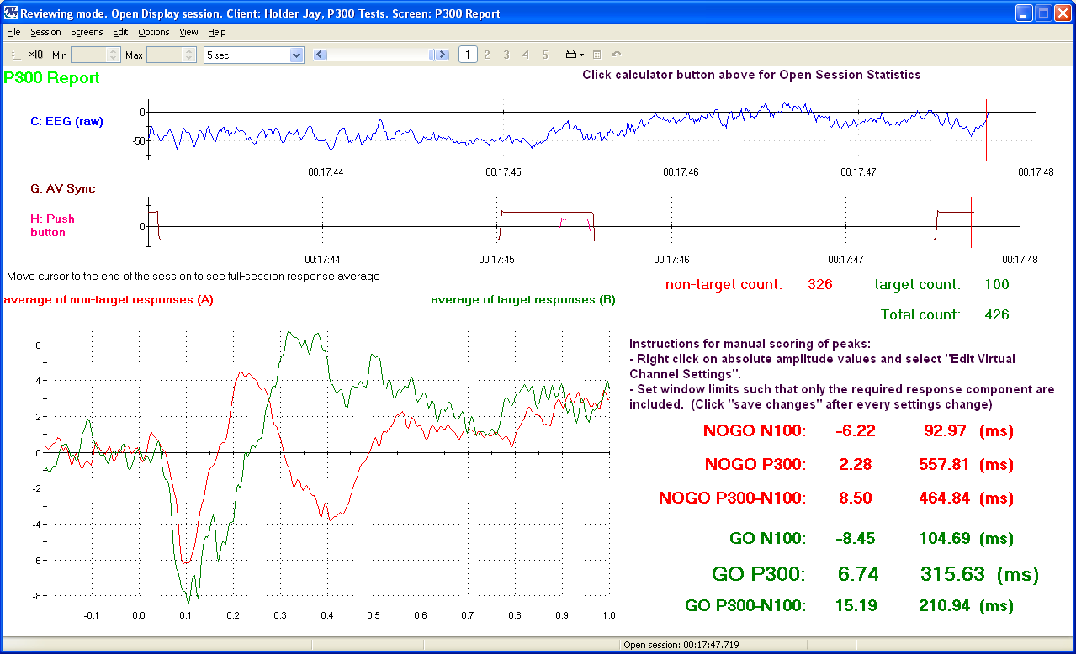
THE P300 WAVE IS AN EVOKED POTENTIAL

Slide 12
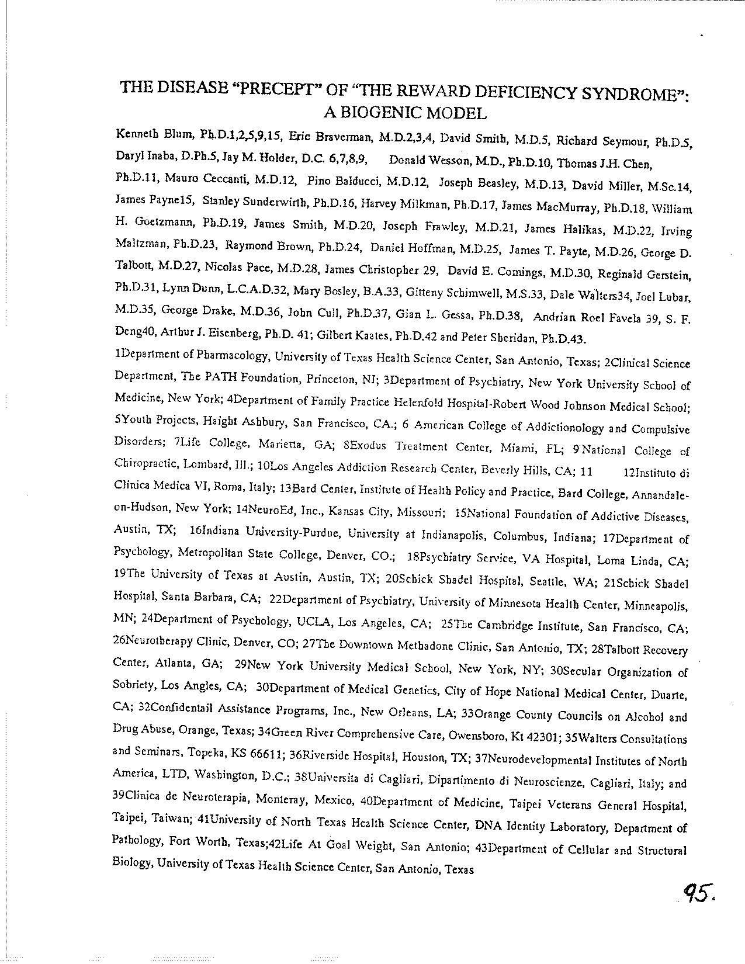

Slide 13
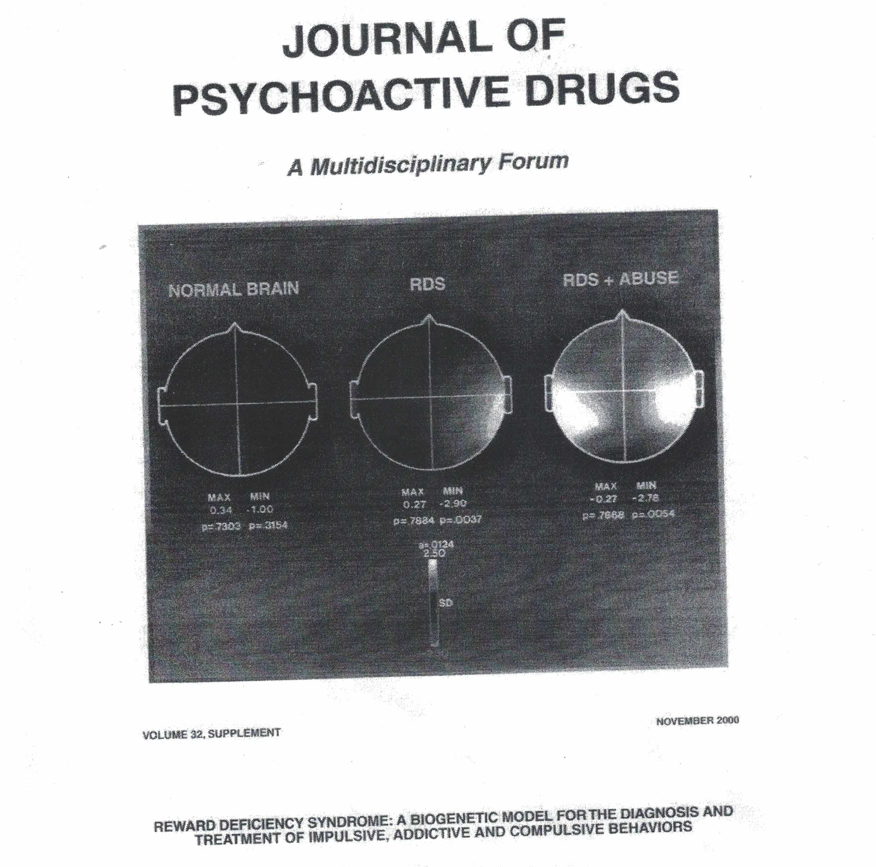

Slide 14
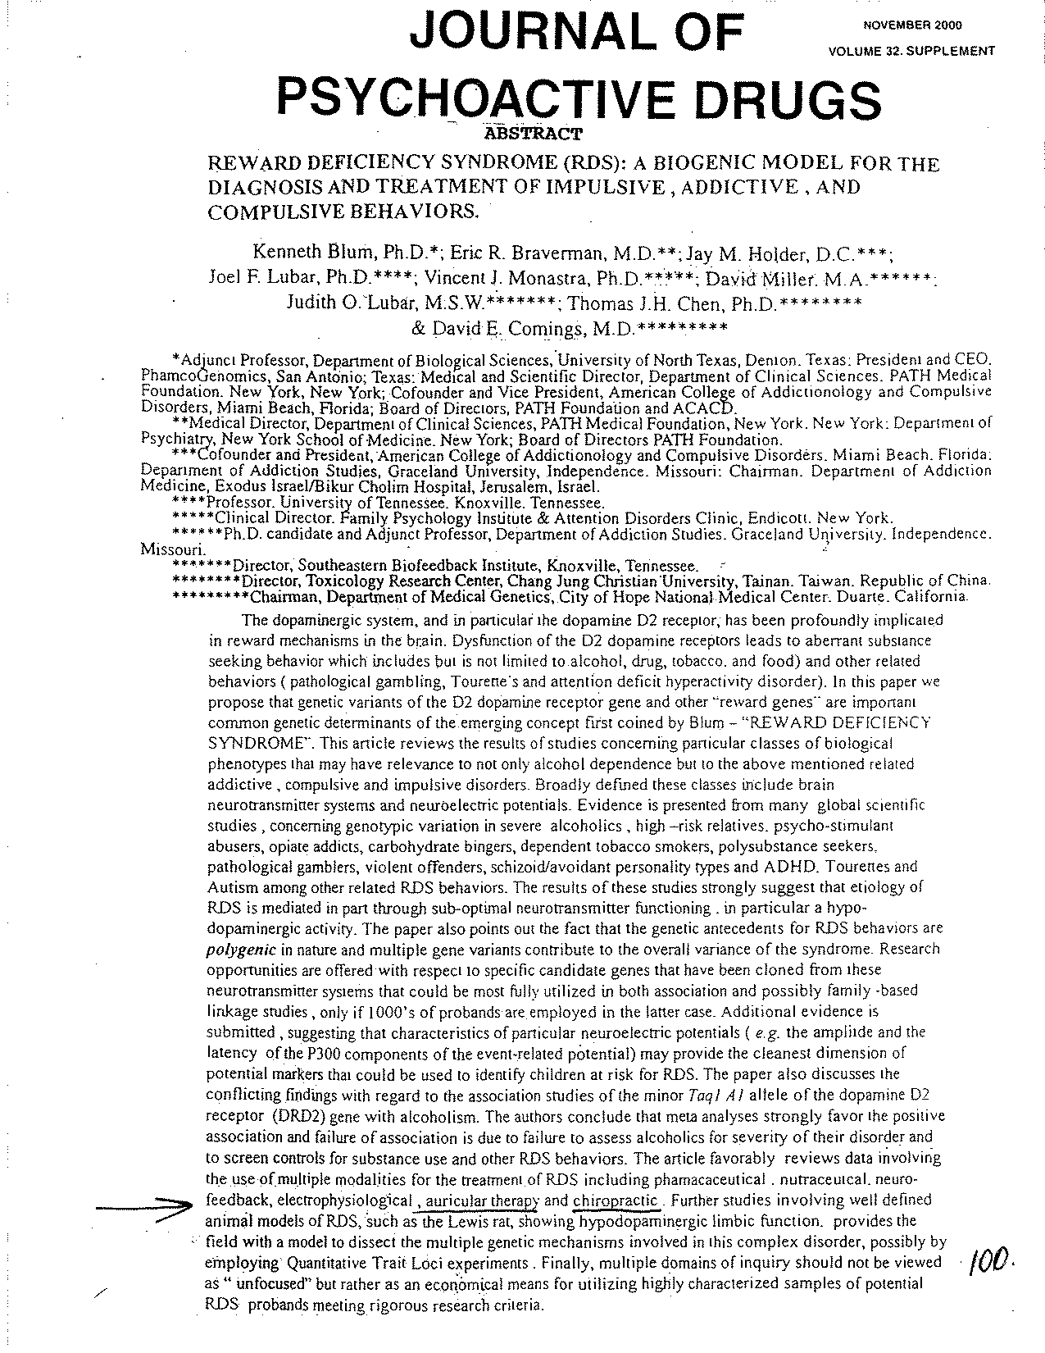

Slide 15
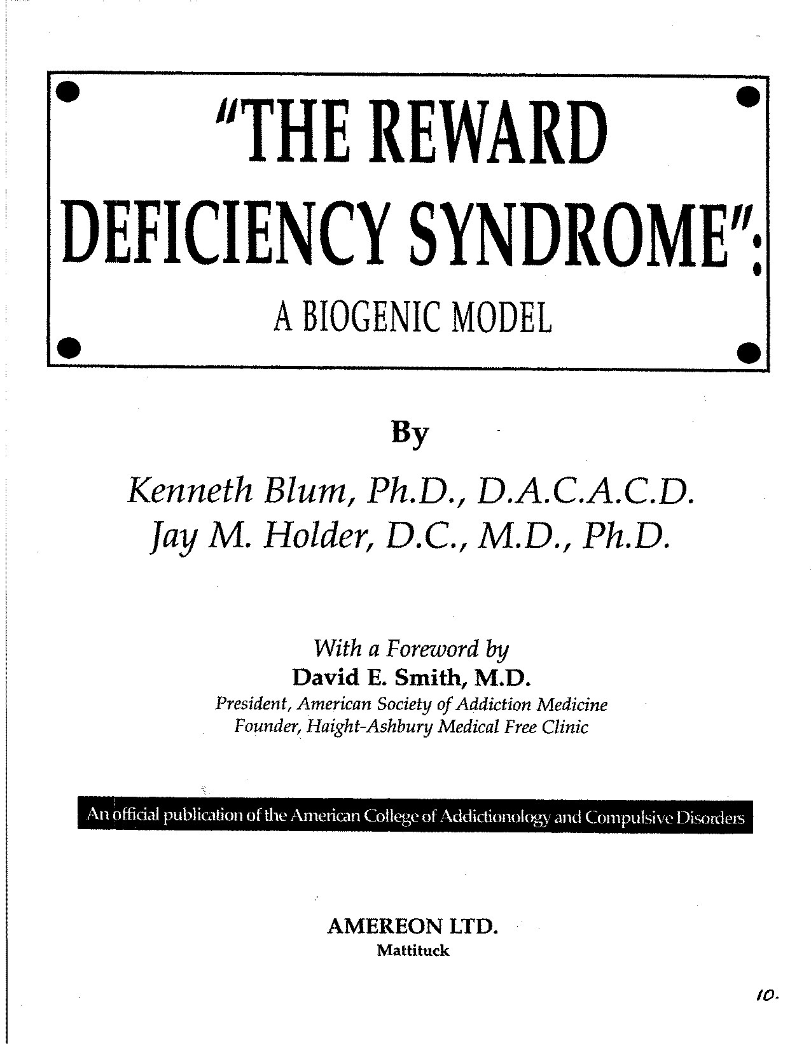

Slide 16
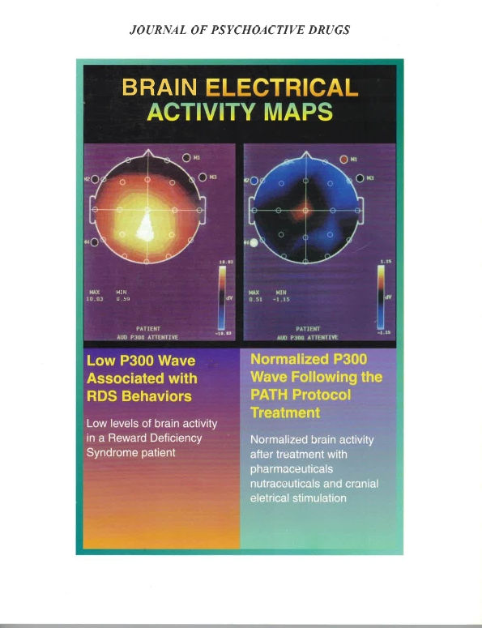

Slide 17
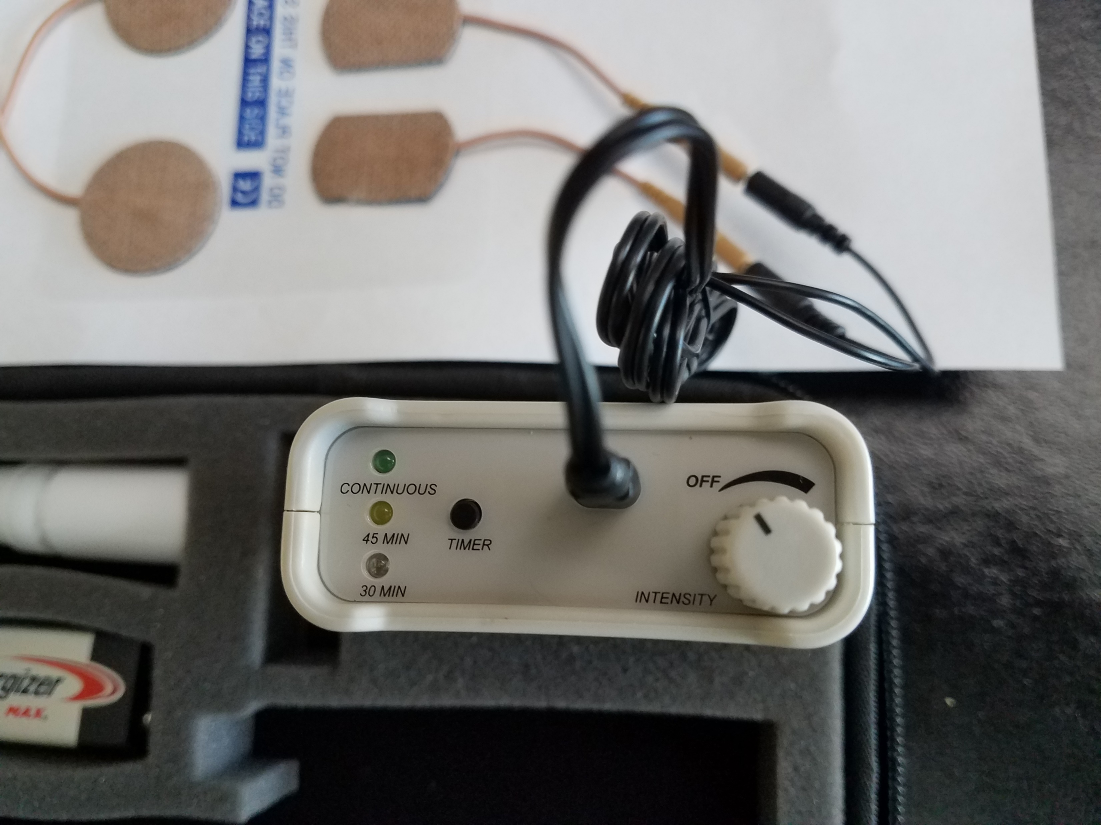
CES Via The Enigma P300 Top View Control Settings

Slide 18
NEUROTRANSMITTER REPLACEMENT THERAPY
  THE 4 AMINO ACIDS:
  DL-Phenylalanine
  L-Glutamine
  L-Tyrosine
  Tryptophan
  THESE BECOME ENKEPHALASE INHIBITORS ON AN EMPTY STOMACH

Slide 19
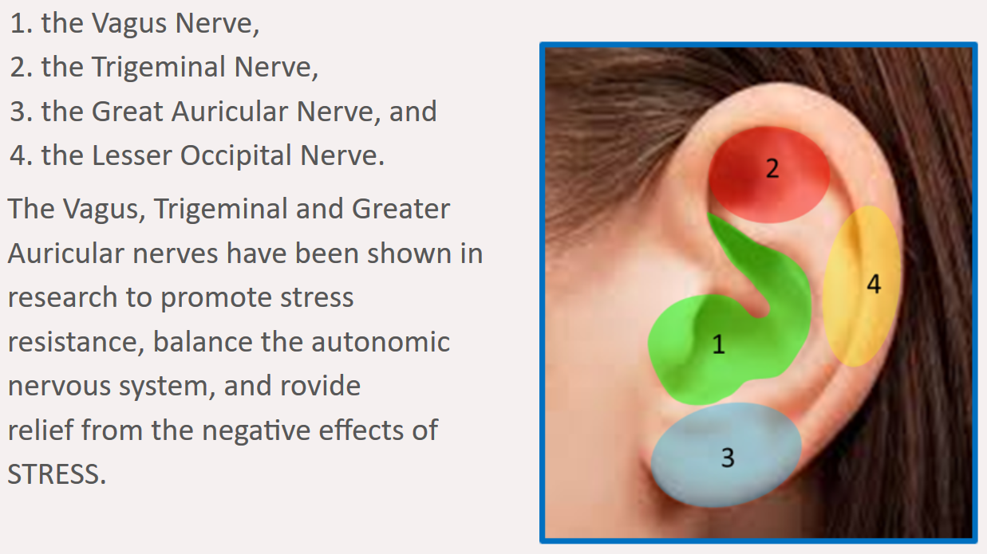
CRANIAL NERVE AUGMENTATION
1. VAGUS NERVE
2. FACIAL NERVE
3. TRIGEMINAL NERVE
4. GLOSSOPHARYNGEAL NERVE
5. 2nd CERVICAL GANGLION
6. 3rd CERVICAL GANGLION
7. 4th CERVICAL GANGLION

Slide 20
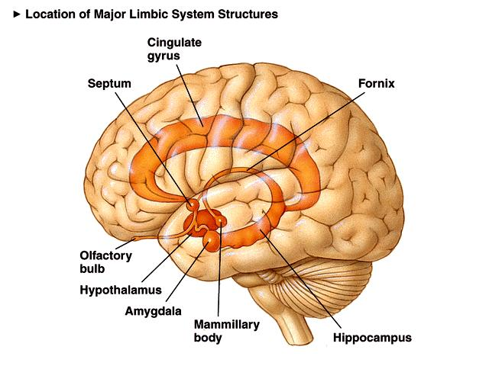
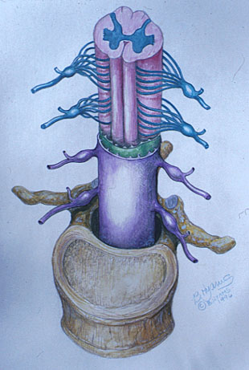
How do Misalignments in the Spine affect the Chemical Imbalances in the Brain?
Candace Pert, PhD
-- Molecules of Emotion
  Sense of well being (emotions) is seated in the limbic system
  This “limbic system tissue” is also found in the Dorsal Horn of the Spinal Cord
Holder Research Institute
  Discovered that only vertebrates can manifest a state of well-being or a deficiency of same

Slide 21
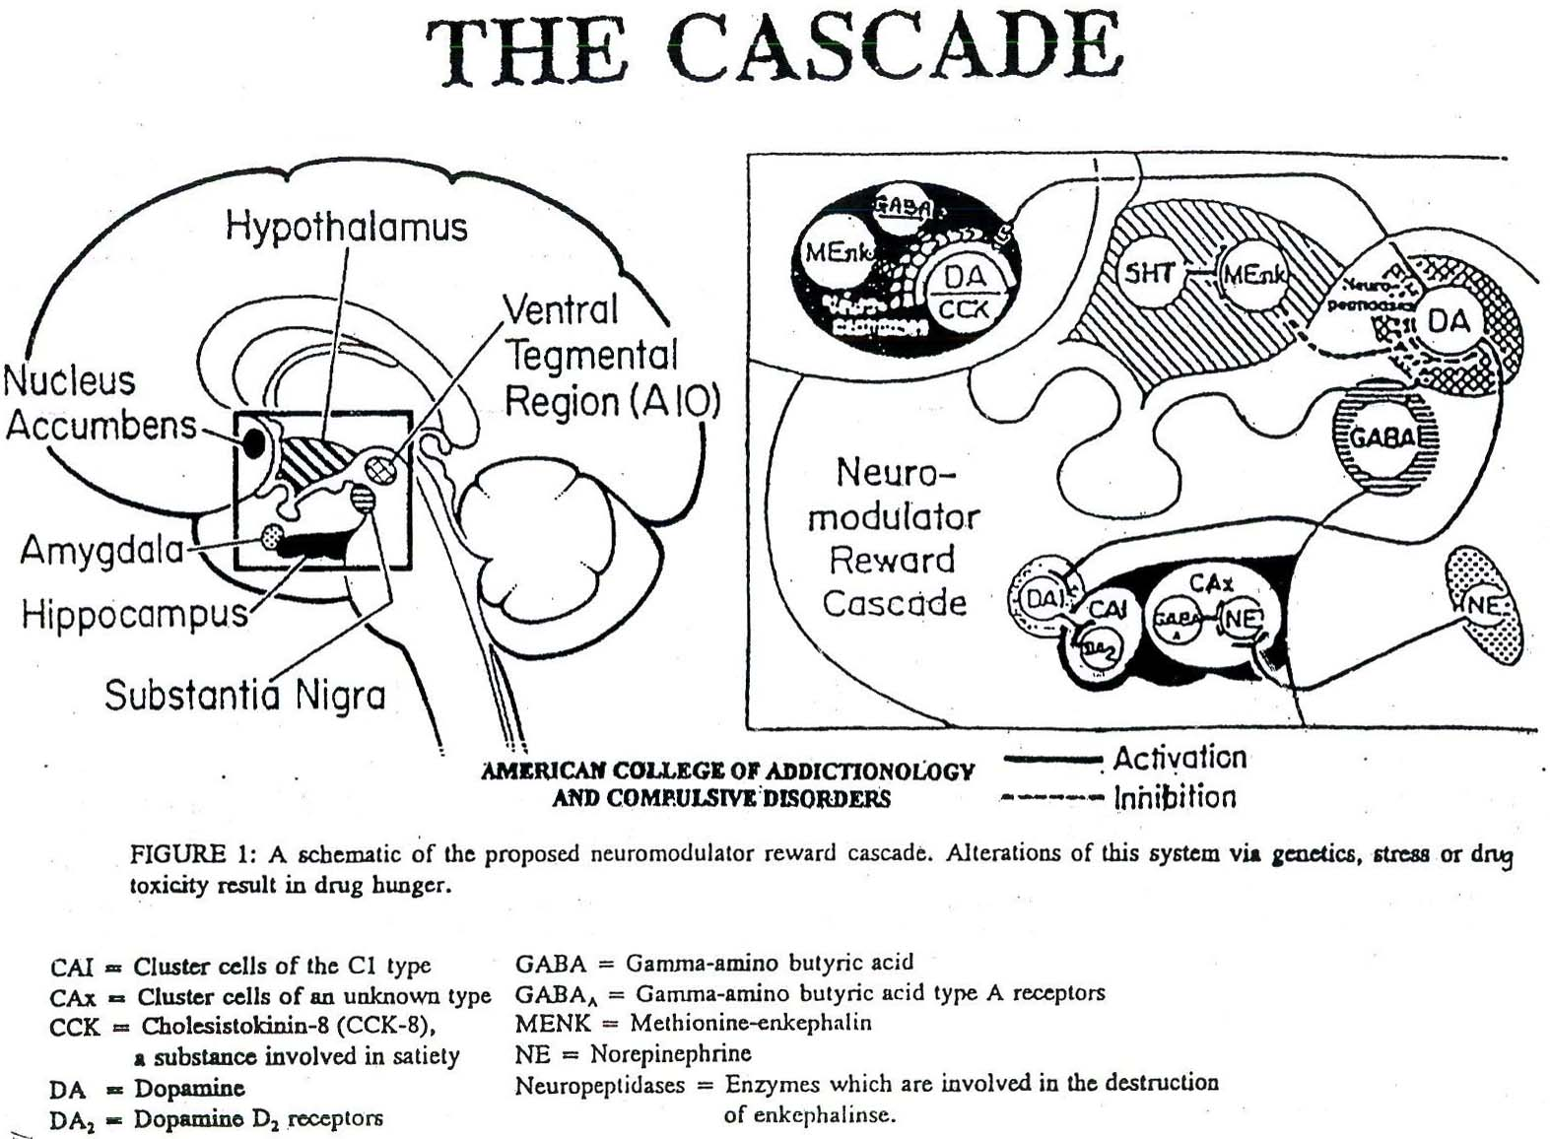
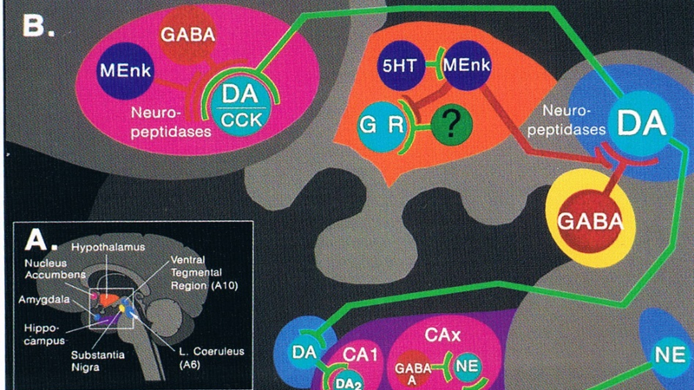

Slide 22
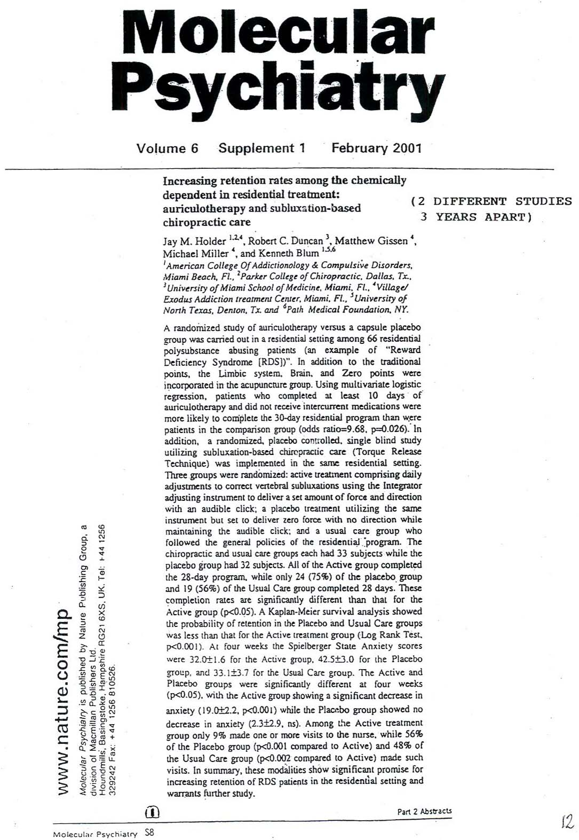

Slide 23
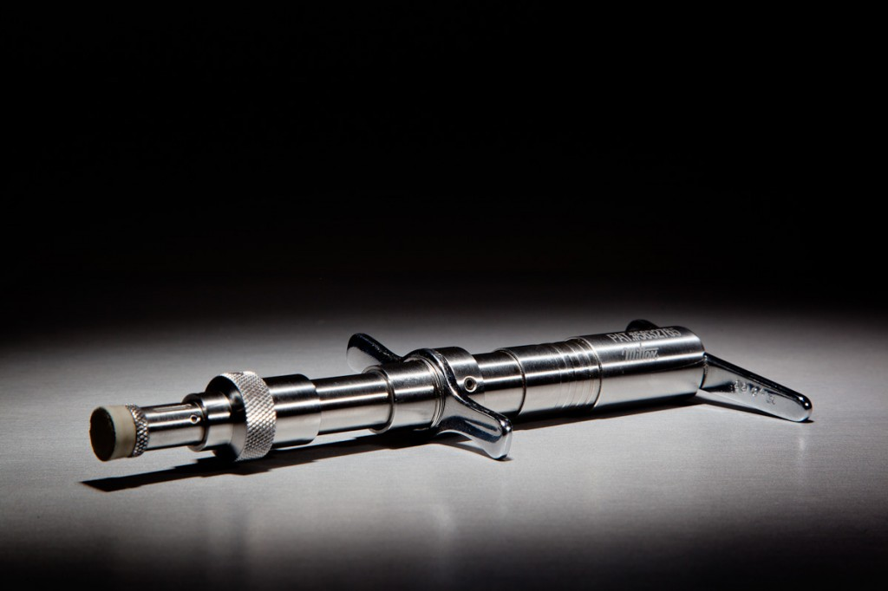

www.healincsummit.com

Slide 24
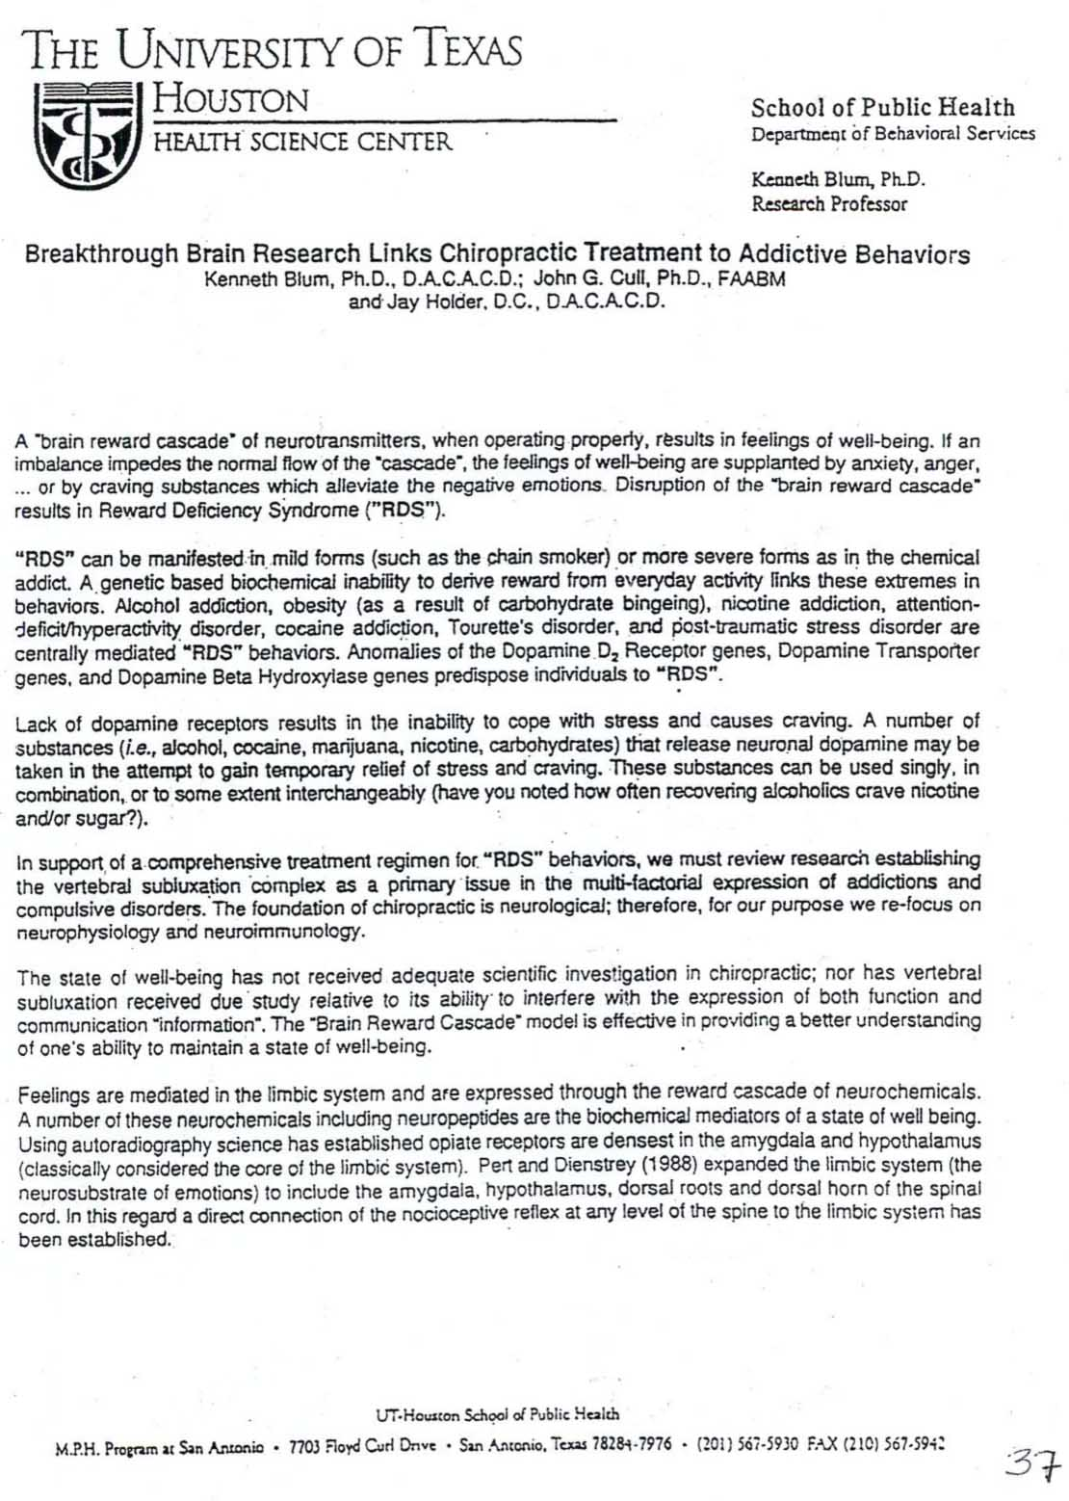

Slide 25
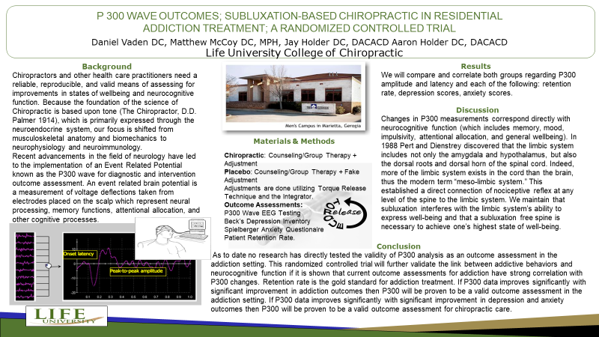

Slide 26
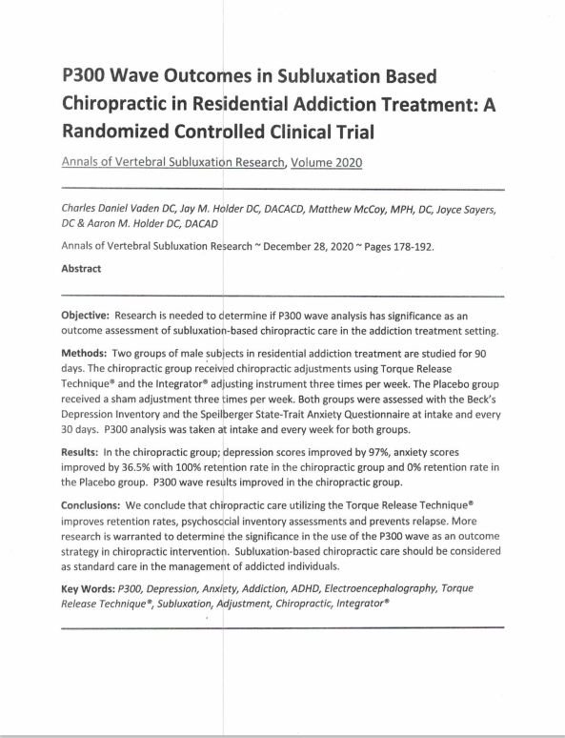

Slide 27
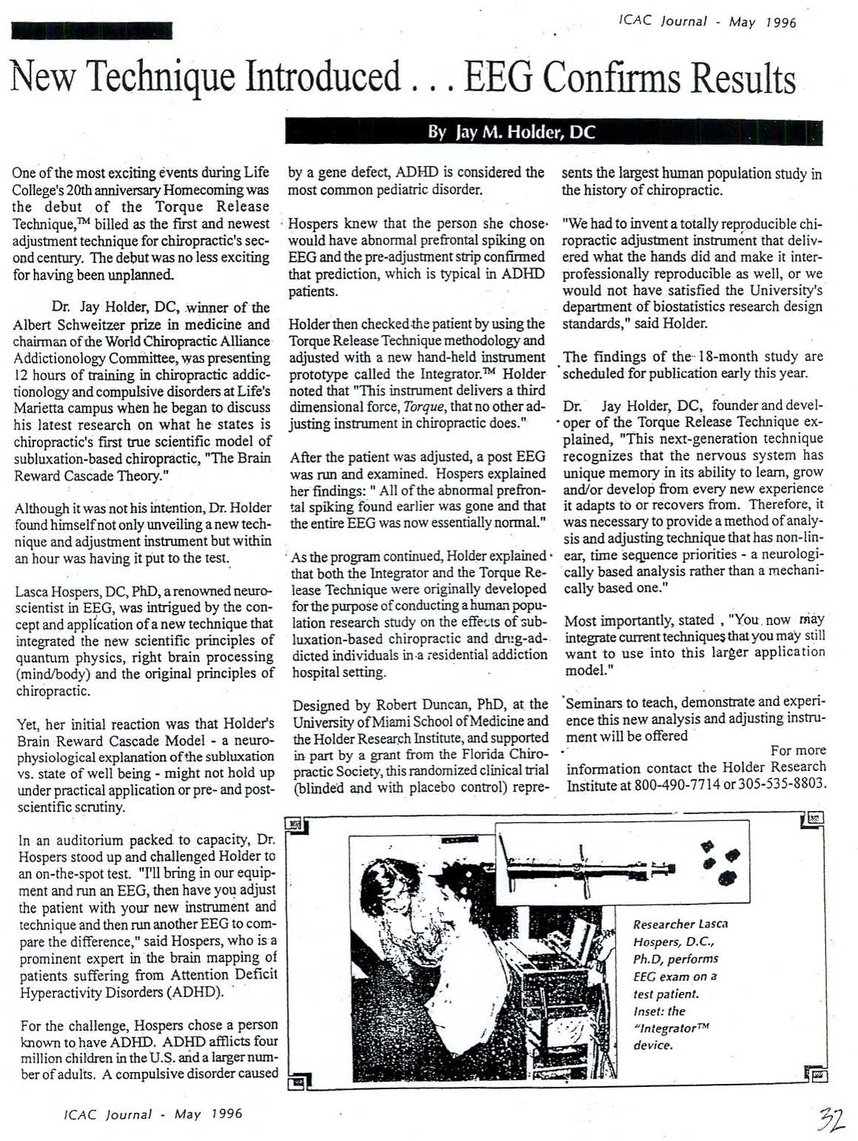

Slide 28
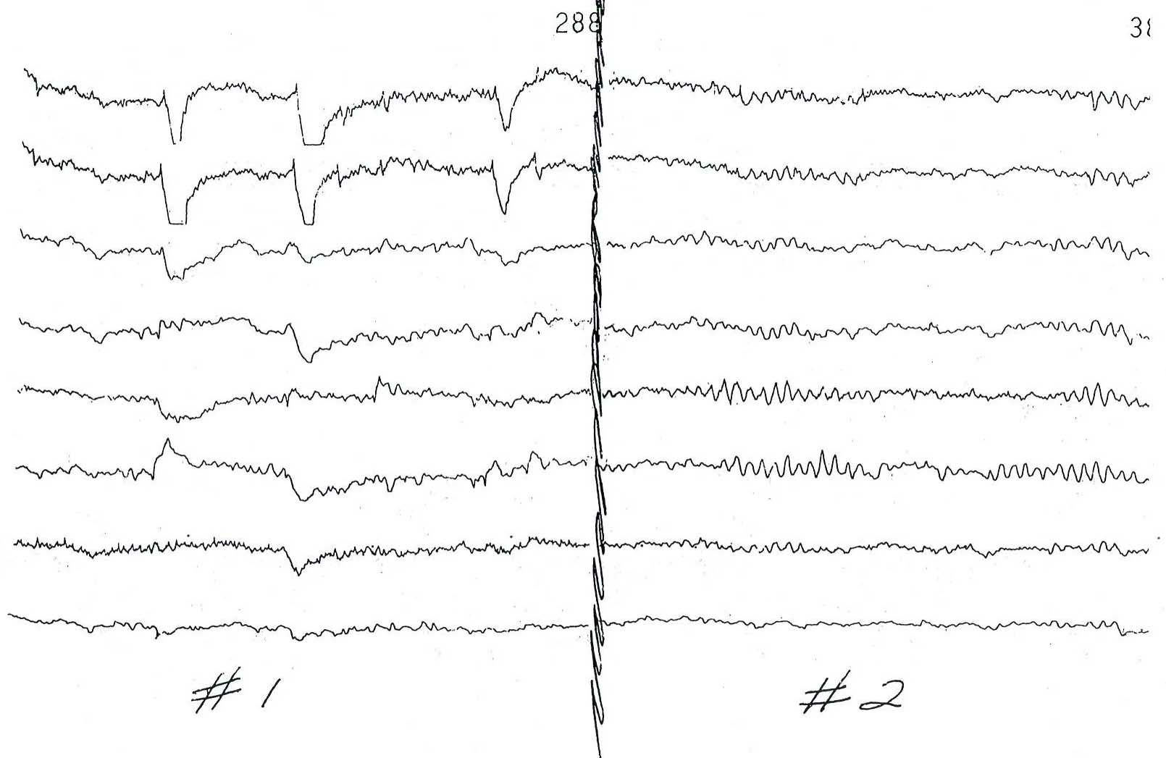

Slide 29
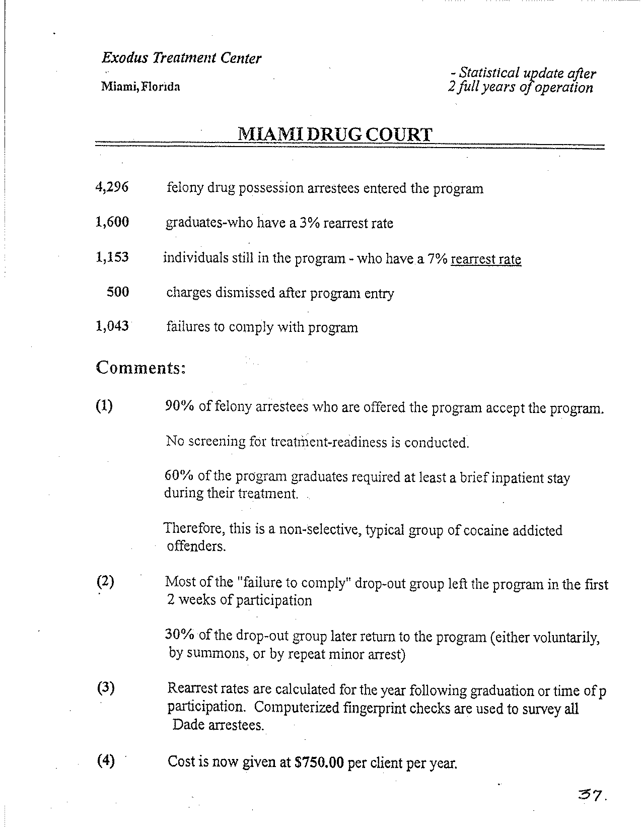

Slide 30
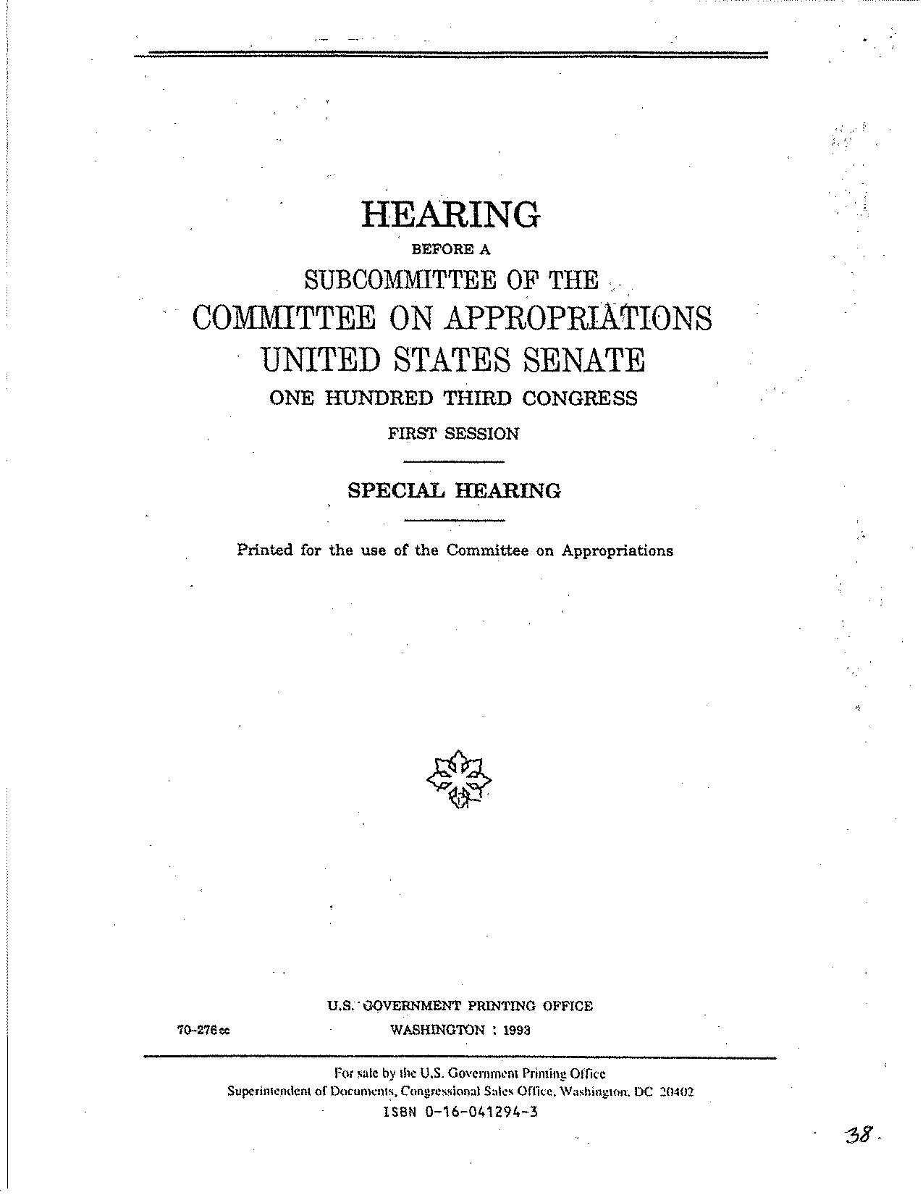

Slide 31
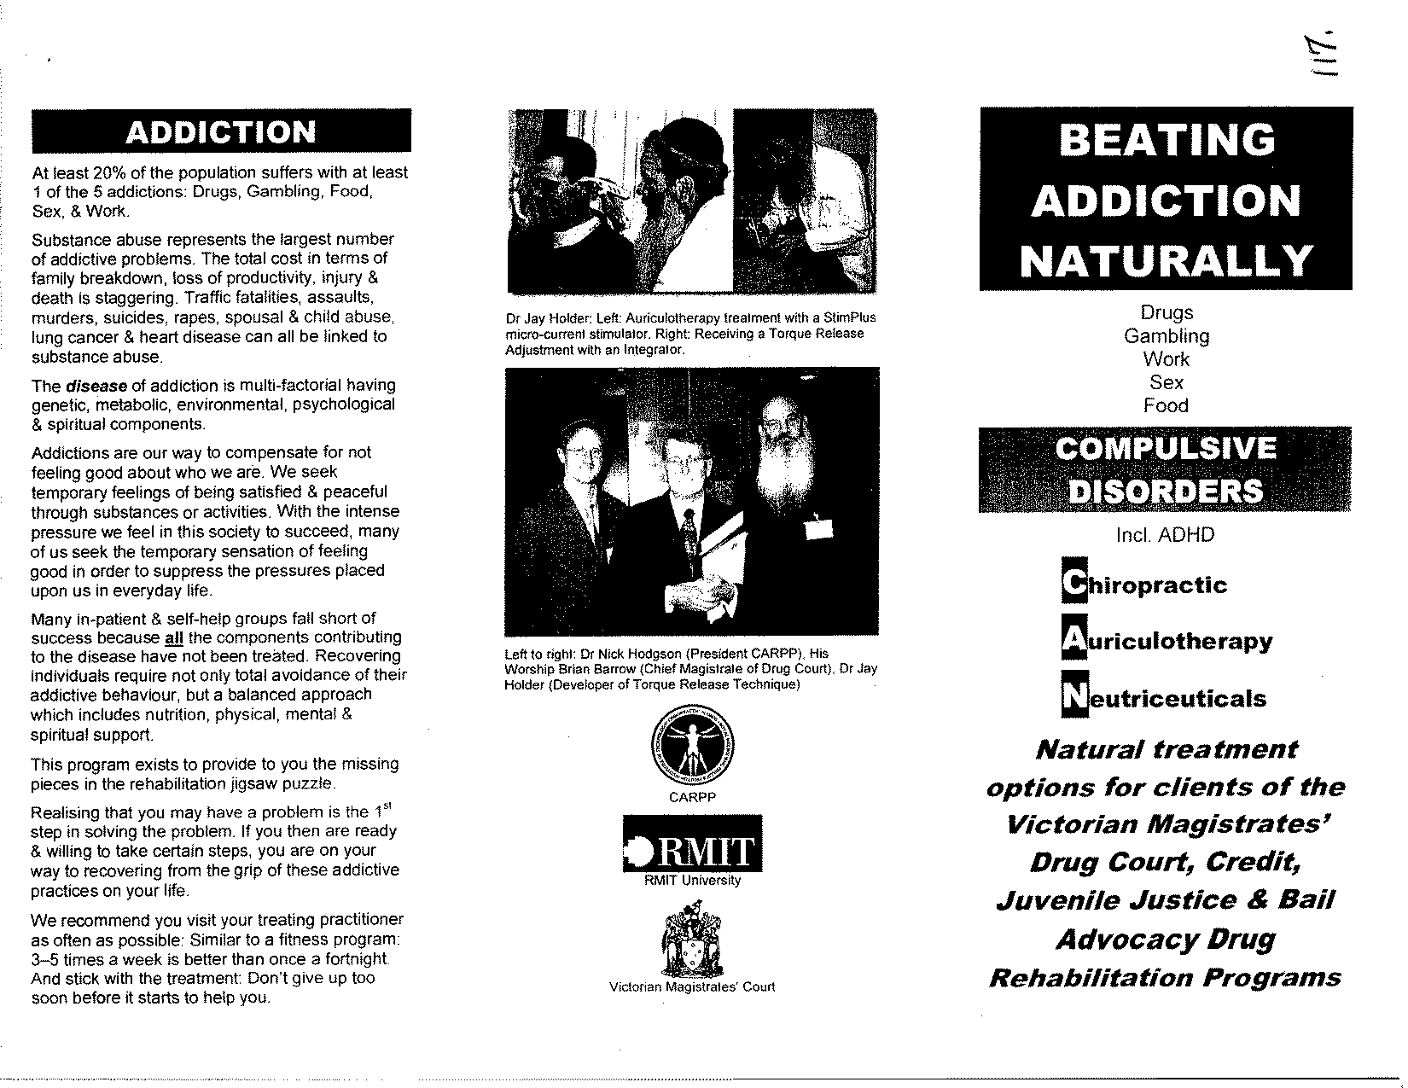

Slide 32
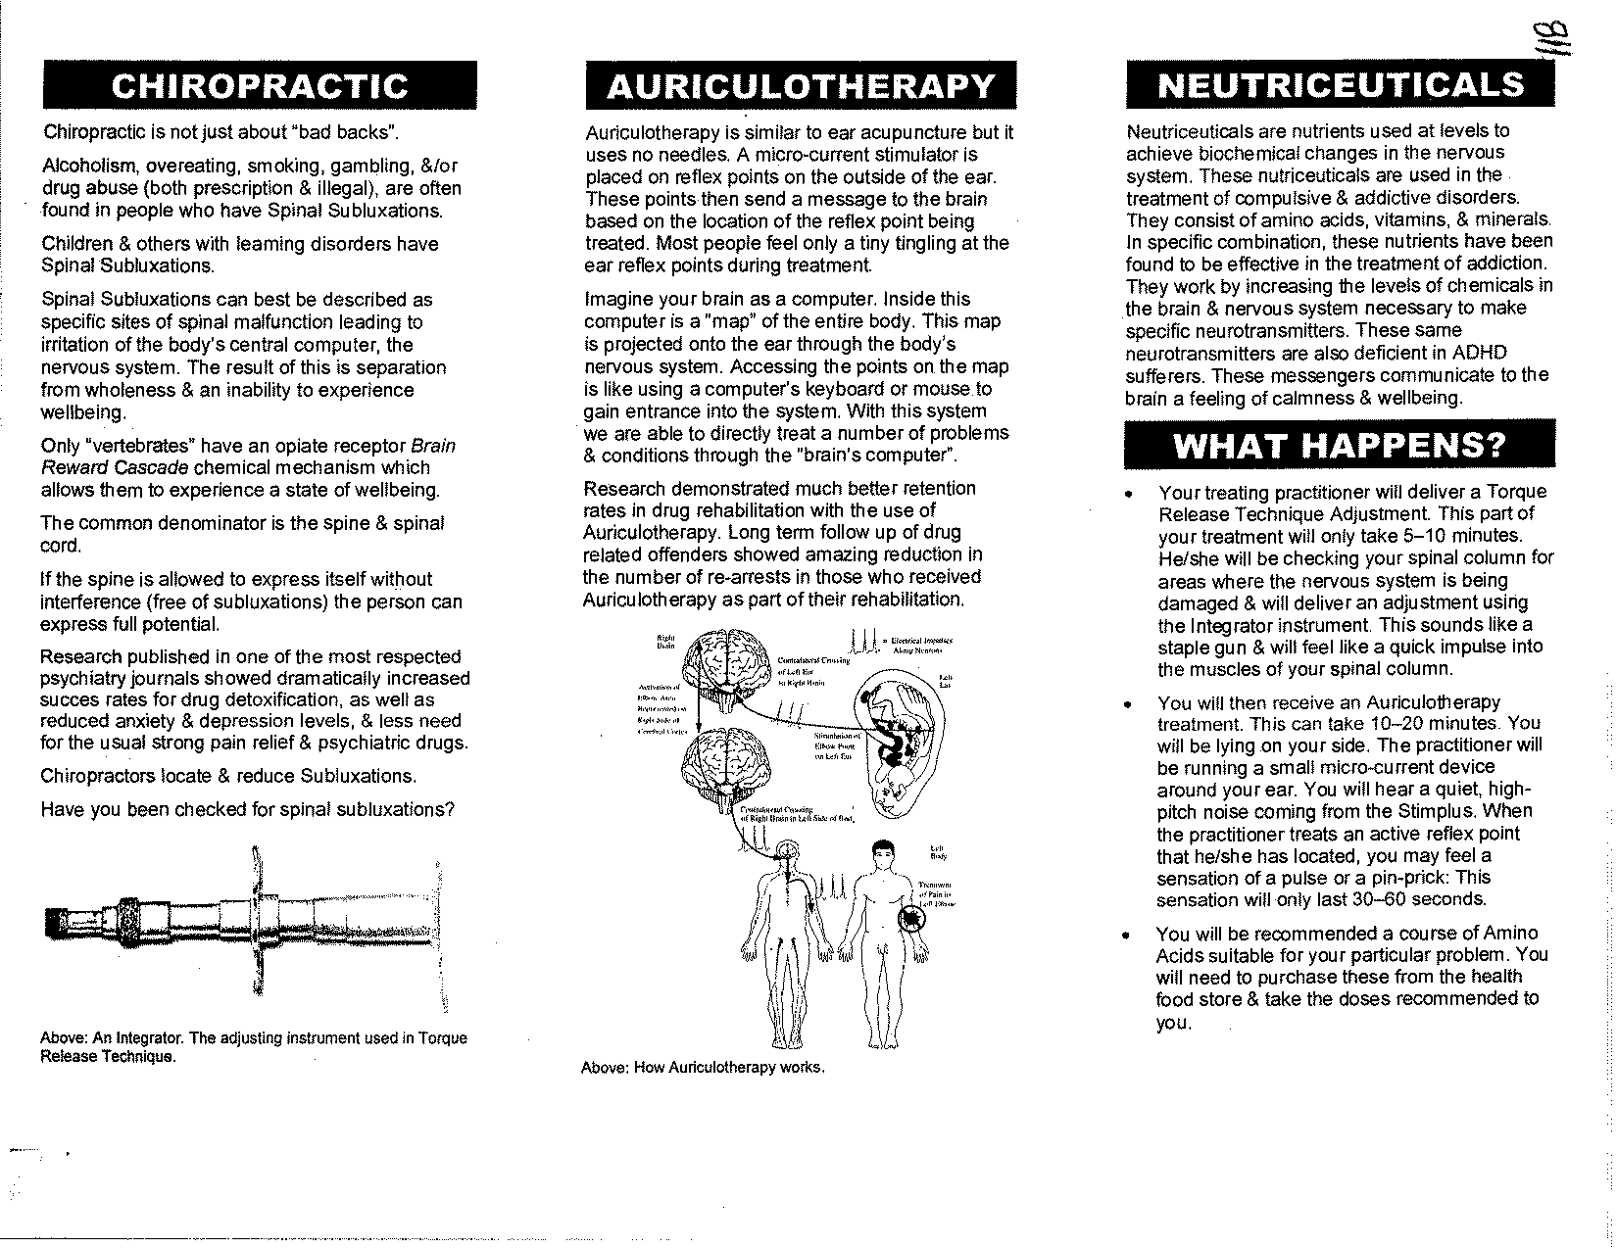

Slide 33


Slide 34


Slide 35


