Slide 1
“Plant Medicine, Psychedelics and the Inner-Sciences of Mental Wellness: Implications for Healthy Longevity and Rejuvenation”
Jeff McNairy, Psy.D., M.P.H.
Chief Medical Officer
Rythmia Life Advancement Center

Slide 2
Ayahuasca is Gaining Attention Globally
Low-cost
Quick results
High success rates

Slide 3
AYAHUASCA
Combination of 2 plants
Banisteriopsis caapi (vine)
DMT-rich leaf-based plant
Beta-carbolines
Harmine
Harmaline
Tetrahydroharmine
MAOIs
Visuals
Memories
Emotional release

Slide 4
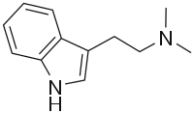
N,N-dimethyltryptamine (DMT)
Naturally occurring
What is the purpose?
What happens when you ingest more?

Slide 5

Consciousness Expansion Opportunity
Order/disorder
Patterns, colors, geometry
Amygdala
Prefrontal cortex
Synaptic plasticity

Slide 6
Epigenetics and Ayahuasca
Methylation
Histone formation
Sigmar-1 gene altered/adjusted

Slide 7

Cancer
Psychological effects
Somatic effects
Cellular effects

Slide 8

Depression
85% of ayahuasca participants with previous SSRI use, did not return to medication post treatment after 6 month follow-up
Rheumenation loops of negativity toward self are minimized
Dopamine and other neurochemical balancing “reset”

Slide 9

Trauma
PTS resolved among military veterans and high success rate with individuals with trauma history
Trauma leads to hypervigilance and empathic abilities
Projective identification normalized for identified target
Emotional flooding results
Lack of self awareness and identity
Remain in dissociated state
Ayahuasca allows for egodystonic process

Slide 10
Literature Reviews
Shows that Ayahuasca has been proven to reduce symptoms of:
  Depression
  Anxiety
  Addiction
  Trauma
  …in those who utilize this substance in a controlled environment based on intention and safety.
  Sources: Antidepressant Effects of a Single Dose of Ayahuasca in Patients With Recurrent Depression, A SPECT Study, Journal of Clinical Psychopharmacology, Vol. 36, No. 1, February 2016, 77-81.; Ayahuasca and the Treatment of Drug Addiction, Bouso &Riba, International Center for Ethnobotanical Education, Research and Service (ICEERS), November 2014, 95-109.; Pilot Evaluation of a Residential Drug Addiction Treatment Combining Traditional Amazonian Medicine, Ayahuasca and Psychotherapy on Depression and Anxiety, Giovanetti, Garcia-Arce, Rush, & Mendive, Journal of Psychoactive Drugs, Vol. 52, 2020, Issue 5.

Slide 11

Why I left my career in Los Angeles and moved permanently to Costa Rica in 2014
Frustrated with traditional Western medical model as psychologist
Saw revolving door of treatment for inpatient health care
Stabilized but did not treat or resolve underlying conditions
Witnessed effects plant medicine had on one patient case study

Slide 12
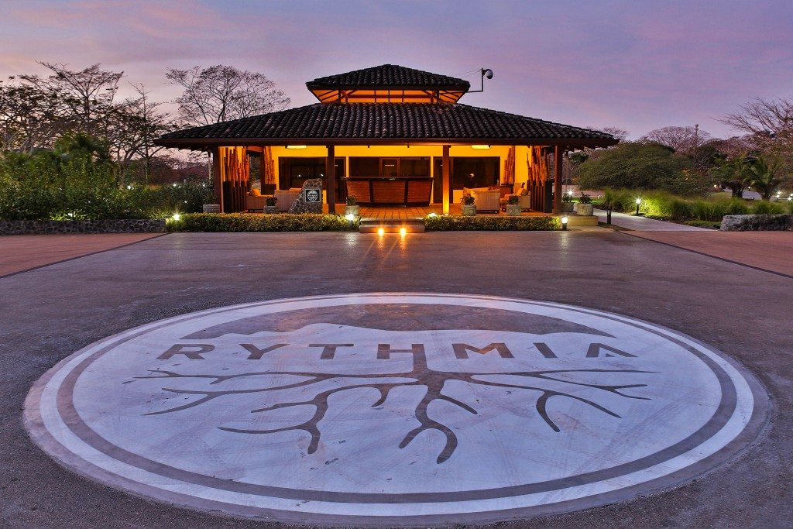
Rythmia Life Advancement Center

Slide 13

Rythmia Life Advancement Center
Opened in 2016
First medically licensed ayahuasca center in the world
Seen 14,000 guests since inception
#1 rated resort of its kind on TripAdvisor
Self-reported success rate of 97.16%

Slide 14

Rythmia Week-Long Program
4 Ayahuasca sessions
3 Breathwork sessions
Daily yoga & Mediation
Bodywork & Spa treatments
Organic high vibrational food
Workshops & Integration classes
2 Hydrocolonics
Psychological services
24/7 Medical supervision by MDs, RNs, and Paramedics

Slide 15

Medical License & Participant Safety
Costa Rica Ministry of Health
Medical contraindications
Vulnerability
Emergency medicine
Provider integrity
Close supervision

Slide 16
The “Rythmia Way”
Dissociative split
2-7 years old
Come back to authentic self
Heal trauma
Move forward
Success = achieve 3 key intentions:
Show me who I’ve become
Merge me back with my soul at all costs
Heal my heart

Slide 17
Rythmia ISO Implementation
The International Organization for Standardization:
  An independent, non-governmental organization
  Develops and publishes international standards in all technical and non-technical fields, such as healthcare

Slide 18

Proprietary Software System
Data point check-ins
400,000 data points collected
56,000 Ayahuasca user sessions
Collection and comparison of data
Most comprehensive medical program
delivery of Ayahuasca in the world

Slide 19

The Reality of Healing
What does an ayahuasca session look like?
Psychosomatic response
Set and setting are important
Mindset is critical (believe vs. hope)
Participant observer of shamanic experience

Slide 20

QUESTIONS & ANSWERS

