Slide 1



Systemic Inflammation,
the Microbiome, Longevity
and Dentistry
Marc Penn, MD, PhD, FACC
Program Director, Cardiovascular Medicine Fellowship
Summa Health Heart and Vascular Institute
Chief Medical Officer,
Quest Center for Cardiometabolic Testing
at Cleveland HeartLab
Quest Diagnostics, Inc.
Chief Medical Officer
Keystone Bio, Inc.
Chief Medical Officer and Co-Founder
Foment Bio, Inc

Slide 2
Challenges
Longevity
Medicine defines healthy as the absence of disease
Disease is often nascent and thus many who appear healthy are not
Solution
Figure out how to define healthy
Identify markers of disease at a time when healthy measures can arrest and reverse disease course

Slide 3
Systemic Inflammation is a Robust Marker of Unhealthy
Key Biomarker for Vascular Inflammation:
Myeloperoxidase
Myeloperoxidase (MPO) is normal contained in granules in WBC
Normal Physiology:
MPO is released at sites of infection to clear infections
Abnormal Physiology:
MPO is released by WBC in the blood stream or blood tissue interface in response to vulnerable plaque and vascular inflammation
Known marker for risk of myocardial infarction and stroke

Slide 4
Variable | Baseline Characteristics
Total N | 3,634
Age, years | 67.7 ± 13.2
Sex
Women | 2,350 (64.7%)
Men | 1,282 (35.3%)
Diabetes Status
Non-diabetic | 2,342 (64.4%)
Pre-diabetic | 642 (17.7%)
Diabetes (Type 1 or 2) | 650 (17.9%)
Myocardial Infarction | 88 (2.4%)
Stroke/Cerebrovascular Accident | 98 (2.7%)
Prior Revascularization | 152 (4.2%)
Laboratory Data
LDL, mg/dL | 126 ± 28
A1c, % | 6.0 ± 0.9
ApoB | 98 ± 19
Cohort of “Worried Well”
Patients with Serial Measures

Slide 5
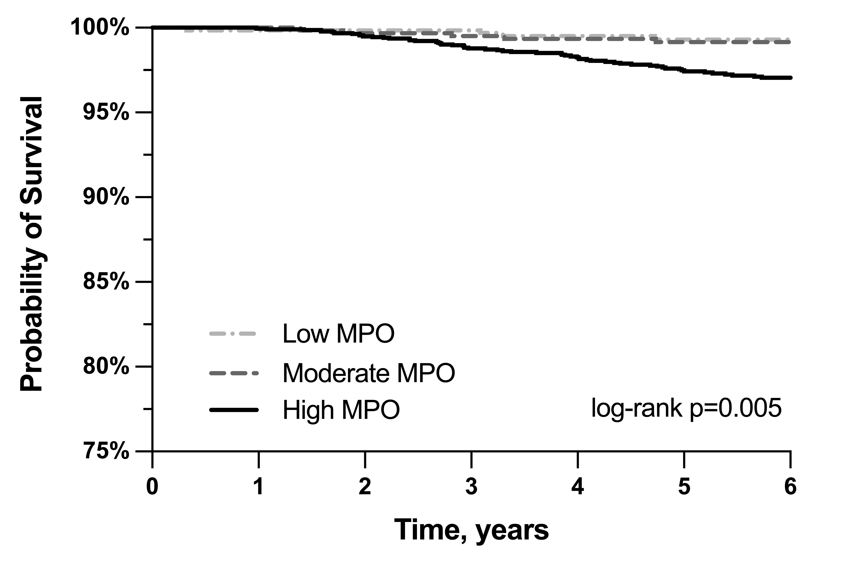
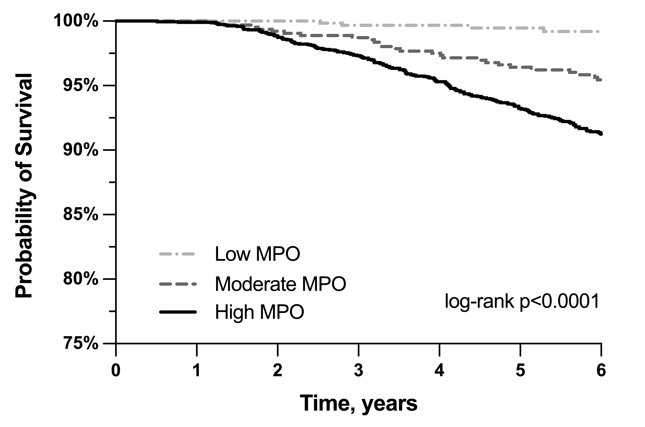
CV Death
Non-CV Death
Penn MS, Macrae C, Goldfaden R, Choksi R, Smith S, Wrenn D, Saghir M, Klemes A. Submitted

Slide 6
Incidence per 1000 Patient Years
Outcome | Baseline MPO Cohort
MI | 2.4
CVA | 4.6
Revascularization | 4.1
Death (all-cause) | 17.0
Any of MI, CVA, Death | 21.5
MPO Category | MI | Death
Low (<470) | 0.9 (0.3-2.7) | 2.3 (1.2-4.6)
Moderate (470–539) | 2.2 (1.2-4.1) | 14.6 (11.5-18.5)
High (≥540) | 2.9 (2.1-3.9) | 21.2 (19.0-23.7)
Penn MS, Macrae C, Goldfaden R, Choksi R, Smith S, Wrenn D, Saghir M, Klemes A. Submitted

Slide 7
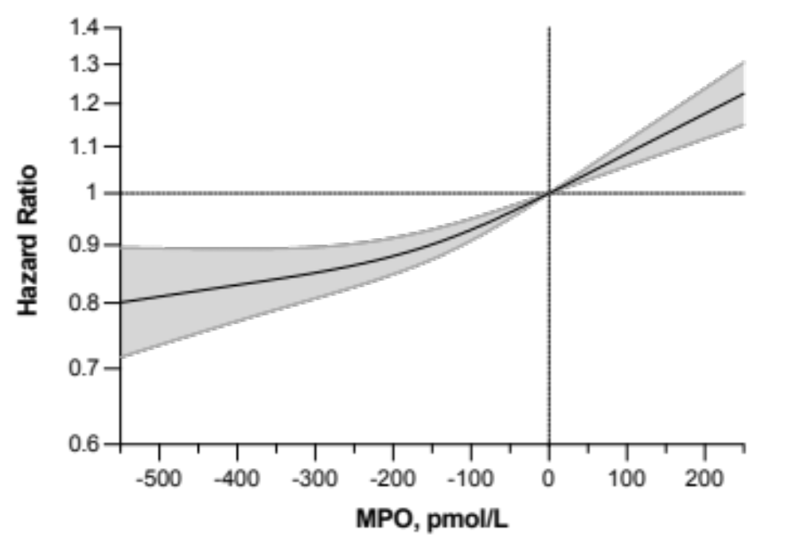
Change in MPO and Death
Lowering Systemic
Inflammation Decreases Mortality
Penn MS, Macrae C, Goldfaden R, Choksi R, Smith S, Wrenn D, Saghir M, Klemes A. Submitted

Slide 8
Systemic Inflammation is Associated Broad Range of Causes of Death
Cause of Death
Percent of Deaths
Penn MS, Macrae C, Goldfaden R, Choksi R, Smith S, Wrenn D, Saghir M, Klemes A. Submitted

Slide 9
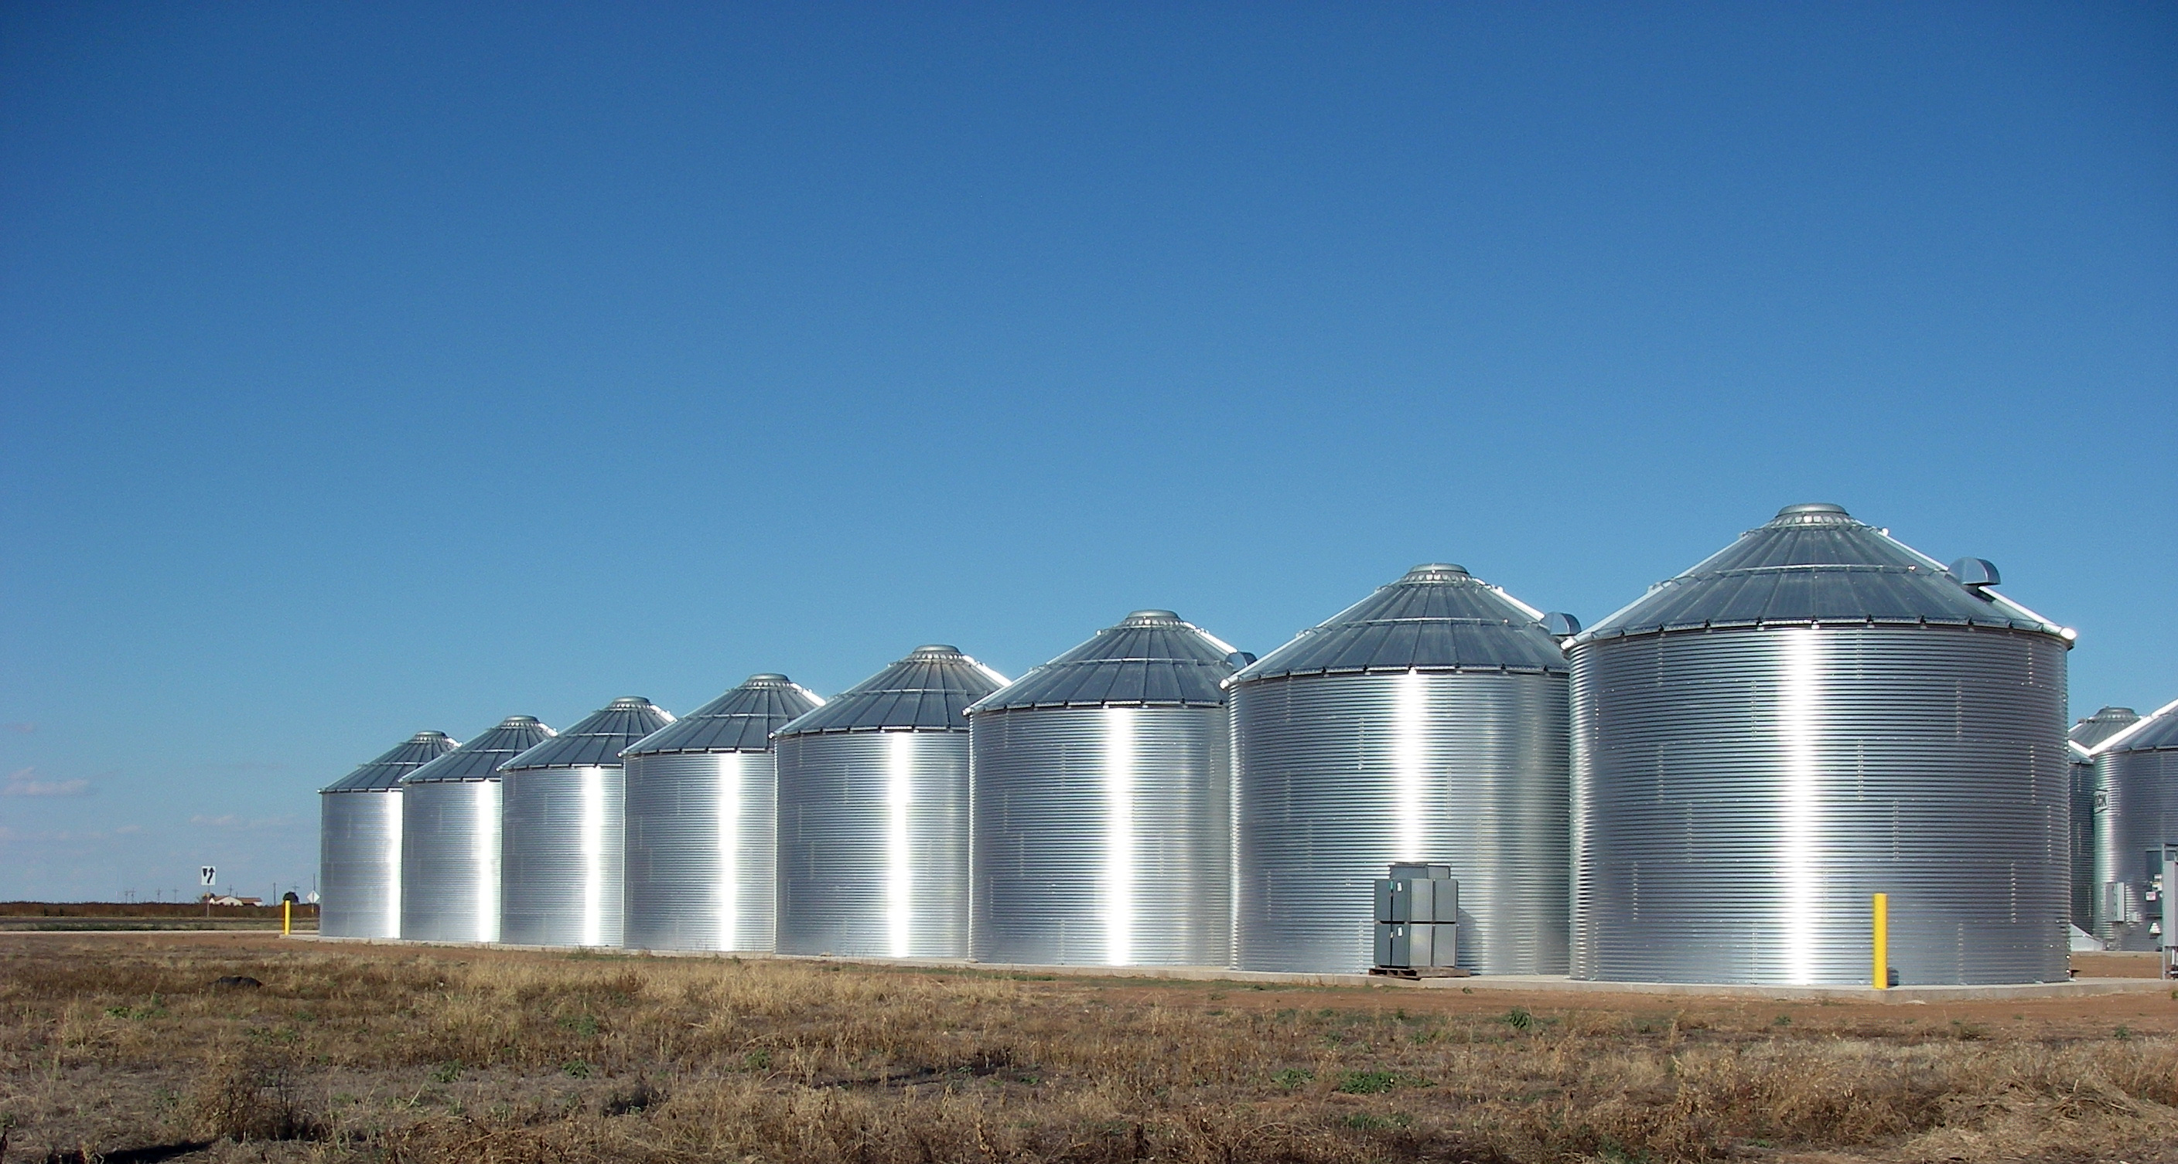
What is Needed to Improve Health and Ultimately Longevity?
Medicine Needs to Break Though its Silos!

Slide 10
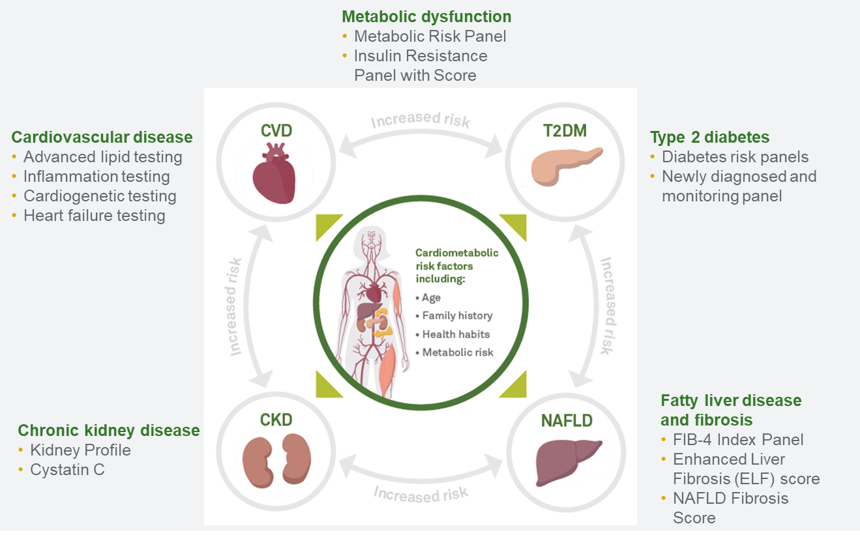
What is Needed to Improve Health and Ultimately Longevity?
Cardiometabolic Disease

Slide 11
We Also Need Novel Thought and Treatment
Microbiome clearly impacts health and disease
Regenerative medicine offers novel insights and therapeutics

Slide 12
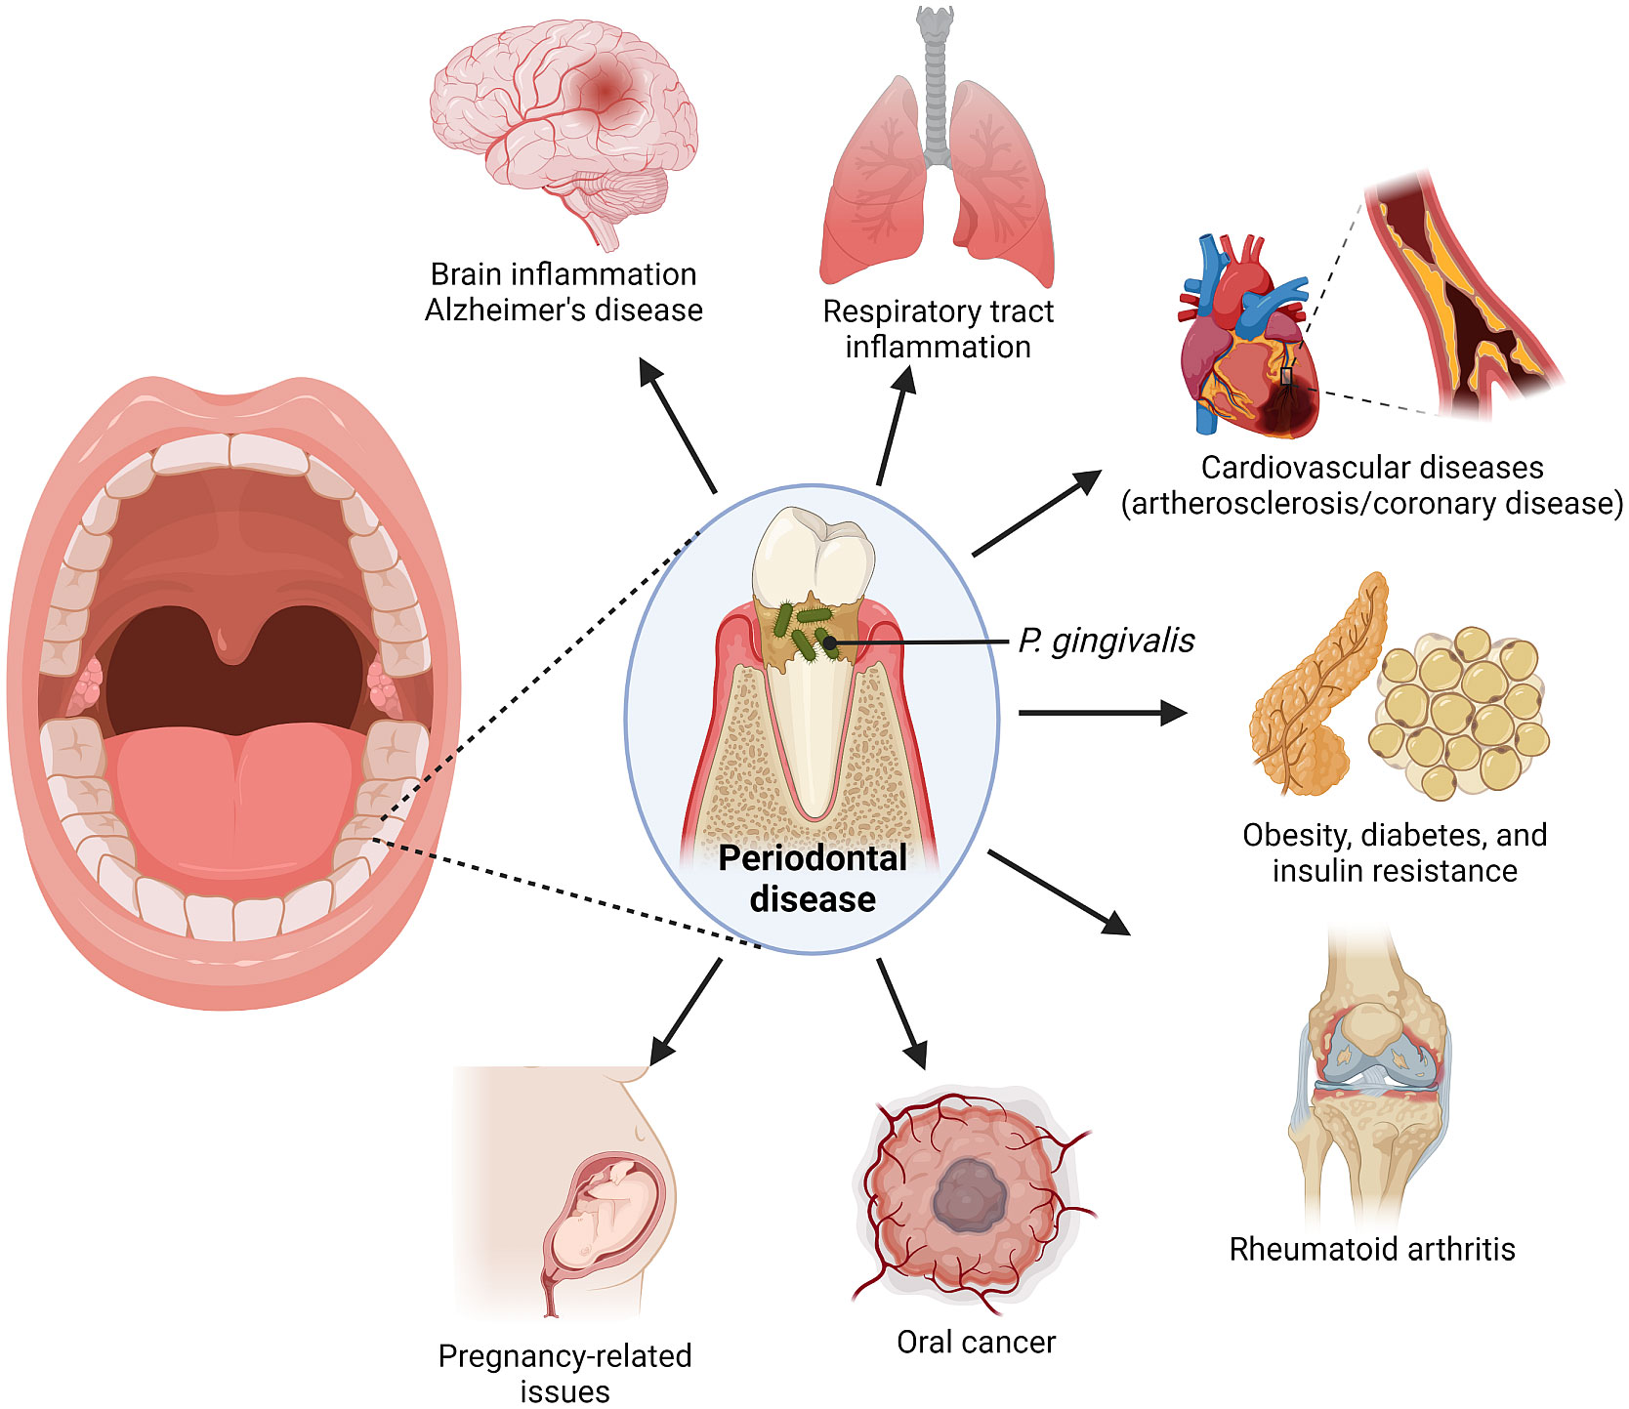
Porphyromonas
Gingivalis and
Human Disease
Effector Mechanisms
P. Gingivalis LPS
Gingipains Release
Citrullination of host proteins
Chow et al. Front. Cell. Infect. Microbiol., 12:1-15, 2022

Slide 13
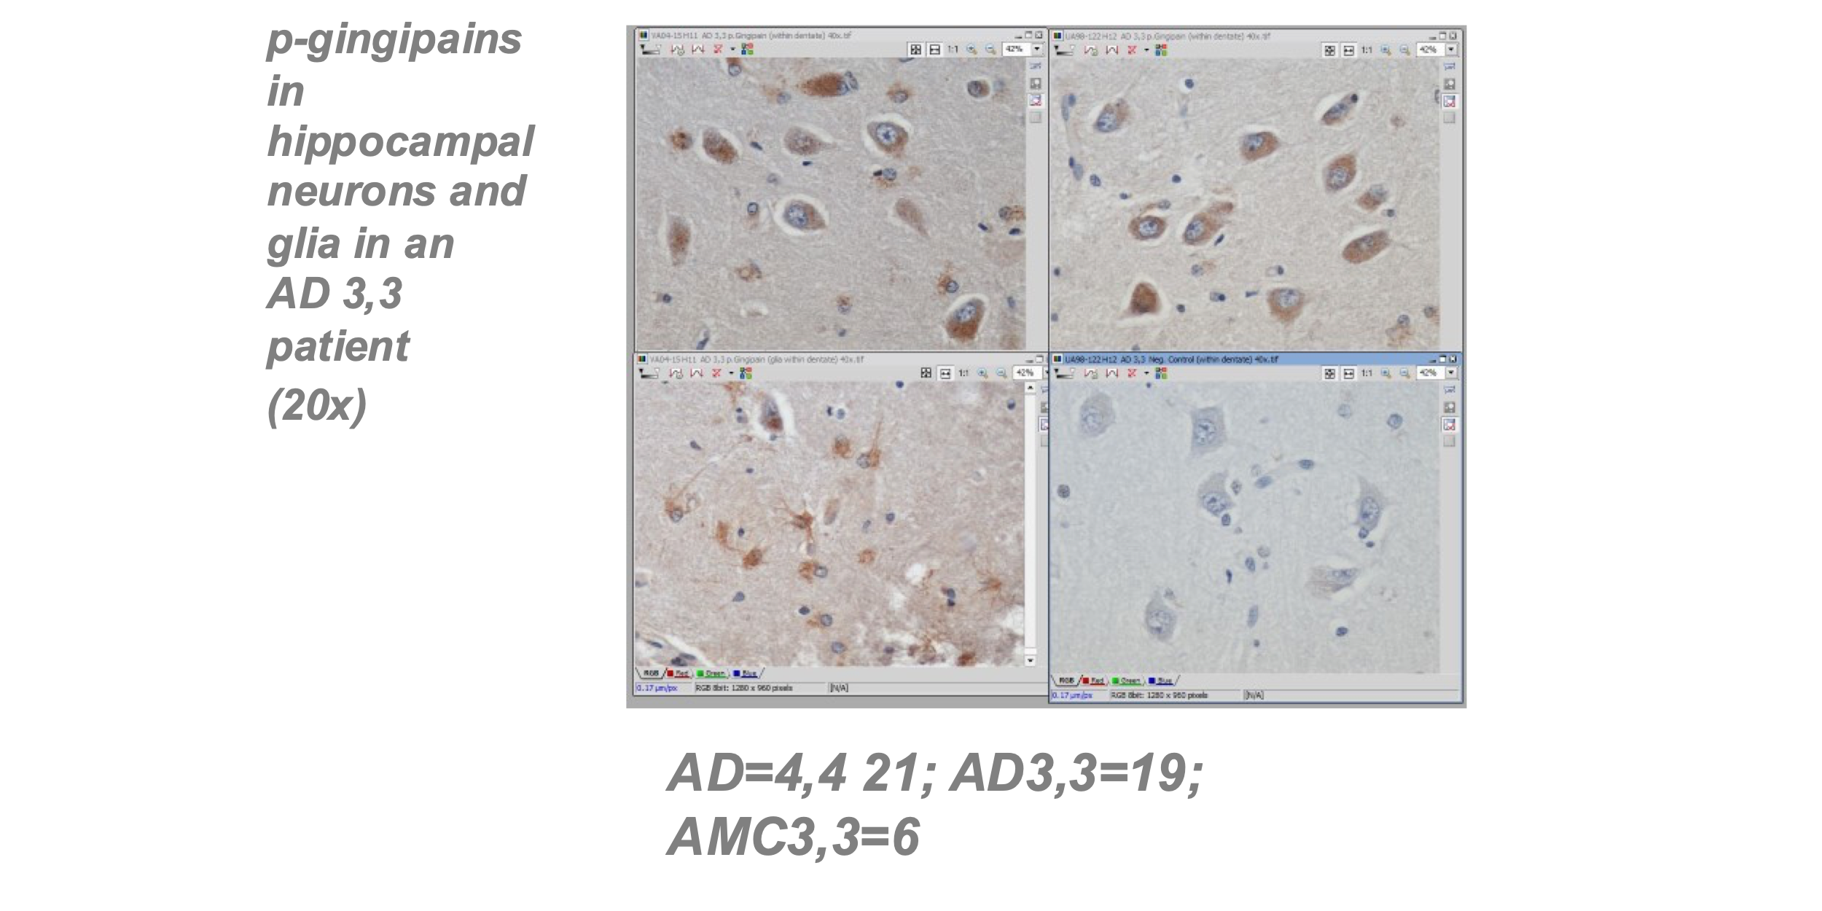
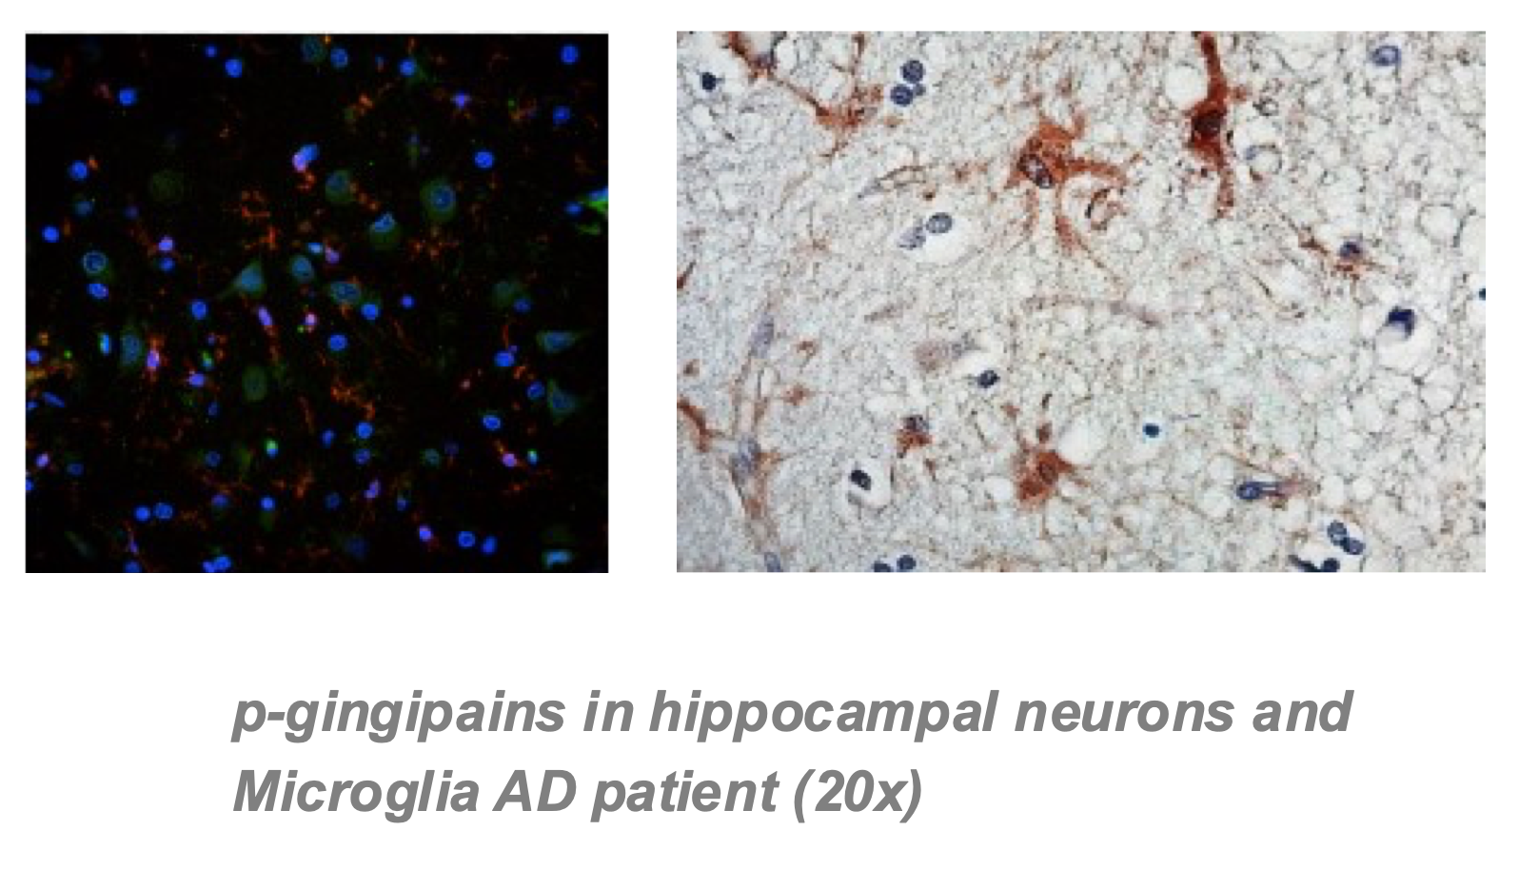
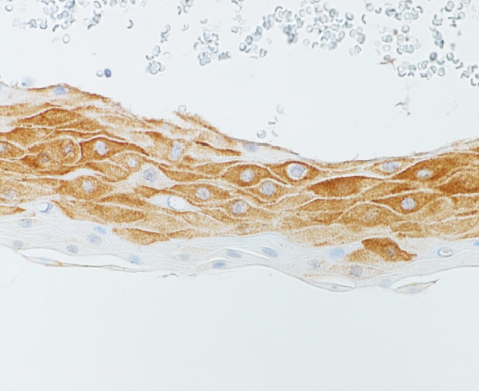
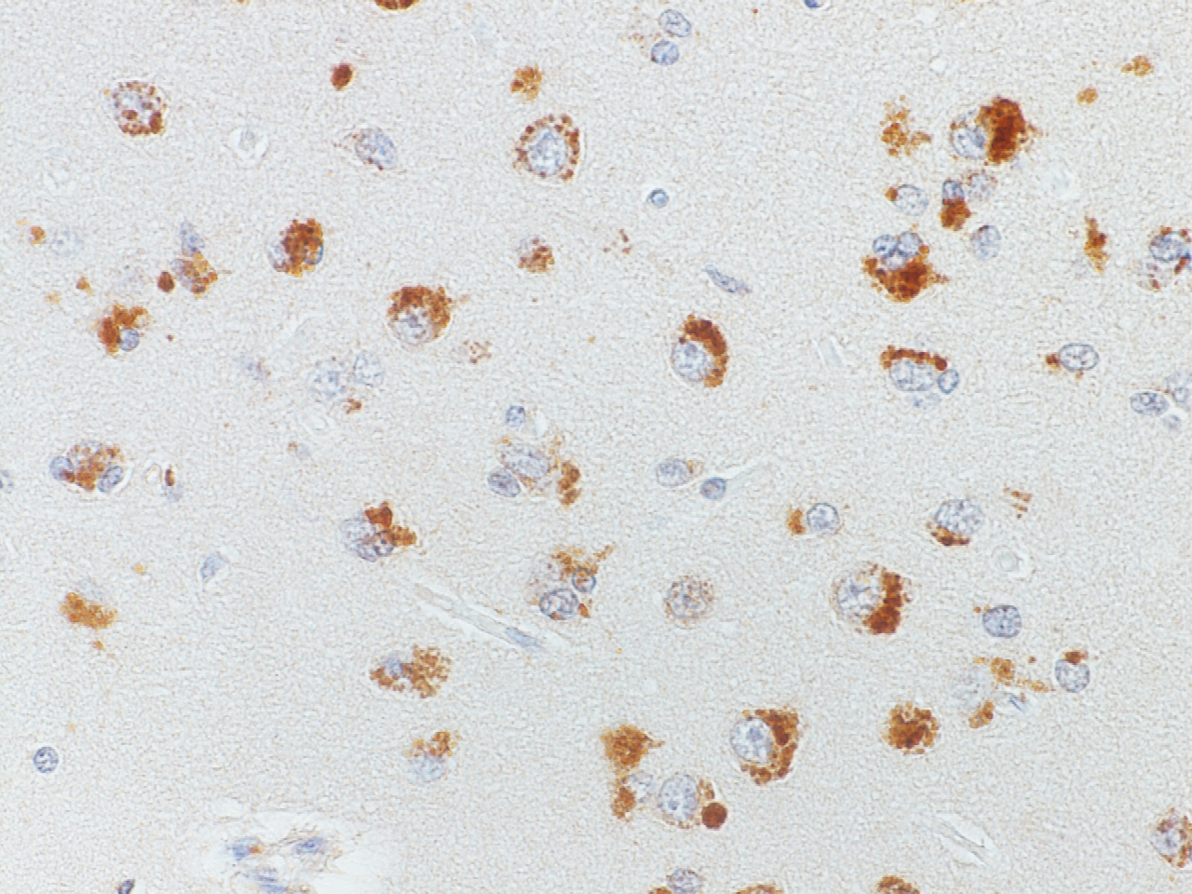
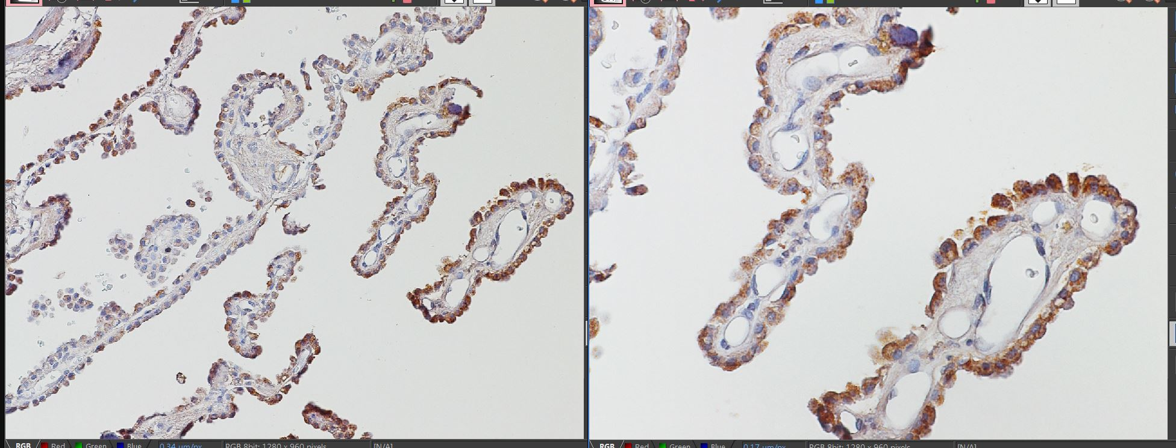
Gingipains in AD brains detected using KB001
Gingipains in Brain Tissue
Gingival Tissue
Frontal Lobe
Choroid Plexus

Slide 14
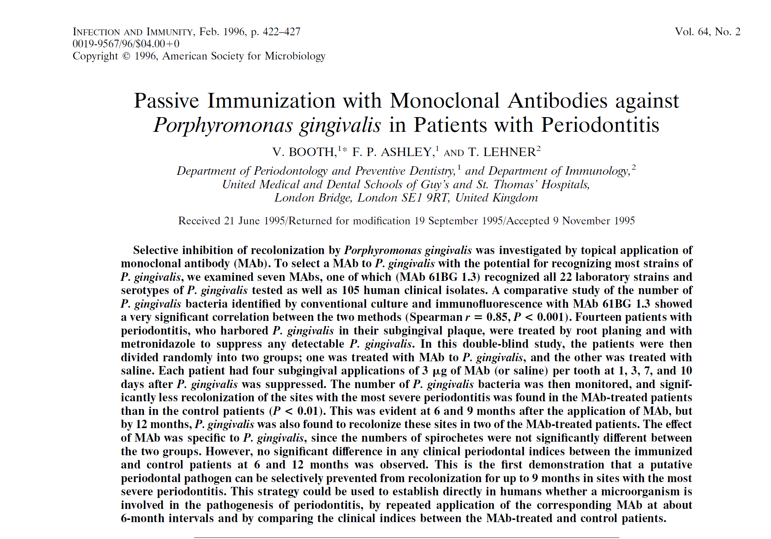
First in man Clinical trial of KB001 Mab.

Slide 15
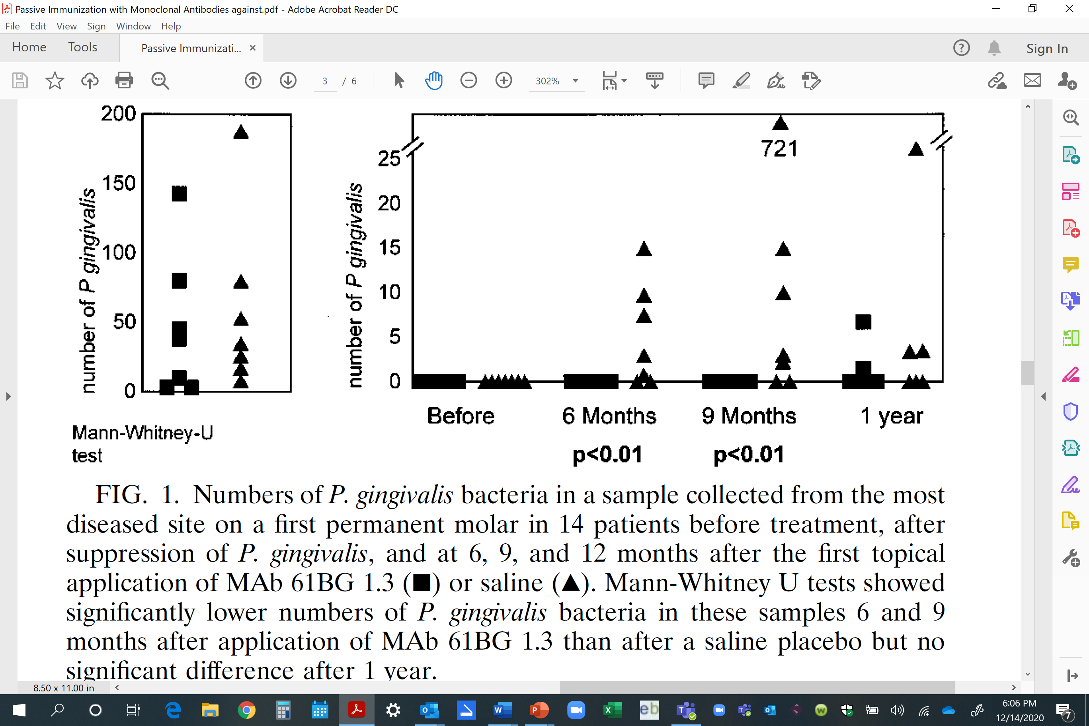
Phase 1 Study of Microbial Efficacy of KB001 against P. gingivalis
After Cleaning
Booth et.al. Infect. Immun. 1996

Slide 16
Study to start in Melbourne, Australia in 2023
A Phase 1/2 Randomized, Double-blinded, Placebo Controlled Study Examining the Effects of Antibody Mediated Oral Clearance of P. gingivalis on Inflammation in Participants with Gingivitis
Dose escalation study with efficacy endpoint of PG at 6 months
Change in inflammatory biomarkers
Periodontal disease

Slide 17
We Also Need Novel Thought and Treatment
Microbiome clearly impacts health and disease
Regenerative medicine offers novel insights and therapeutics

Slide 18
The Problem
In the 1990’s and 2000’s medicine made significant strides in the treatment of acute conditions like heart attack and stroke. This success combined with growing cardiometabolic dysfunction has led to a population of patients with chronic conditions that have significant morbidity and drive health care costs

Slide 19
Solution Evolution
20+ years of findings from studies in regenerative medicine have identified exosomes as a key regulator of tissue remodeling
Stem cells
can repair injured tissue
Paracrine factors repair injured tissue
Exosomes for repair of injured tissue
2000’s
Late 2000’s
2010’s

Slide 20
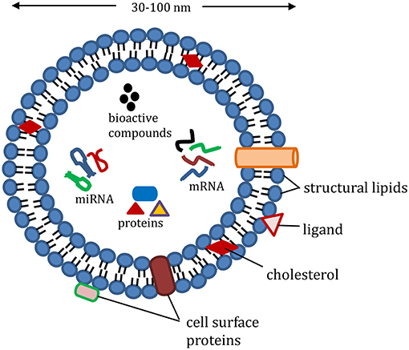
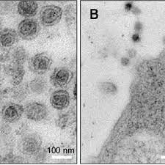
Exosomes
Choi and Mun, Appl. Microsc. 47:171-175, 2017
Akuma et al. Front. Sustain. Food Syst., 3:1-8, 2019

Slide 21
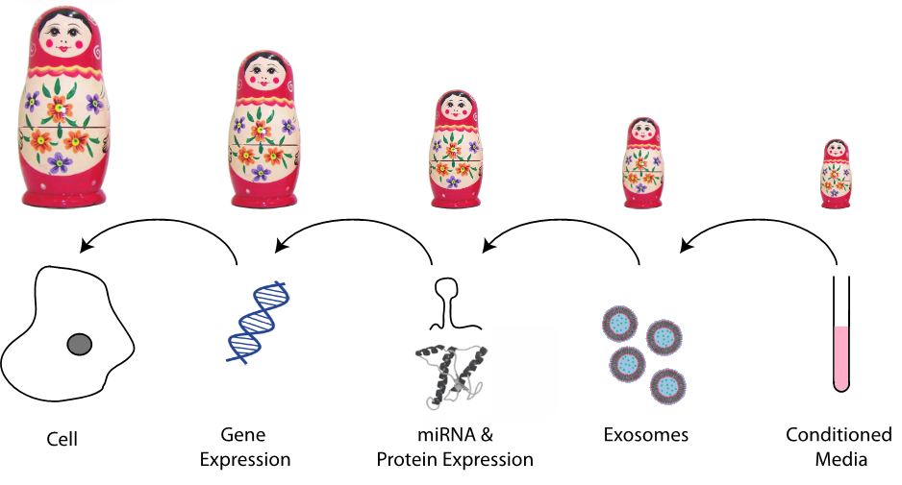
Stem Cell Based Tissue Repair
Penn, MS. The Unraveling of the Matryoshka Doll. Circ Res 120:175-177, 2017

Slide 22
Vectors Drive Exosome Production
Based on work done in the Penn laboratory over the past 20 years it has been determined that the local over-expression of Stromal Cell Derived Factor-1 (SDF-1) or Calcium/calmodulin-dependent protein kinase kinase 1 (CAMKK1) leads to local exosome release.
Hearts treated with exosomes derived from MSC or MSC over-expressing either pSDF-1 or pCAMKK1 at the time of heart attack.
Data are based on improvement in heart function from time of heart attack to 2 weeks later.
Change in
Ejection Fraction (%)
Source of Exosomes

Slide 23

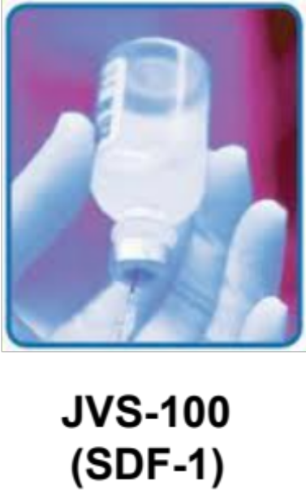
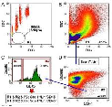
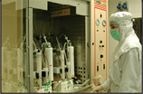
Transforming Process Into Product
Cell Therapy
SDF-1/CAMKK1
Gene Therapy
Tissue Harvest
Cell Selection
The Foment Bio advantage is a safe targeted scalable low COGs gene therapy that induces local exosome release solving the deliver challenge of exosomes as a therapeutic
Expansion

Slide 24
Model of Cardiometabolic Disease
Diabetes induced in C57 mice
using high fat diet
LFD (10 kcal% fat)
HFD (60% kcal% fat)
Notes:
LV function in HFD induced diabetic mice before and following pCMVe hSDF-1 plasmid injection.
C57 mice were randomly assigned to LFD (10 kcal% fat) or HFD (60% kcal% fat) and Serial echocardiography was used to assess cardiac
function. pCMVe hSDF-1 plasmid (80 ug) was injected into the LV wall of half group of the 27-week-old HFD mice. Compare to age-matched
LFD mice, 25-week-old HFD mice showed 40% decrease in EF. The infusion of hSDF-1 plasmid led to a 34% and 45% improvement in EF 1 and 3 week later compared to non-treatment group, respectively. There is early loss of cardiac function in HFD cardiac CXCR4 null mice.

Slide 25
Model of Cardiometabolic Disease

Slide 26
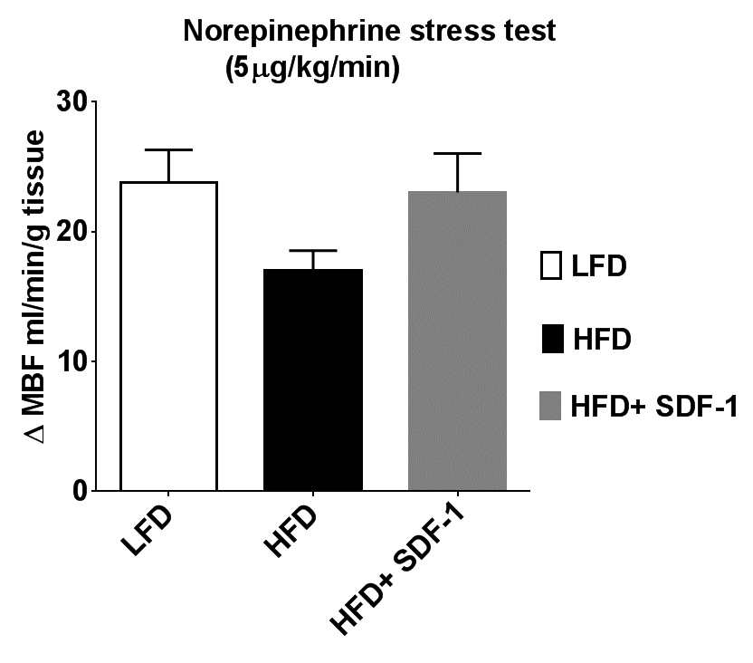
Enhanced Tissue Perfusion
hSDF-1 plasmid
Notes:
LV function in HFD induced diabetic mice before and following pCMVe hSDF-1 plasmid injection.
C57 mice were randomly assigned to LFD (10 kcal% fat) or HFD (60% kcal% fat) and Serial echocardiography was used to assess cardiac
function. pCMVe hSDF-1 plasmid (80 ug) was injected into the LV wall of half group of the 27-week-old HFD mice. Compare to age-matched
LFD mice, 25-week-old HFD mice showed 40% decrease in EF. The infusion of hSDF-1 plasmid led to a 34% and 45% improvement in EF 1 and 3 week later compared to non-treatment group, respectively. There is early loss of cardiac function in HFD cardiac CXCR4 null mice.

Slide 27
Clinical Condition Directly Due to Cardiometabolic Risk
Initial clinical targets for SDF-1 and CAMKK1 plasmid include:
Heart failure 6 million Americans
Chronic Kidney Disease 37 million Americans
Erectile Dysfunction 30 million Americans
Wound healing 0.2 million scar revisions annually

Slide 28
Summary
Systemic inflammation is a marker of loss of health
Lowering systemic inflammation can decrease mortality
The first step to achieving longevity in this era of chronic disease risk is the de-silo’ing of our approach to medicine
P. gingivalis is a key bad actor in the microbiome having multiple down-stream effects on health and GI microbiome
Regenerative techniques will ultimately be cell free, except for those that lead to direct tissue replacement through directed differentiation
Systemic Inflammation,
the Microbiome, Longevity
and Dentistry

