Slide 1
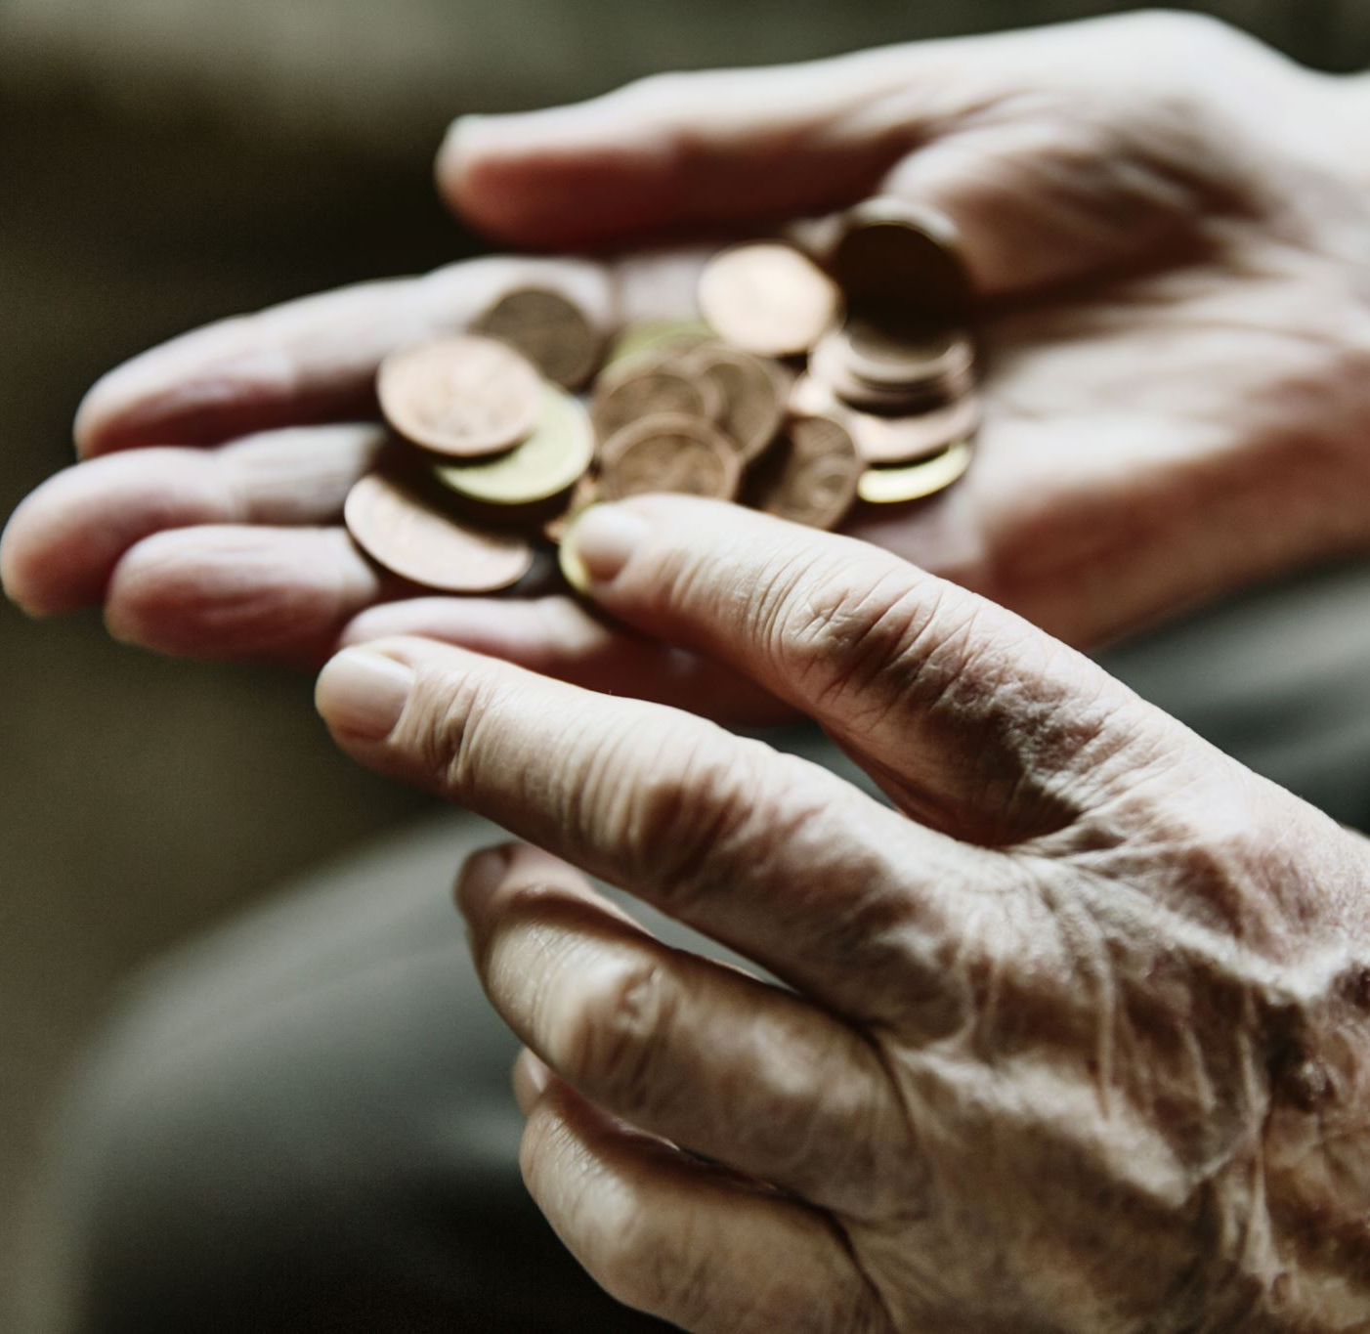
You probably know this already but…
Taking what you learned here today and making significant money is not a guarantee.

Slide 2

The problem is, no one has ever shown you how to monetize what you learned here today

Slide 3

We are going to show you how to add at least $20,000 in new revenue without running any new ads

Slide 4
This is exactly how..
Dr. Marc Pietropaoli has added over $500,000 in sales to his cash practice in the past 6 months.
Dr. Marc Hawass adds $25,000 per month
Dr. Mickey Barber grew her practice by 25% in 90 days
Dr. Nicole Garcia went from one day in her cash practice to buying her competition and 10xing her business.
Larry Seigel, NP funds all of his marketing expense to grow his clinics to multiple locations.
Dr. Kevin Aister paid for the purchase of a clinic
Dr. Kane Lai is able to stay at home and not go into the clinic
Trevor Buccieri took a 2 week cruise vacation with his wife and 3 young kids, never checking into the clinic.
And some guy named Dr. Don Buford .. You may have heard of him…

Slide 5


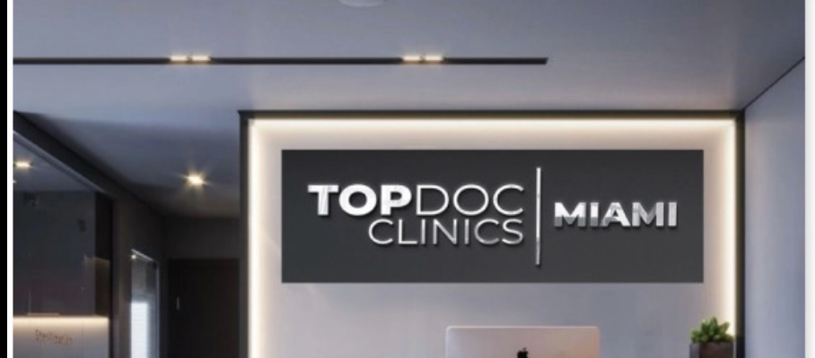





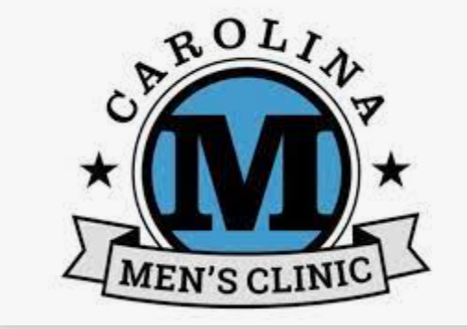

Slide 6
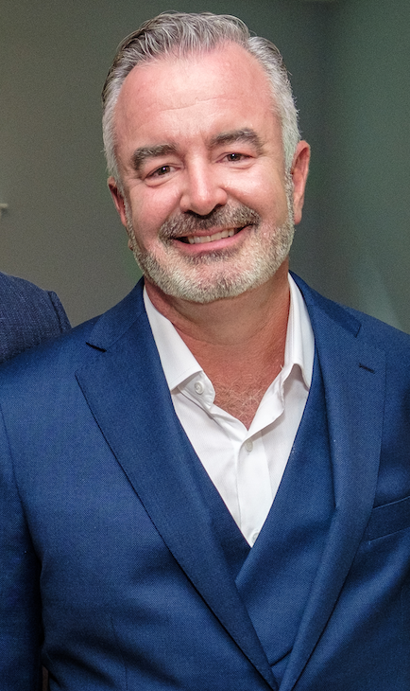
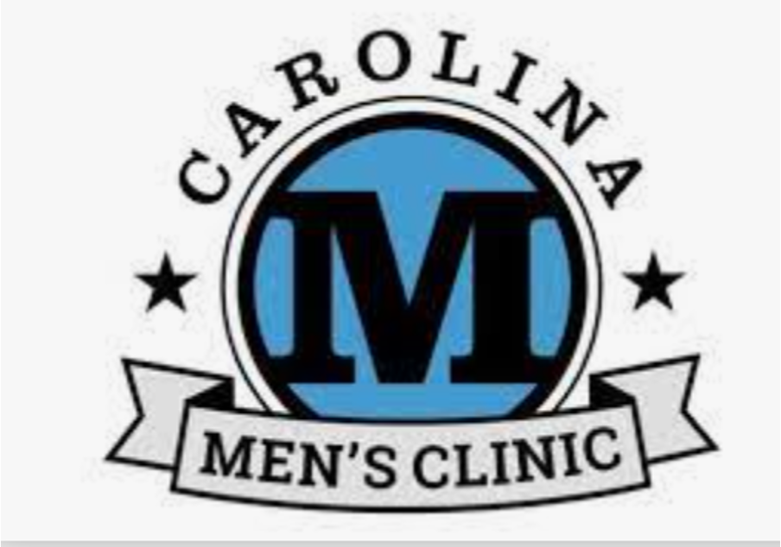
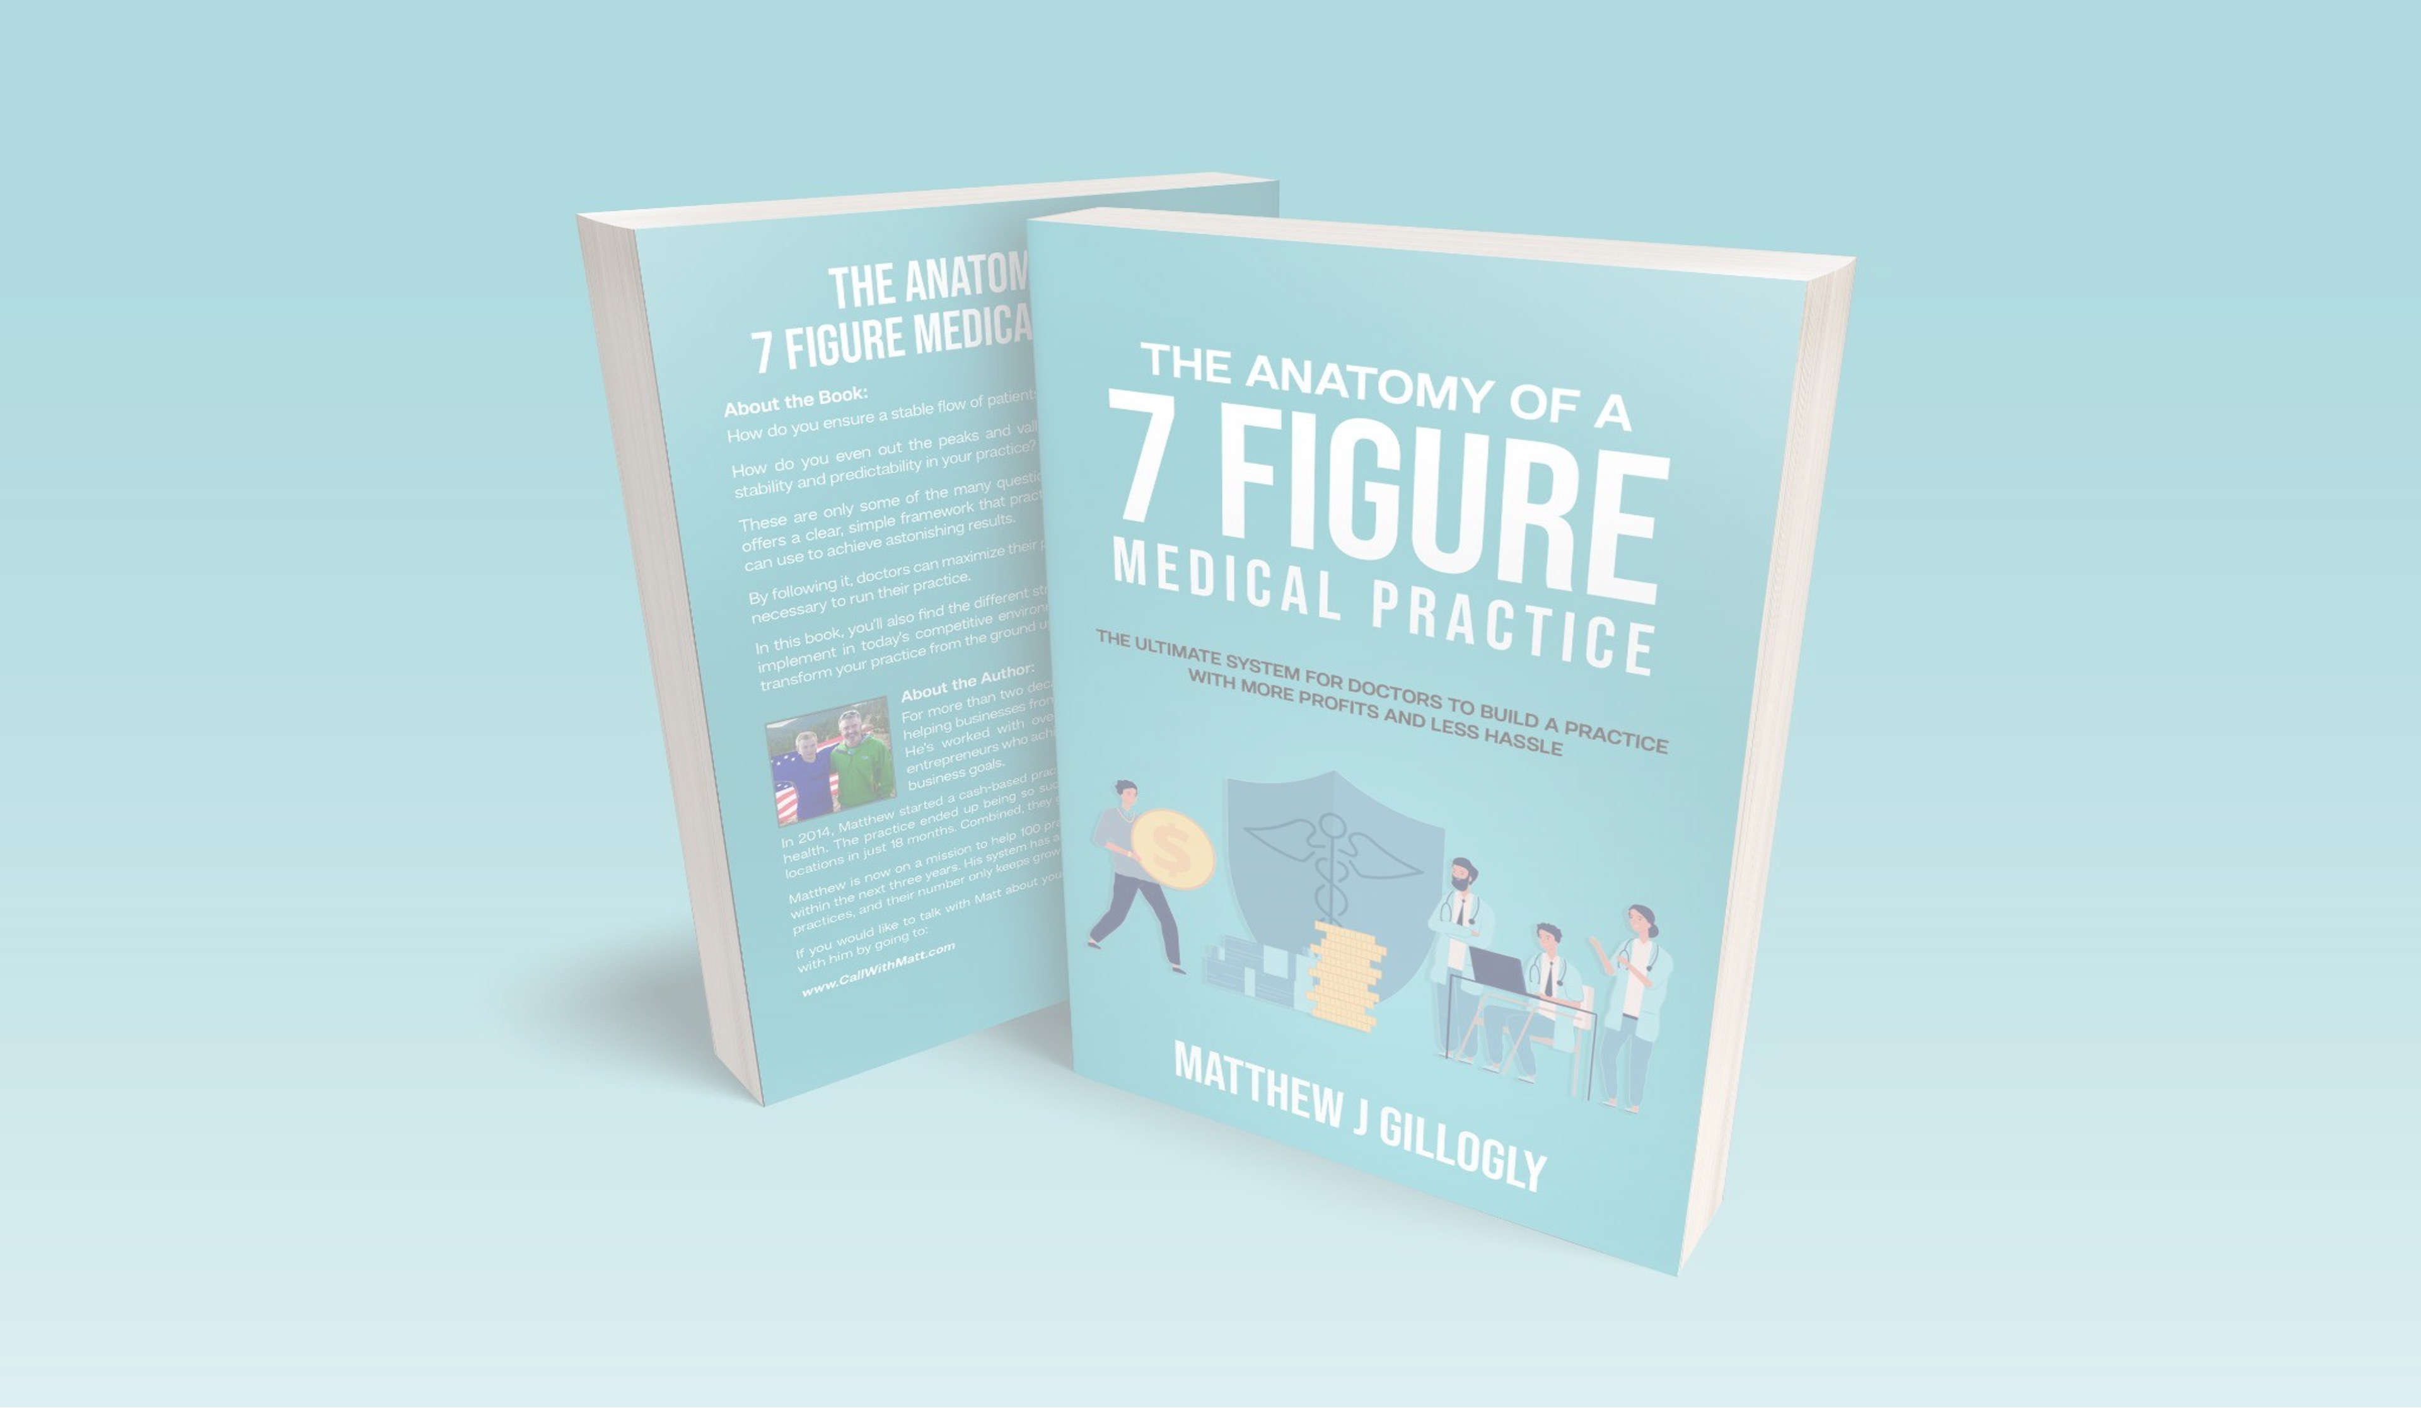
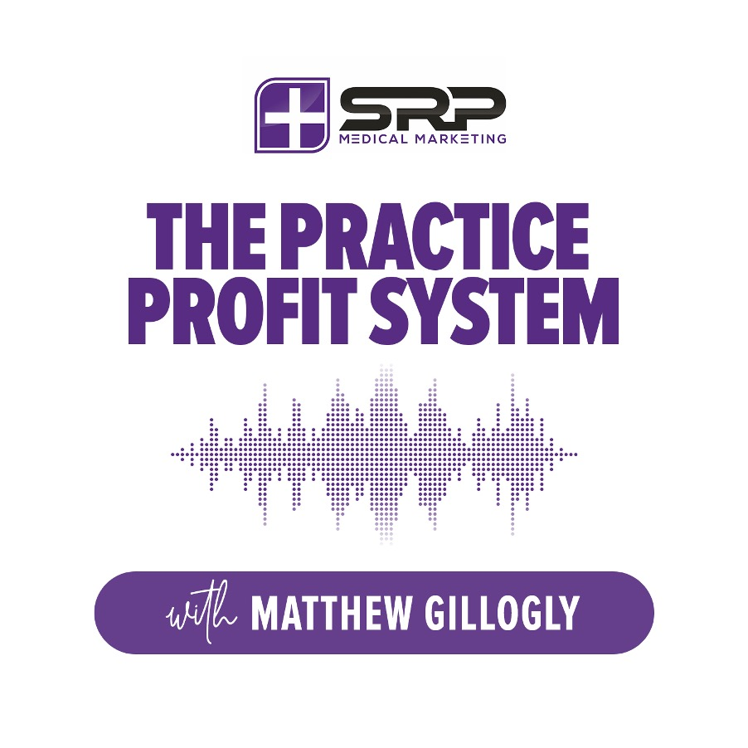
Matthew J Gillogly
Founder and CEO Of The Carolinas Men’s Clinic
Author/Speaker
Podcast Host
Mentor & Investor
Own 7 clinics today.

Slide 7

If You’ve Been Struggling To Grow Your Practice …
This Is Probably Why…

Slide 8

The Doctors Paradox

Slide 9
Medical Skill
10 = Excellent
Struggle
Scale
Business Skill
1 = Poor
Business Skill
10 = Excellent
Bankruptcy
Investigation
Medical Skill
1 = Poor

Slide 10

The Problem Is Most Doctors and Practice Owners…
Don’t charge enough for their services. Thinking they need to be ‘competitive’ with their pricing.
Offer too many services (falsely thinking by doing everything they will make more money)
Sell ‘Ala-Cart’ solutions instead of packages to fix the entire issue.
Invest too much money into machines and medical ‘trainings’
Do NOT have a system to grow, scale and exit their business

Slide 11

That problem is solved with what I call …
The 4 Day Cash Machine..

Slide 12

You will LOVE this solution because…
You will not need to hire another agency.
Run cruddy Facebook ads and get leads that don’t respond or show.
Discount your prices to compete with your competition
You will spend ZERO dollar on advertising or marketing
It doesn’t require you to become a sales expert
You can start running it immediately
Getting you patients who are ready to BUY

Slide 13
It is used in our clinics today that we own in…

Slide 14

New York, Florida, Nevada, Texas, Colorado, Arizona and California.

Slide 15

It works for our clients in places like..

Slide 16

Billings, Montana,
Manhattan, NY
Jackson, Tennessee,
Rochester Hills, MI
Washington DC,
Buffalo, NY
Dallas, TX
South Atlanta and more

Slide 17

It works if you have a list of patients who are mostly Medicare and Medicaid

Slide 18

Step #1 – Target A Small Portion Of Your Existing Patients and Prospects

Slide 19
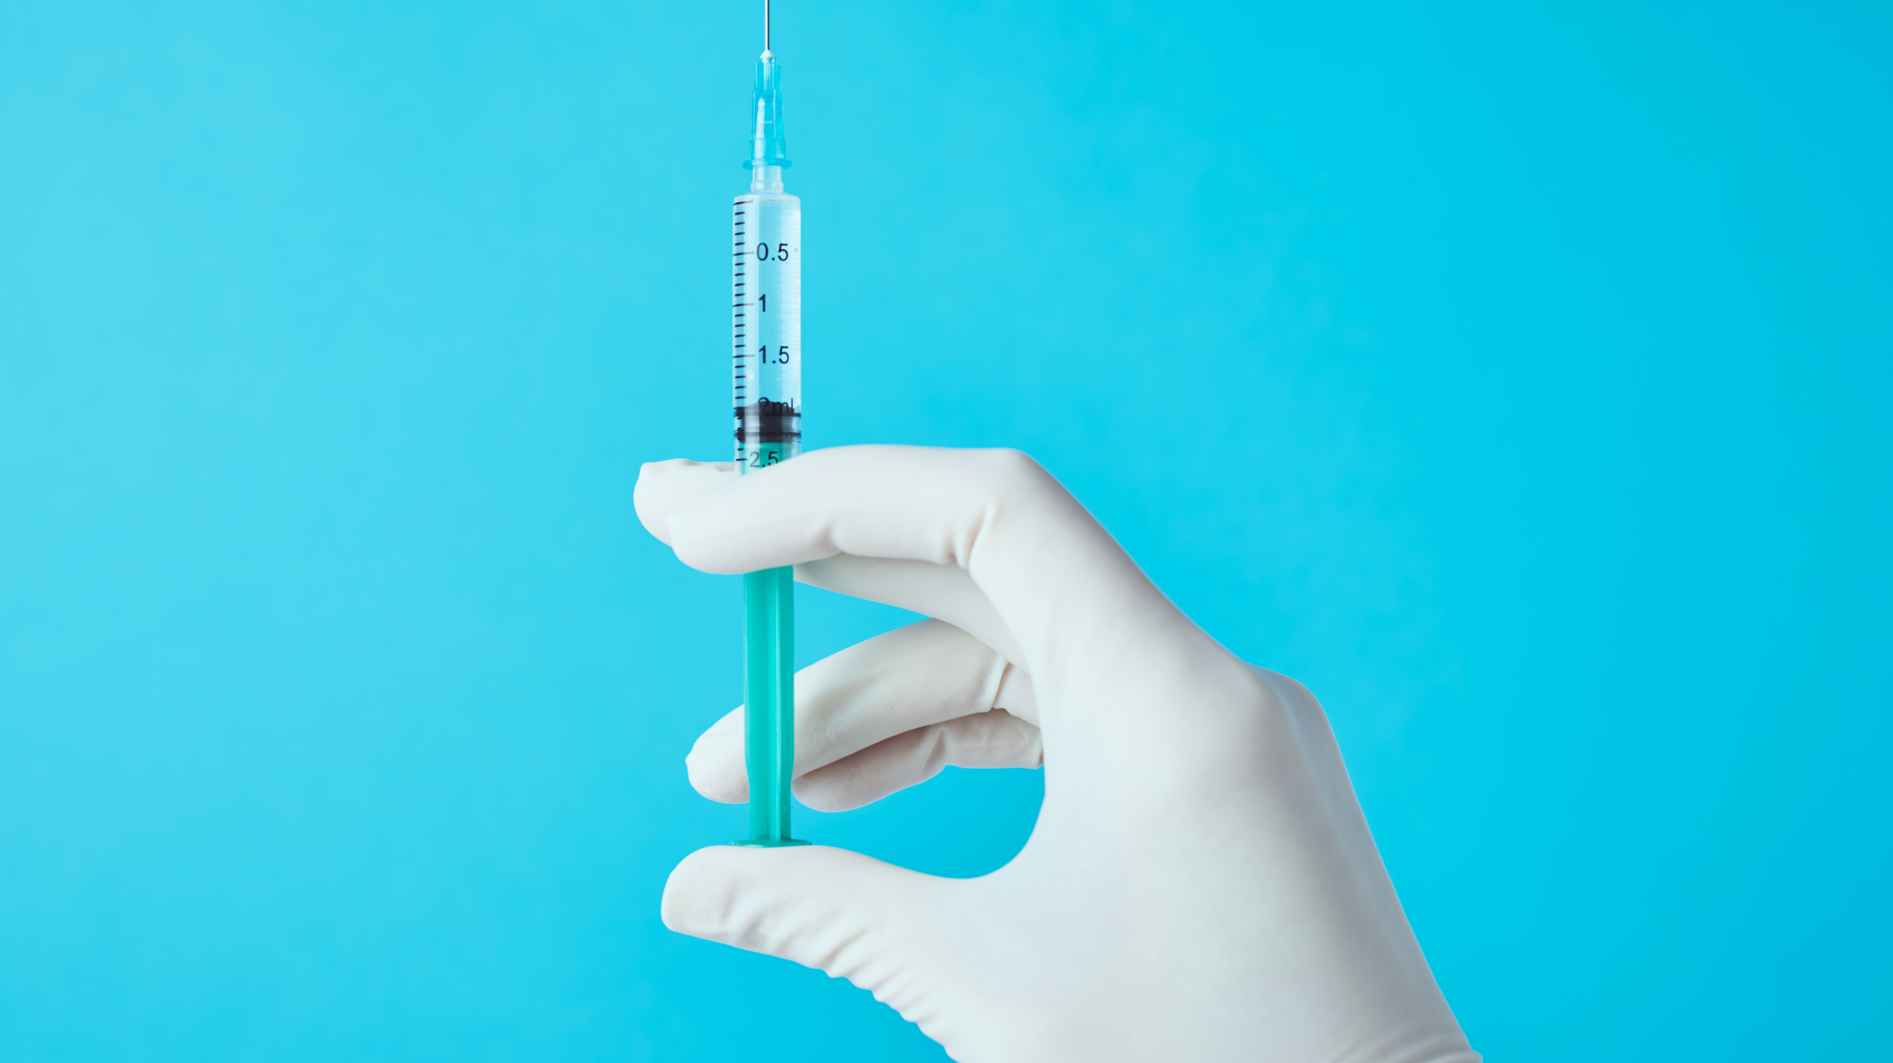
The P Shot Problem

Slide 20
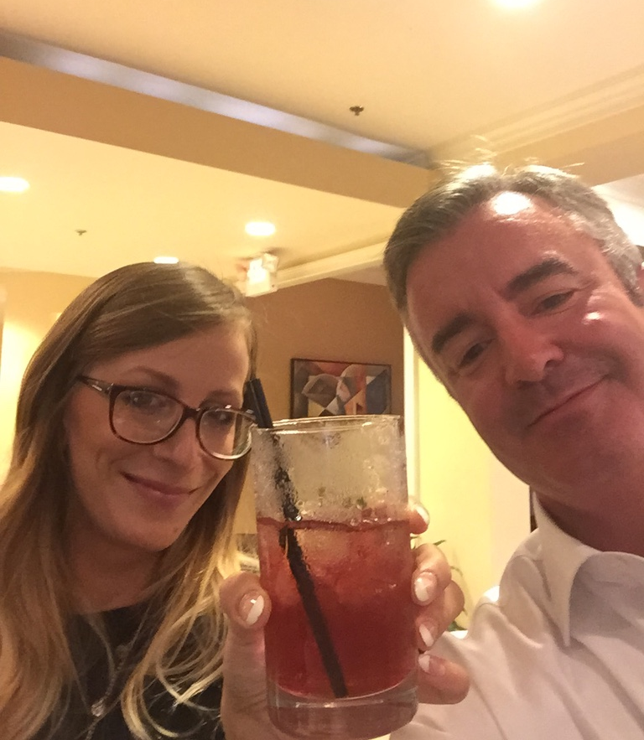
Launching A New Procedure At Our Clinic
Sent 1200 emails
55 inquires
Closed 22 patients at $1,500 each
Total revenue collected BEFORE we did our first procedure
$33,000

Slide 21
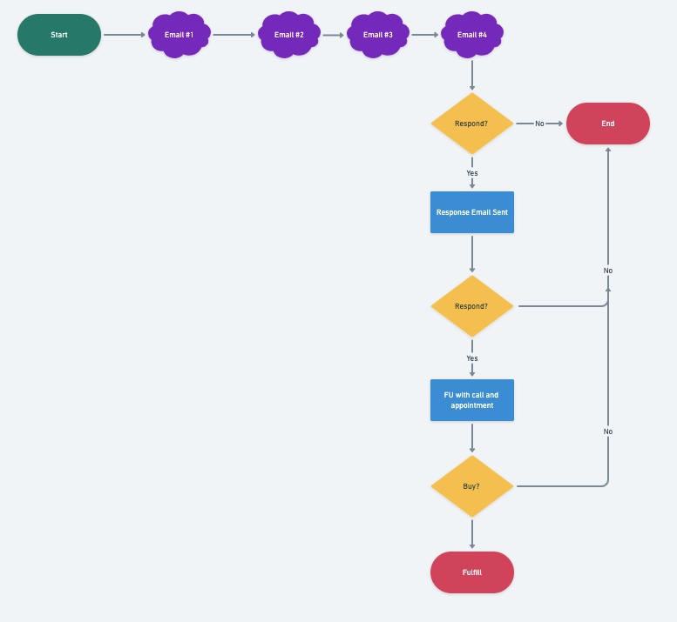
The 4 Day Cash Machine….

Slide 22
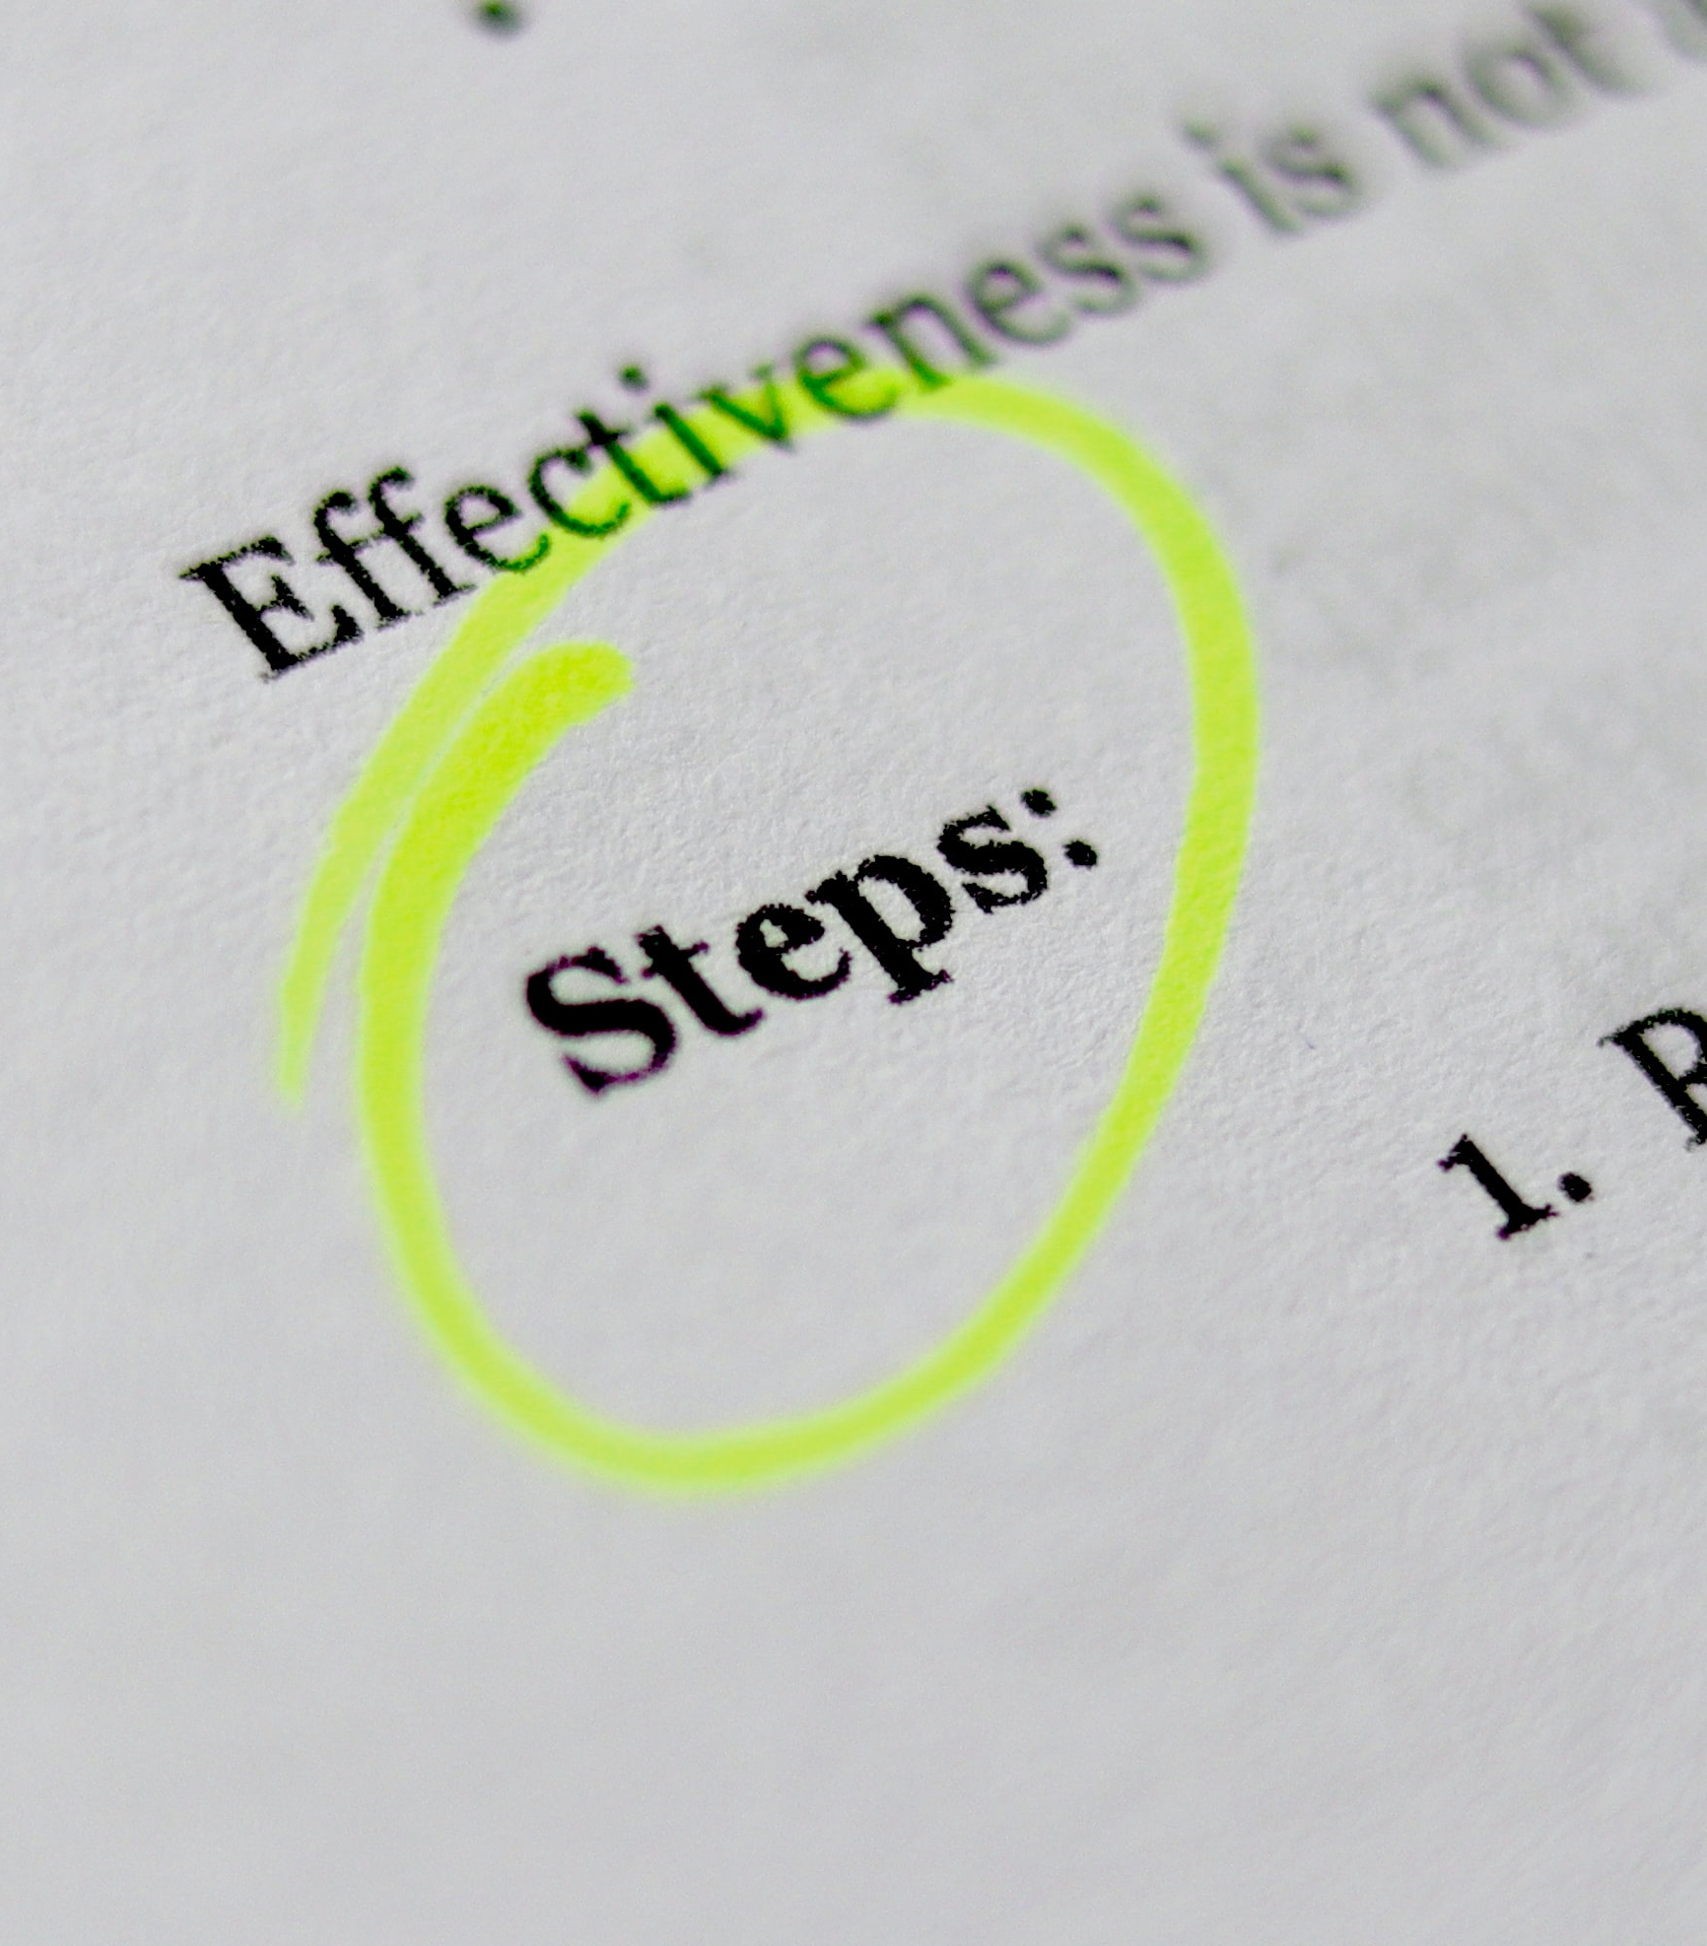
Step 2: Use Proven Emails And Scripting

Slide 23

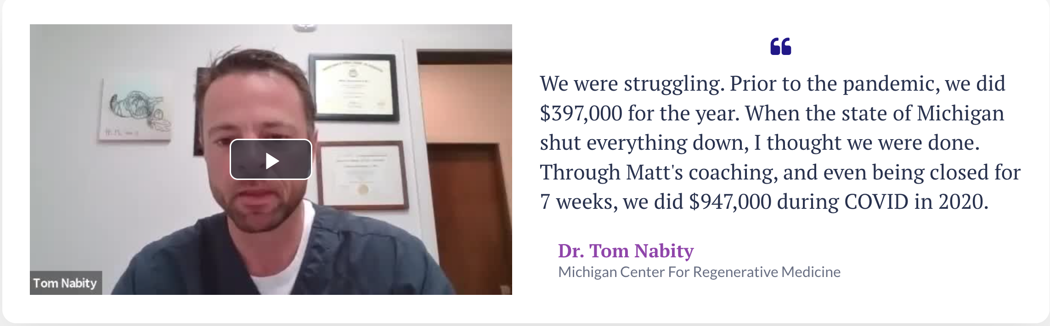
Dr. Tom Nabity

Slide 24
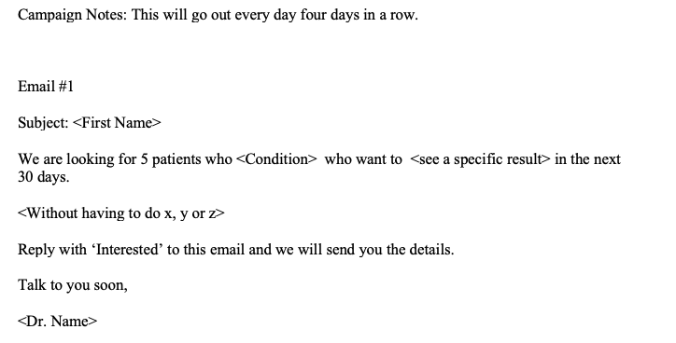
Email #1 - #4

Slide 25
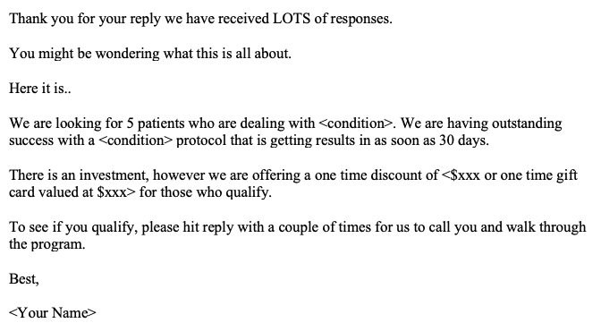
Response email

Slide 26
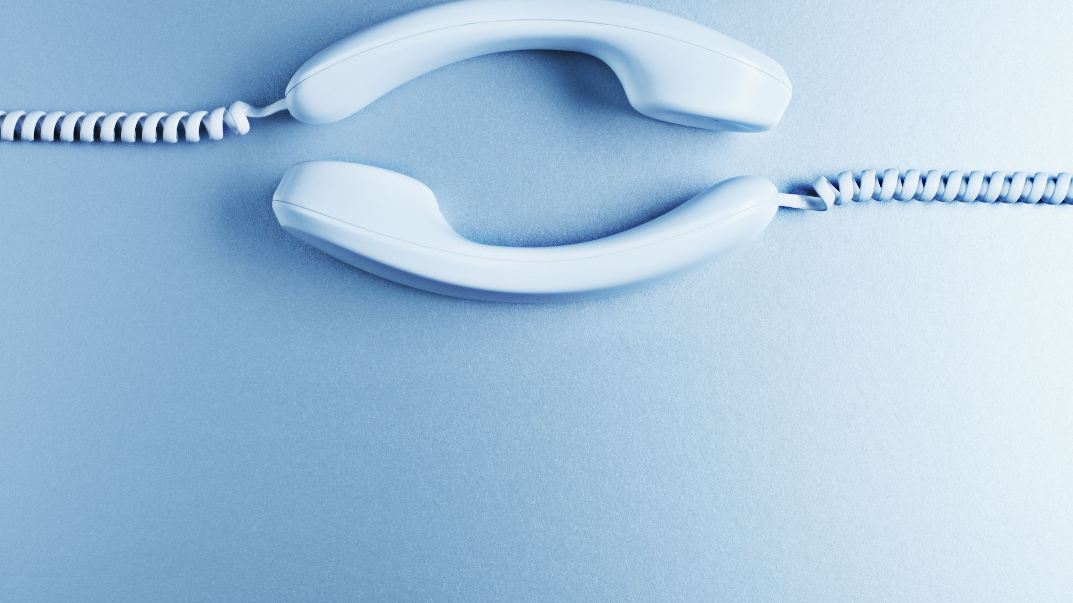
Inbound Call Scripts

Slide 27

Do you have a script that you follow when making an offer to a prospect?

Slide 28

Big Money Script

Slide 29

Dr. Mark Hawass Toronto, Canada
“Our average price per package is in excess of $8,300. Last Friday alone, we had an 80% conversion rate on new patients to treatment and we made over $40,000.

Slide 30
Dr. Mark Hawass Toronto, Canada
He works 6 days a month in his clinic.
His staff is there 5 days a week, treating patients, answering calls.
Dr. Hawass comes in for new patients consults and PRP injections.

Slide 31
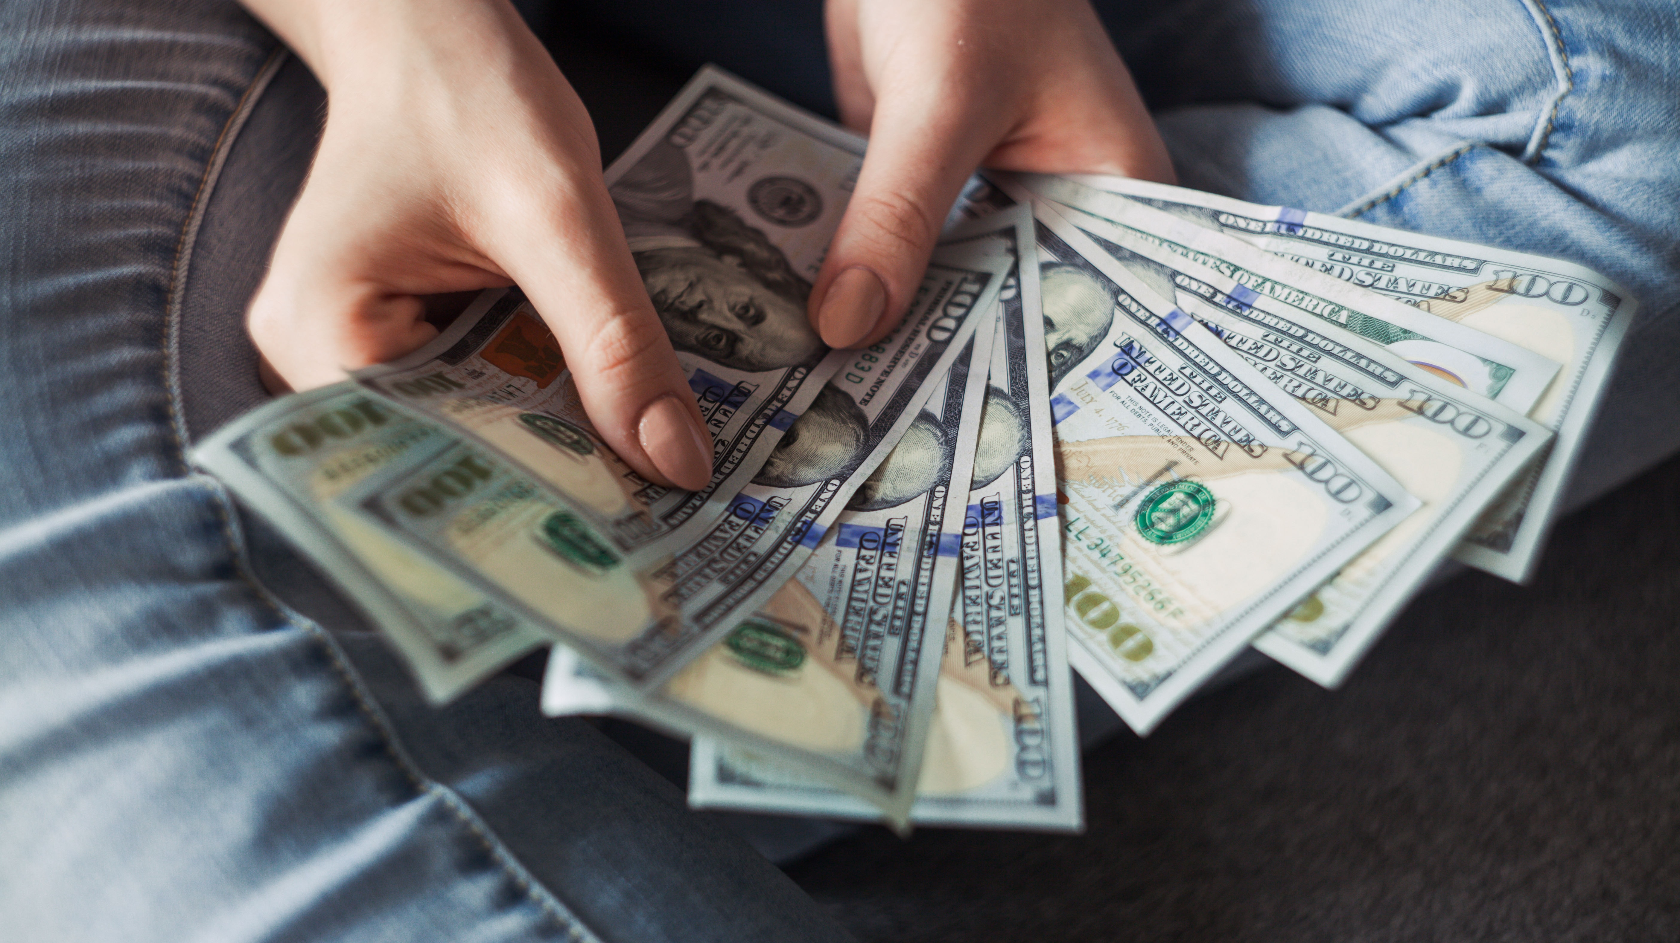
Step 3: Create Premium Pricing

Slide 32

You do this by creating a…
Signature Solution

Slide 33
Signature Solution Vs. Selling A Procedure
Charge premium prices
The patient comes in ready to buy
Work less, make more
Known for one thing in the market
Low overhead, low stress
Focused on the relationship
Sell on price
Endless follow up and phone selling
Seeing an endless flow of patient, taking no time off, wondering where all the money went.
Nobody can explain what you do
Countless machines, high fixed costs, constant stress
Always focused on the transaction

Slide 34
What is a signature solution?
Dream Outcome
Most Pressing Problem
The Hidden Pain

Slide 35
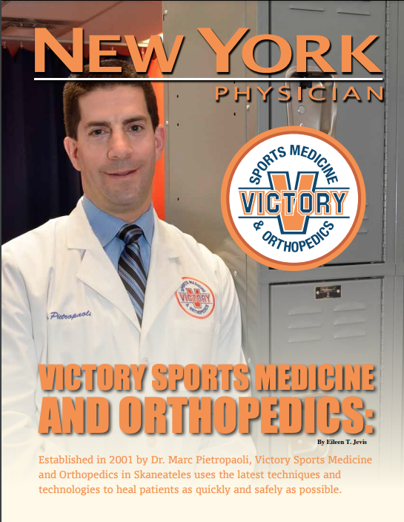
Dr. Marc Pietropaoli – Skaneateles, NY
Orthopedic Surgeon For 20 Plus Years
Falling Reimbursement Rates
Costs Going Through The Roof
Small Market

Slide 36
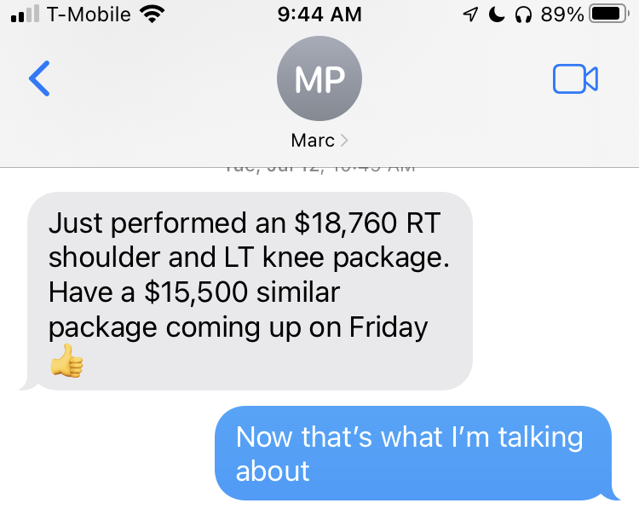
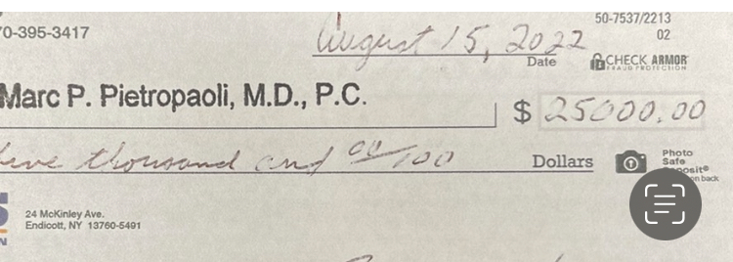
600 names
60 inquires
12 appointments
$59,260 in cash revenue

Slide 37
The 4 Day Cash Machine….

Slide 38

What Is Next?
Starting On Monday April 24th at
7 PM Eastern, we have another
‘4 Day Challenge’.
This is FREE and you can learn the entire process.

Slide 39
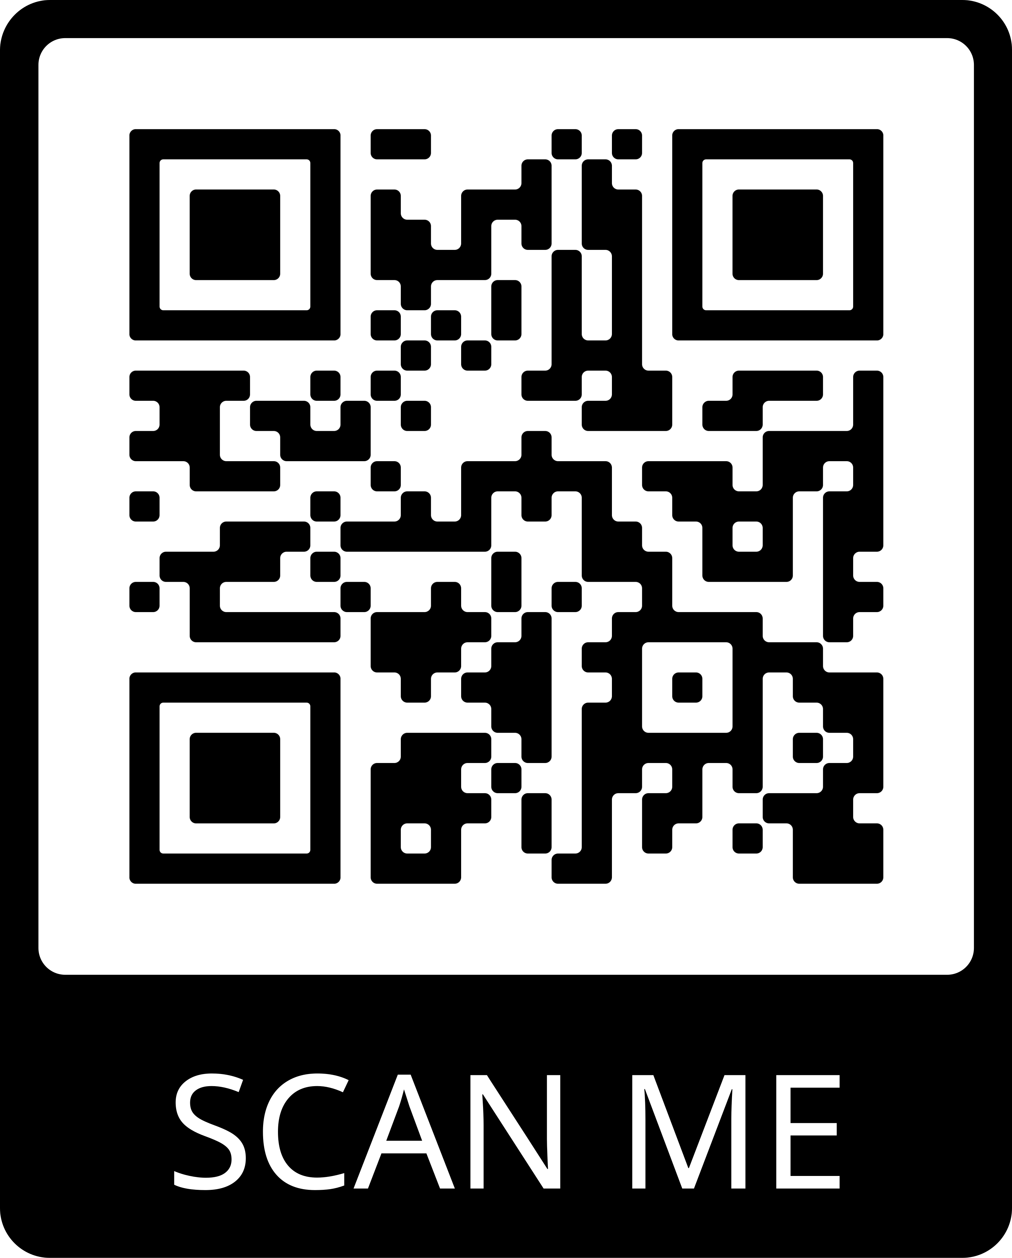

Scan This Code Or… www.ThePracticeProfitSystem.com/4Day

Slide 40

www.ThePracticeProfitSystem.com/4Day

