Slide 1
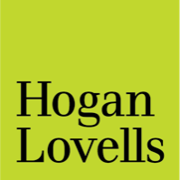

Strategies for Expediting Access to Regenerative Medicines and Wellness Products
Mike Druckman, Partner
Sally Gu, Senior Associate
April 18, 2023

Slide 2

US FDA Regulatory Framework
In the US, FDA regulates:
  Human drugs and biological products
    Tissue products
    Cellular therapies
    Gene therapies
    Blood and vaccines
    Therapeutic proteins
  Medical devices
  Animal drugs
  Food, dietary supplements, cosmetics, tobacco

Slide 3
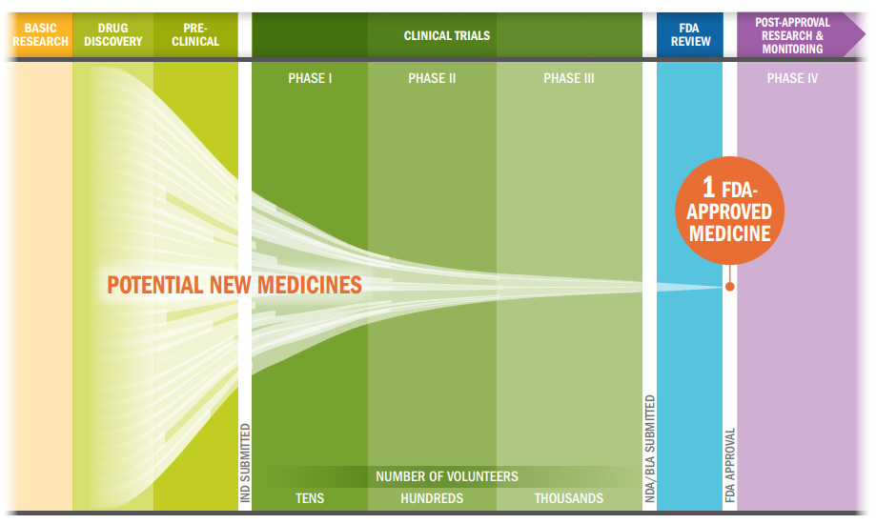
Development Process for Biologics
Pre-IND development – animal and non-clinical studies
Clinical trials – testing human use under an IND
Biologics License Application (BLA) review process
Post-approval compliance requirements
The average cost of researching and developing a successful drug is estimated to be $2.6 billion and take > 10 years
Hogan Lovells
| 3
Notes:
Infographic is from PhRMA: http://phrma-docs.phrma.org/sites/default/files/pdf/rd_brochure_022307.pdf

Slide 4
Strategies for Expediting Regenerative Medicine Development
Expedited program designations: increased interactions with and support from FDA throughout the development process
  E.g., Regenerative Medicine Advanced Therapy (RMAT) designation, Breakthrough Therapy Designation
Alternative forms of obtaining data: collecting high-quality data outside of traditional, lengthy, and expensive randomized clinical trials
  E.g., real-world data, investigator-initiated studies, foreign trials, scientific literature
Alternative pathways to biologics approval: shortcuts clinical trial time (but comes with additional post-approval requirements)
  E.g., accelerated approval pathway

Slide 5
Considerations for Choosing a Regulatory Pathway
Pre-approval requirements
Cost/time of development program
Manufacturing requirements
Advertising, promotion, labeling
Pricing, coverage and reimbursement
Ex-US markets
Notes:
Statistic comes from PhRMA and BIO reports: http://phrma-docs.phrma.org/sites/default/files/pdf/rd_brochure_022307.pdf; https://www.bio.org/blogs/how-long-does-it-take-get-drug-approved

Slide 6
Alternative Pathways to Market for Regenerative Products
Exceptions to full panoply of biologics regulation
  “361 HCT/P” exception
  “Expanded access”
Regulation as a device
  510(k) exemptions
  “General wellness” exception
Regulation as a food/dietary supplement or cosmetic
Ex-US market

Slide 7

Questions?

Slide 8

www.hoganlovells.com
"Hogan Lovells" or the "firm" is an international legal practice that includes Hogan Lovells International LLP, Hogan Lovells US LLP and their affiliated businesses.
The word "partner" is used to describe a partner or member of Hogan Lovells International LLP, Hogan Lovells US LLP or any of their affiliated entities or any employee or consultant with equivalent standing. Certain individuals, who are designated as partners, but who are not members of Hogan Lovells International LLP, do not hold qualifications equivalent to members.
For more information about Hogan Lovells, the partners and their qualifications, see www.hoganlovells.com.
Where case studies are included, results achieved do not guarantee similar outcomes for other clients. Attorney advertising. Images of people may feature current or former lawyers and employees at Hogan Lovells or models not connected with the firm.
© Hogan Lovells 2023. All rights reserved.

