Slide 1


WWW.HEALINCSUMMIT.COM | (347) 844-3076
www.mimansa.co

Slide 2



LONGEVITY
& INTEGRATIVE MEDICINE
By Dr. Mima MD MS IFMCP
CEO, Founder of Mimansa
WWW.HEALINCSUMMIT.COM | (347) 844-3076
www.mimansa.co

Slide 3

WHAT ARE
THE MAIN PILLARS
OF LONGEVITY
WWW.HEALINCSUMMIT.COM | (347) 844-3076
www.mimansa.co

Slide 4





MOVE
RIGHT
OUTLOOK
EAT
WISELY
CONNECT
WWW.HEALINCSUMMIT.COM | (347) 844-3076
www.mimansa.co

Slide 5


WHAT ELSE DO WE NEED TO INCLUDE?
WWW.HEALINCSUMMIT.COM | (347) 844-3076
www.mimansa.co

Slide 6
MOVE
RIGHT
OUTLOOK
DETOXIFICATION
EAT
WISELY
CONNECT
WWW.HEALINCSUMMIT.COM | (347) 844-3076
www.mimansa.co

Slide 7

WHAT IS TOXIC BURDEN?
WWW.HEALINCSUMMIT.COM | (347) 844-3076
www.mimansa.co

Slide 8



THE GLASS THEORY
How full is your glass?
Are you draining it faster than it's filling up?
Mold
Trauma
Radiation
Parasites
Pesticides
Allergens
Stress
Bacteria
Heavy Metals
Limiting Beliefs
WWW.HEALINCSUMMIT.COM | (347) 844-3076
www.mimansa.co

Slide 9




ACCELERATED AGING
Chronic Disease,
Cancer, Mortality
WWW.HEALINCSUMMIT.COM | (347) 844-3076
www.mimansa.co

Slide 10


The future of health care includes prevention through home care
WWW.HEALINCSUMMIT.COM | (347) 844-3076
www.mimansa.co

Slide 11

How Integrative Medicine Fits in a longevity-based healthcare model
WWW.HEALINCSUMMIT.COM | (347) 844-3076
www.mimansa.co

Slide 12



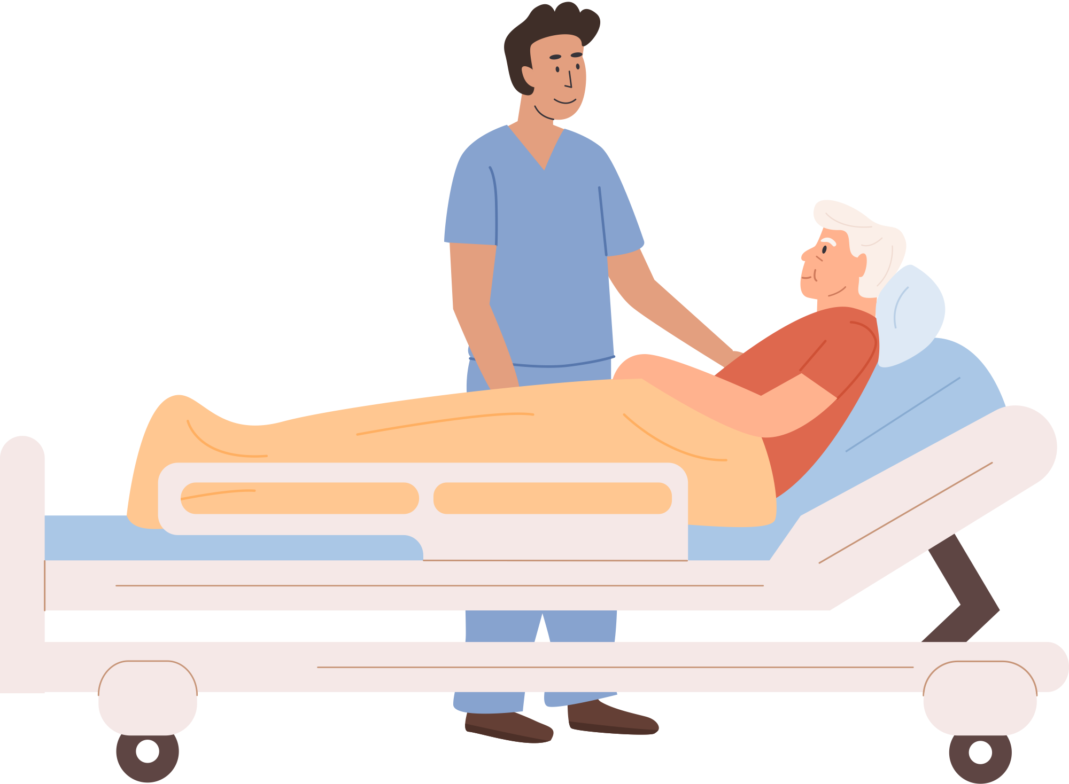

Contribution to extension of healthy life expectancy and health longevity society
EARLY
PREVENTION
PREVENTION OF WORSENING OF HEALTH PROBLEMS
HEALTH CHANGES DUE TO AGING
EARLY PREVENTION
IMPROVEMENT OF QUALITY OF LIFE
INDEPENDENT
LIVING
LONG-TERM
CARE
WWW.HEALINCSUMMIT.COM | (347) 844-3076
www.mimansa.co

Slide 13


What we can
learn from the
Blue Zones
WWW.HEALINCSUMMIT.COM | (347) 844-3076
www.mimansa.co

Slide 14

The Blue Zone
WWW.HEALINCSUMMIT.COM | (347) 844-3076
www.mimansa.co

Slide 15

Proven Practices to Improve Healthspan and Lifespan
WWW.HEALINCSUMMIT.COM | (347) 844-3076
www.mimansa.co

Slide 16

WWW.HEALINCSUMMIT.COM | (347) 844-3076
www.mimansa.co

Slide 17


How we can modify our toxic zones
WWW.HEALINCSUMMIT.COM | (347) 844-3076
www.mimansa.co

Slide 18
Creating a Balanced Longevity Healthcare System that Includes the Earth
WWW.HEALINCSUMMIT.COM | (347) 844-3076
www.mimansa.co

Slide 19

GOOD FOR YOU AND GOOD FOR THE EARTH
WWW.HEALINCSUMMIT.COM | (347) 844-3076
www.mimansa.co

