Slide 1





Immunoaging in Regenerative Medicines: Cost-Effective Technology
Pranela Rameshwar, Ph.D.
Professor, Dept of Medicine, Hematology/Oncology
www.healincsummit.com | (347) 844-3076

Slide 2

Presentation Structure
Why immune aging might not be druggable
  Complexity of the Hematopoietic System
    Neural-Hematopoieitc axis
    Microenvironment
      Mesenchymal Stem Cells
Hematopoietic/Immune Aging
  Clonal emergence
  Undiagnosed cancer
Research in the Lab
Translation in the Bahamas:
  Model of Academia-Bahamian initiative
Future
www.healincsummit.com

Slide 3
Complex Hematopoietic System
Significance
www.healincsummit.com

Slide 4
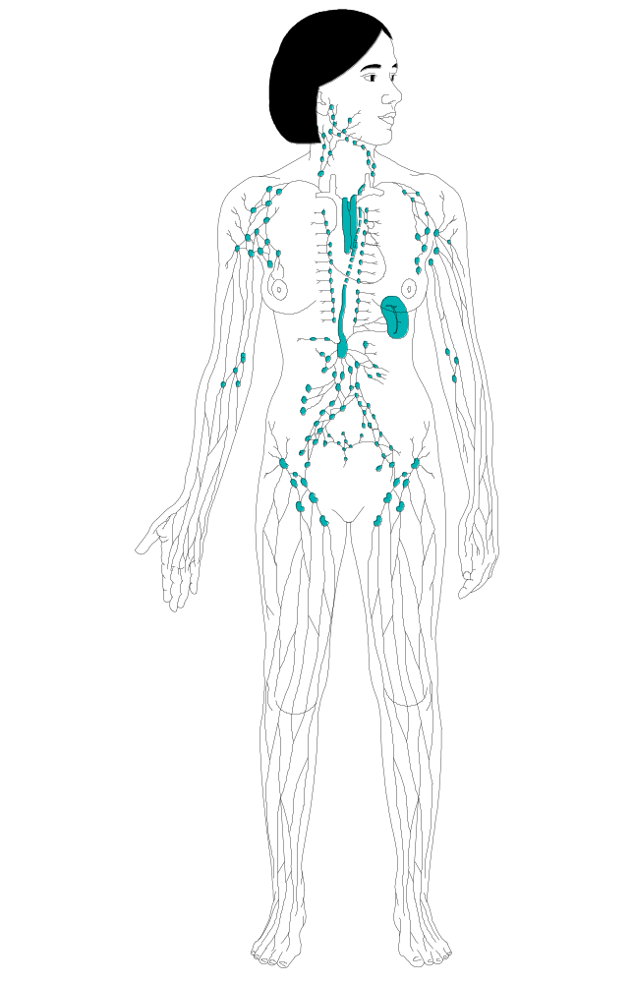
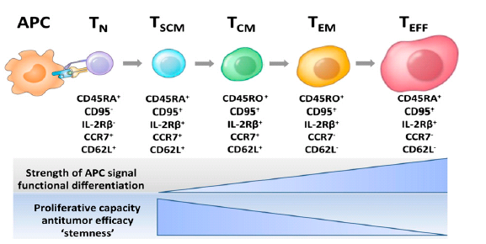
HSC
Total cells/day:
1 trillion/70 kg (avg./person =10¹²/day):
200 billion RBC
70 billion neutrophils e.g. short ½ life
(6 h)
CLP
CMP
T-progenitors
B-progenitors
GEMMP
Erythroid
Monocytes
Granulocytes
T-cells
DC
NK
T-
B-
B-cells
Megakaryocytes
www.healincsummit.com
Nicholas P. Restifo, Blood 2014;124:476; Stemberger C et al, Blood 2014;124:628

Slide 5
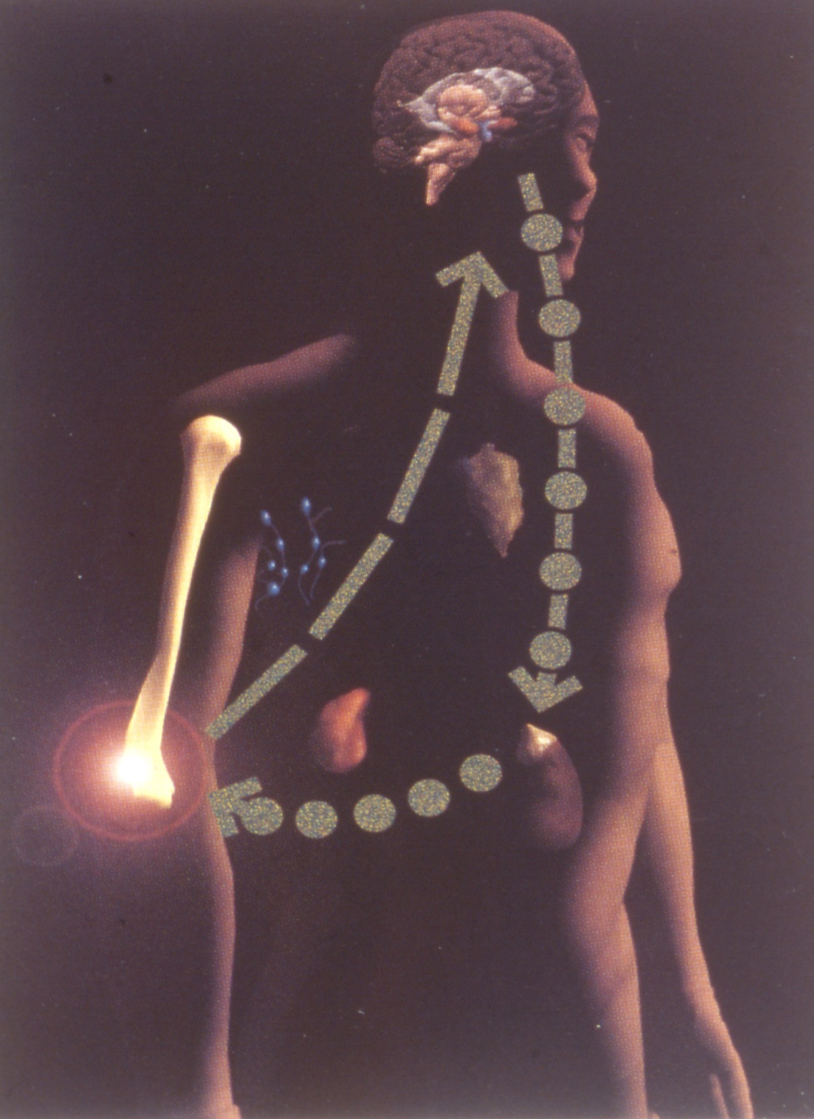
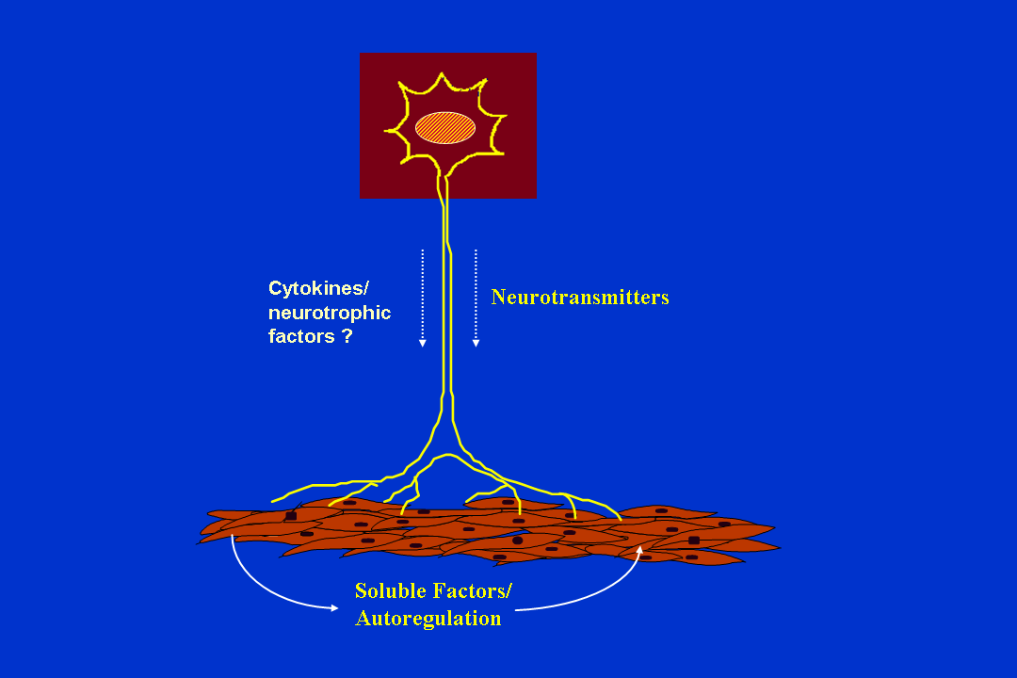
Nervous
Endocrine
Immune/
Hematopoietic
(Neuroimmune communication: Video
From Emotions and Disease Exhibit,
Multimedia Software Inc.)
www.healincsummit.com

Slide 6
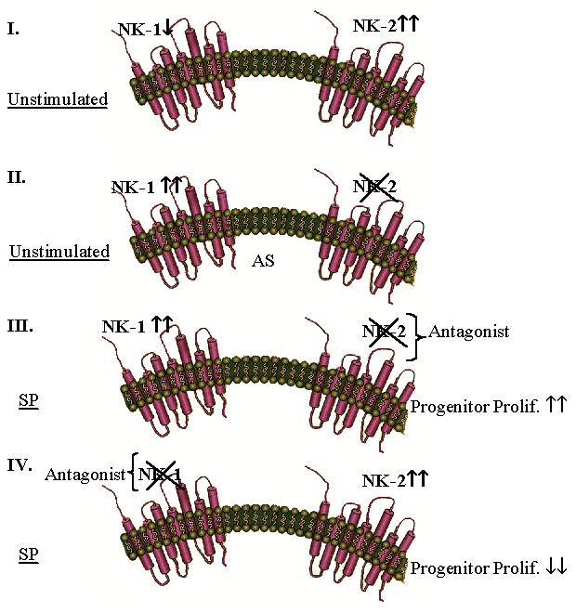
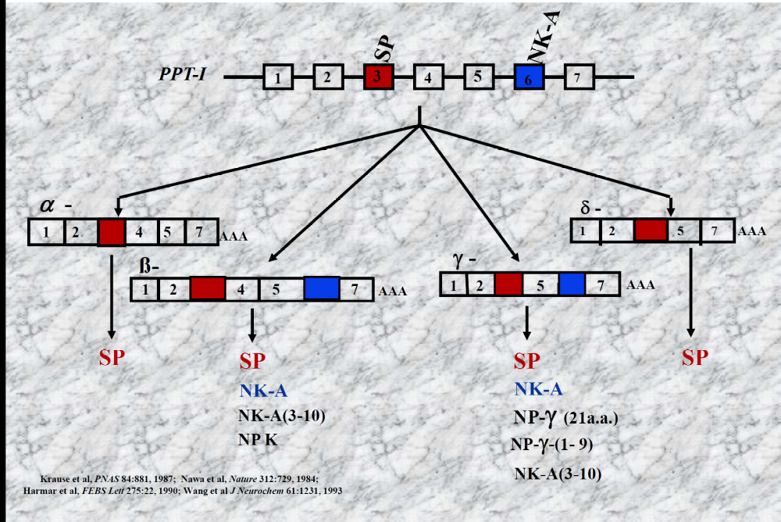
G₀
_{+SP/G0/1 transit}

www.healincsummit.com
J Neuroimmunol 2003;138:65

Slide 7
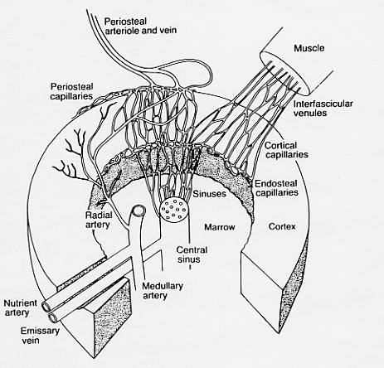
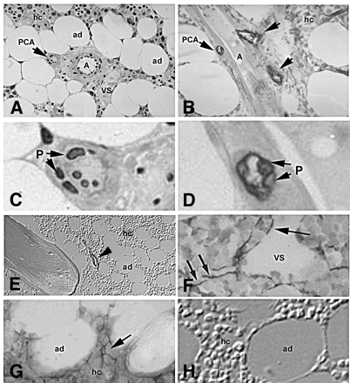

Marrow Cavity
Central Sinus
Bone
Stroma
MSC (direction of differentiation toward periphery)
LHSC (direction of differentiation toward sinus)
Mature Immune Cells
MSC
Stroma
www.healincsummit.com
Bianco P et al, Stem Cells 2001;19:180

Slide 8
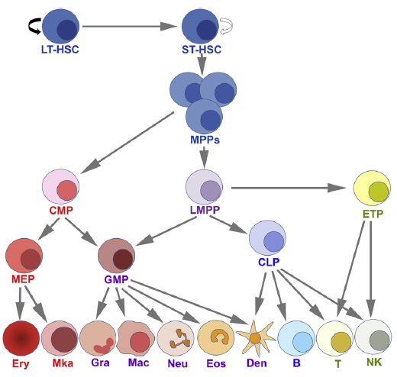
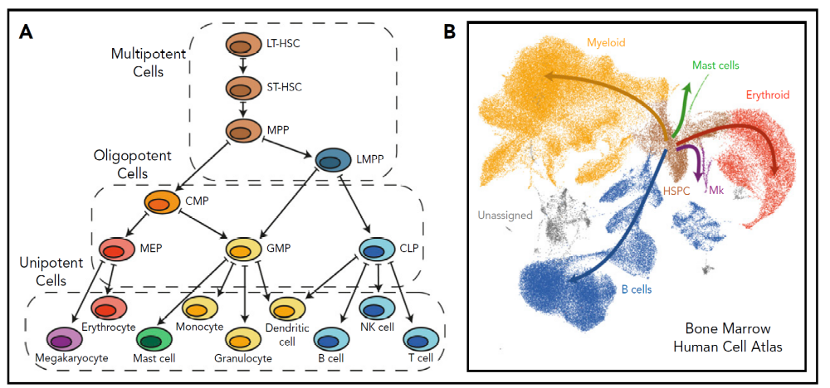
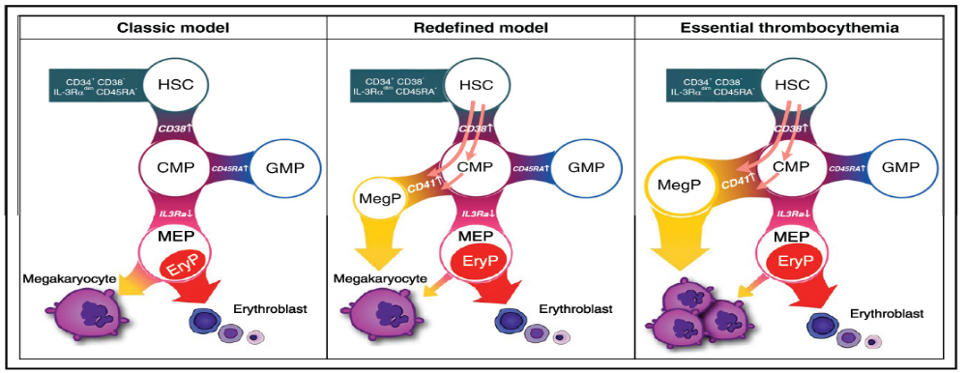
HEMATOPOIETIC SYSTEM – Moving Forward
www.healincsummit.com
Panigrahi AK & Pati D, Exp Hematol 2012;40:967
Kohta Miyawaki et al, Blood 2017;129:3332
Sam Watcham et al, Blood 2019;133:1415
Notes:
A schematic of hematopoietic differentiation. The solid curved arrow represents higher potential of self-renewal of LT-HSCs. This schematic
merges several models as discussed in references 2, 8, 10–13. LT-HSC5Long-term HSC; ST-HSC5short-term HSC; CMP5common myeloid progenitor;
LMPP5lymphoid-primed MPP; ETP5early T-lineage progenitor; MEP5megakaryocyte-erythrocyte progenitor; GMP5granulocyte-monocyte progenitor;
CLP5common lymphoid progenitor; Ery5erythrocyte; Mka5megakaryocyte; Gra5granulocyte; Mac5 macrophage; Neu5neutrophil; Eos5eosinophil;
Den5dendritic cell; B5B-cells; T5T-cells; NK5natural killer cells.

Slide 9
HEMATOPOIETIC AGING
www.healincsummit.com

Slide 10
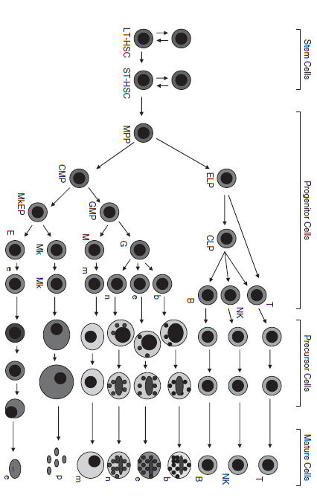
Hallmarks of Aging
Immunosenesence
Increased HSCs
Increased Myeloid cells
Decreased Lymphoid Cells
Increased Hematological Disorders
Mayani H, Stem Cells Dev 2010;19:285
www.healincsummit.com
Notes:
Hierarchical organization of the hematopoietic system. At least 4 separate compartments are comprised within
the hematopoietic system. The fi rst compartment corresponds to hematopoietic stem cells (HSC), which are capable of both
self-renewal and multilineage differentiation. Two different HSC subsets have been identifi ed, capable of long-term (LT)
and short-term (ST) reconstitution, respectively. HSC give rise to hematopoietic progenitor cells (HPC), including both multilineage
progenitors and those committed to specifi c blood lineages. HPC, in turn, generate morphologically recognizable
precursor cells, which, fi nally, give rise to fully mature, circulating cells. Abbreviations: MPP, multipotent progenitor; ELP,
early lymphoid progenitor; CLP, common lymphoid progenitor; CMP, common myeloid progenitor; GMP, granulocyte–
macrophage progenitor; MkEP, megakaryocyte–erythroid progenitor; T, T cell; NK, natural killer cell; B, B cell; b, basophil;
e, eosinophil; n, neutrophil; m, monocyte; Mk, megakaryocyte; p, platelet; e, erythrocyte.

Slide 11
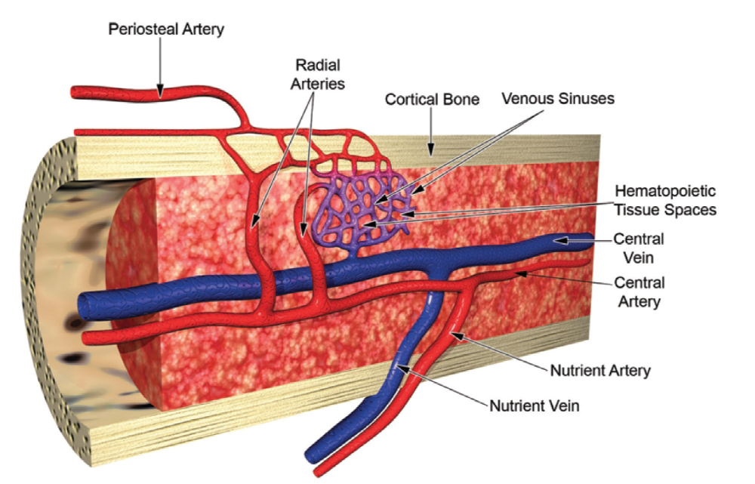
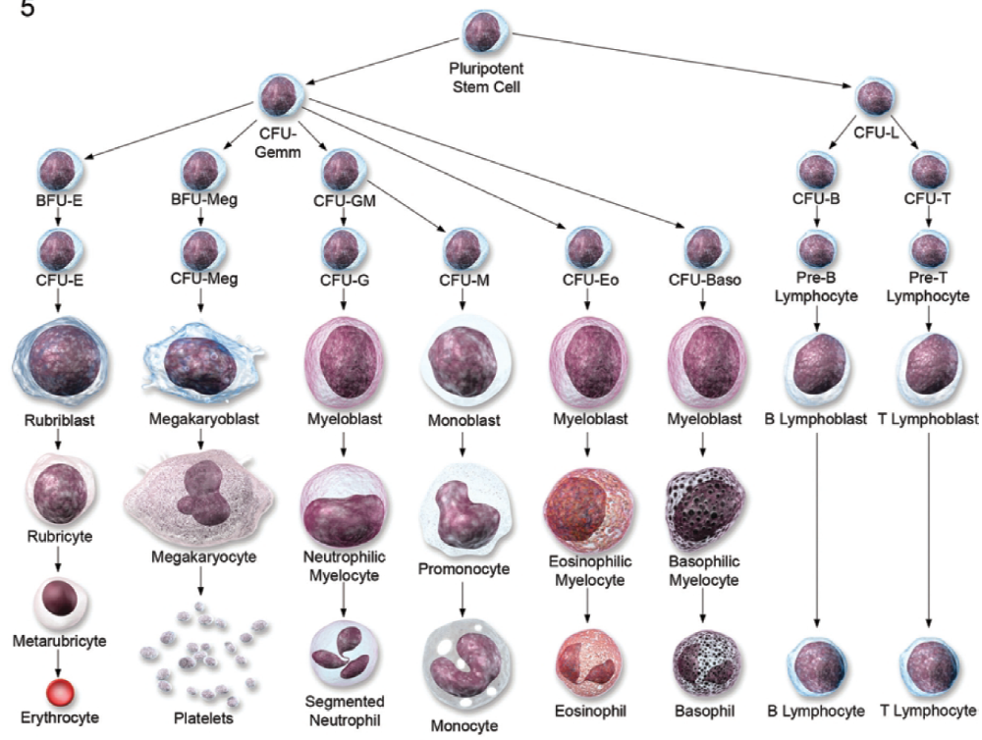
GREGORY S. TRAVLOS, Toxicologic Pathol 34:548-65, 2006
Notes:
Diagrammatical representation of the vascular supply of the bone marrow. Adapted from: Abboud, C. N. and Lichtman, M. A. (2001) Structure of the
marrow and the hematopoietic microenvironment. InWilliams Hematology, 6th edition. Copyright McGraw-Hill, used with permission. Adaptive drawing by David
Sabio. 6.—Representation of the maturation progression of the multiple cellular lineages present in the bone marrow. CFU = colony forming unit; E = erythyroid;
Meg = megakaryocyte; Gemm = granulocytic, erythyroid, monocyte-macrophage, and megakaryocytic; GM = granulocyte/monocyte; G = granulocyte; M =
monocyte; Eo = eosinophil; Baso = basophil; L = lymphocyte. Drawing by David Sabio.

Slide 12
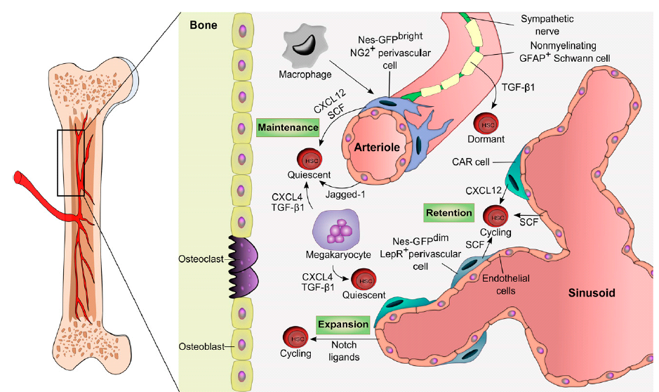
Philip E. Boulais & Paul S. Frenette, Blood 2015;125:2621
Notes:
The adult bone marrow HSC niche. The vasculature has emerged as a key structure for the maintenance of HSCs in the bone marrow. Dormant HSCs are found
around arterioles where factors such as CXCL12 and SCF secreted by perivascular, endothelial, Schwann, and sympathetic neuronal cells promote their maintenance. Less
quiescent or activated HSCs are located near sinusoidal niches which are likely diverse in their influence for self-renewal, proliferation, and differentiation. Hematopoietic cells
such as macrophages or megakaryocytes are examples of HSC-derived progeny that can feed back to the niche to influence HSC migration or proliferation. GFAP, glial
fibrillary acidic protein; TGF-b1, transforming growth factor beta-1.

Slide 13
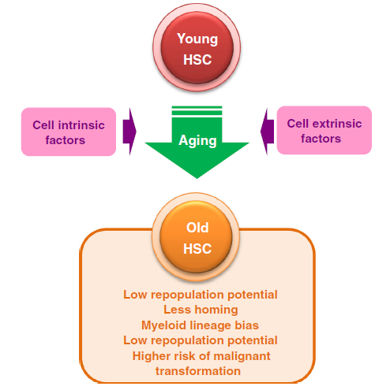
Ayako Nakamura-Ishizu & Toshio Suda, Int J Hem 100:317, 2014
Notes:
Characteristics of aged HSCs. Both cell-intrinsic and -extrinsic
factors affect aging of HSCs

Slide 14
↑Myeloid Cells
Immune Dysfunction
Clonal Hematopoiesis, E.g., AML
Middle Age
Years
CHIP ↑↑
Restored
Hematopoiesis/
Functional Immune
System
HEMATOPOIETIC
RESTORATION
www.healincsummit.com

Slide 15
www.healincsummit.com

Slide 16
REFLECTING
Hematopoietic Aging
Is this druggable?
www.healincsummit.com

Slide 17
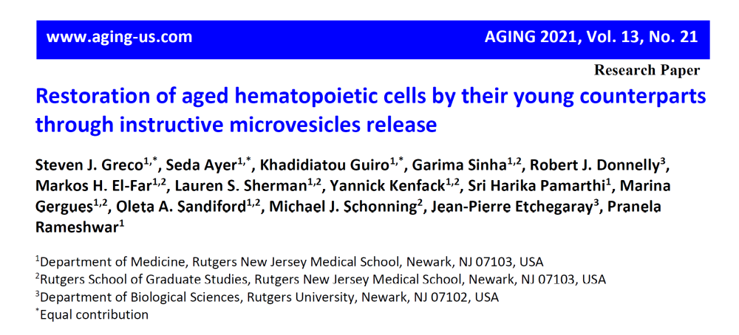
RESEARCH AT RUTGERS
www.healincsummit.com

Slide 18
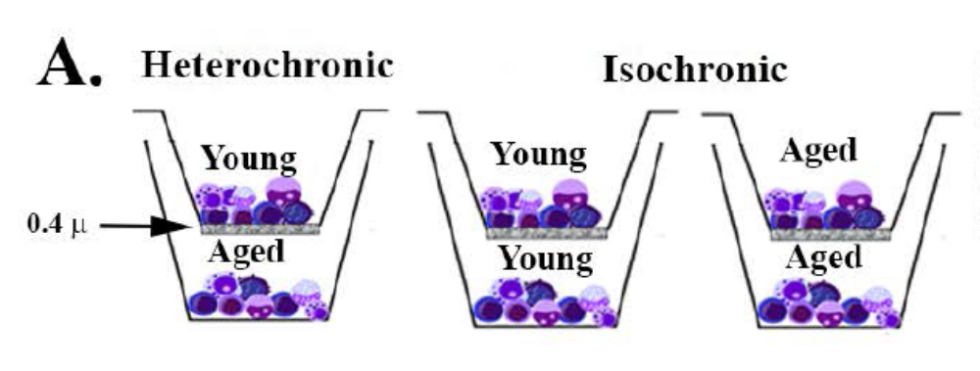
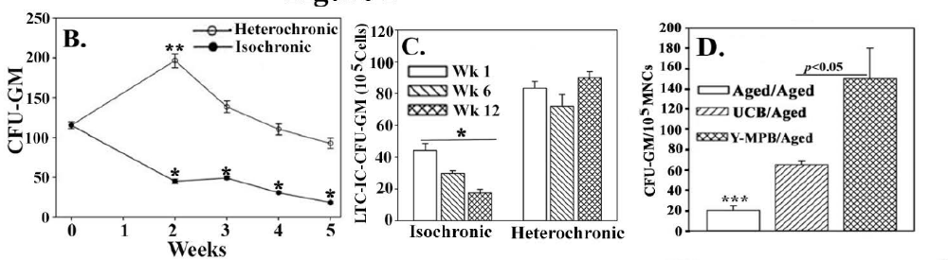
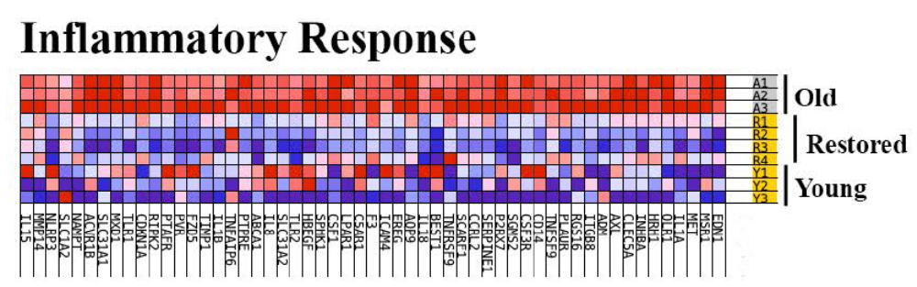
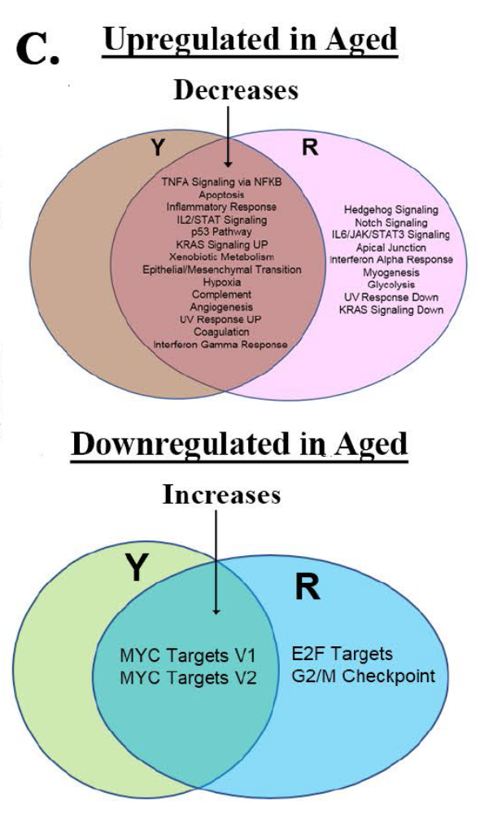
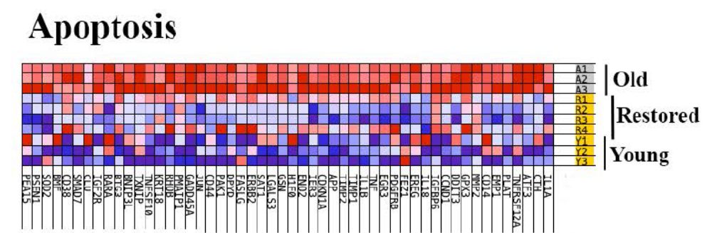
In vitro Restoration of Aged Hematopoietic Cells
www.healincsummit.com

Slide 19
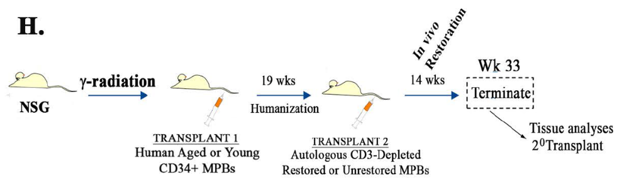
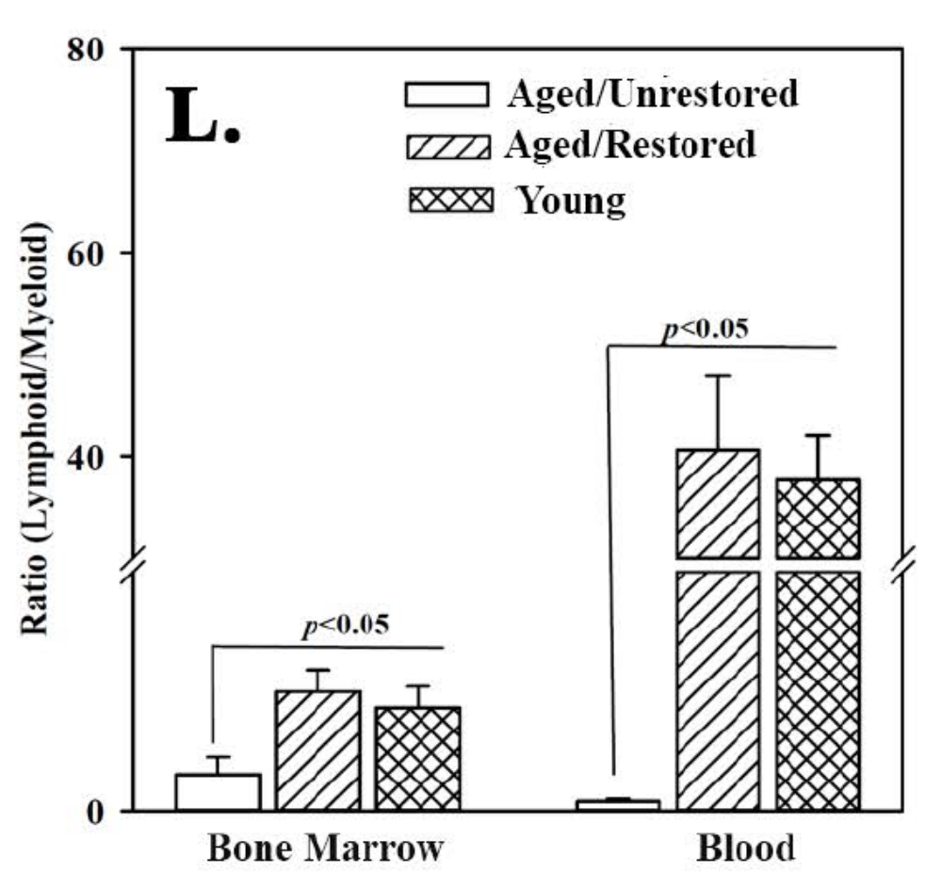
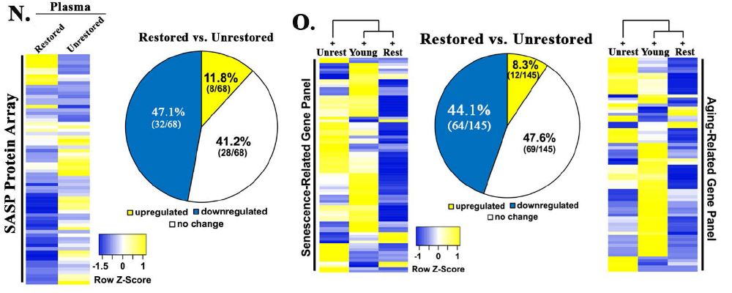
In vivo Hematopoietic Restoration
www.healincsummit.com

Slide 20
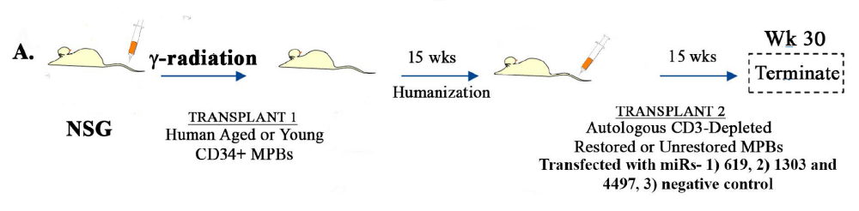
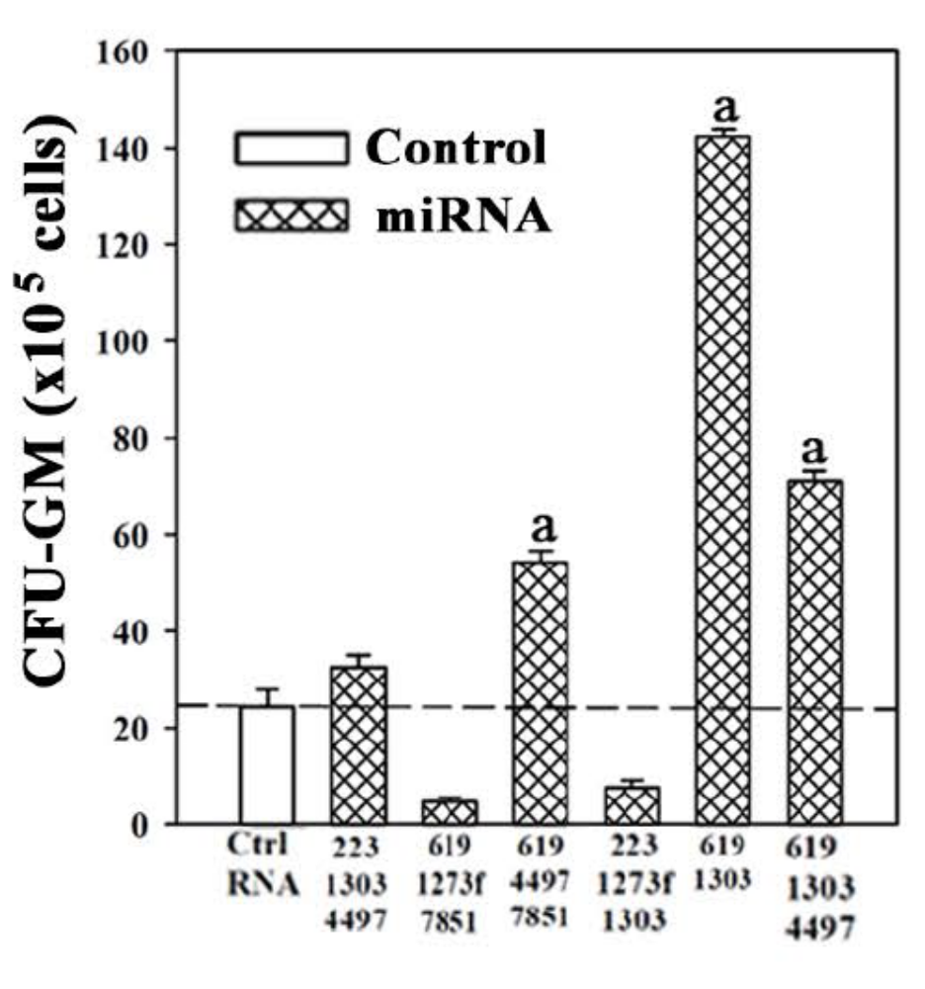
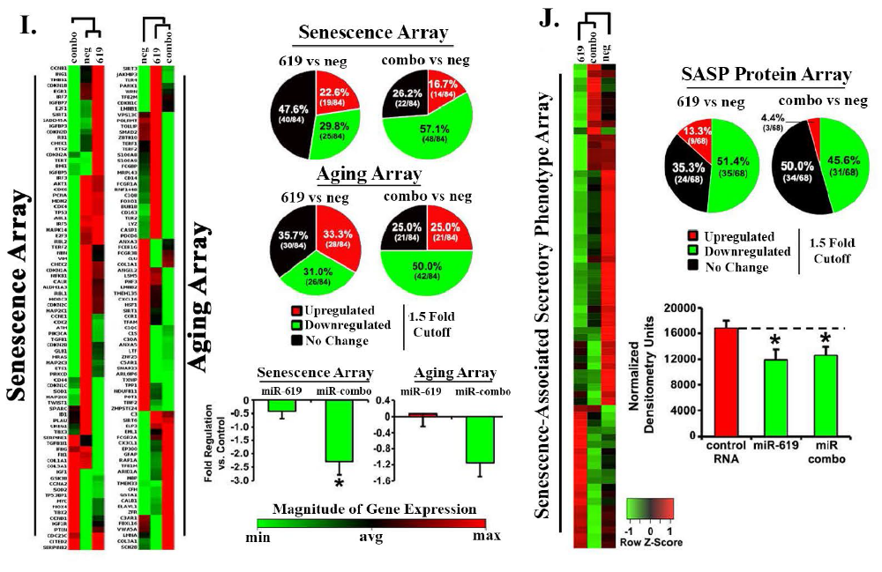
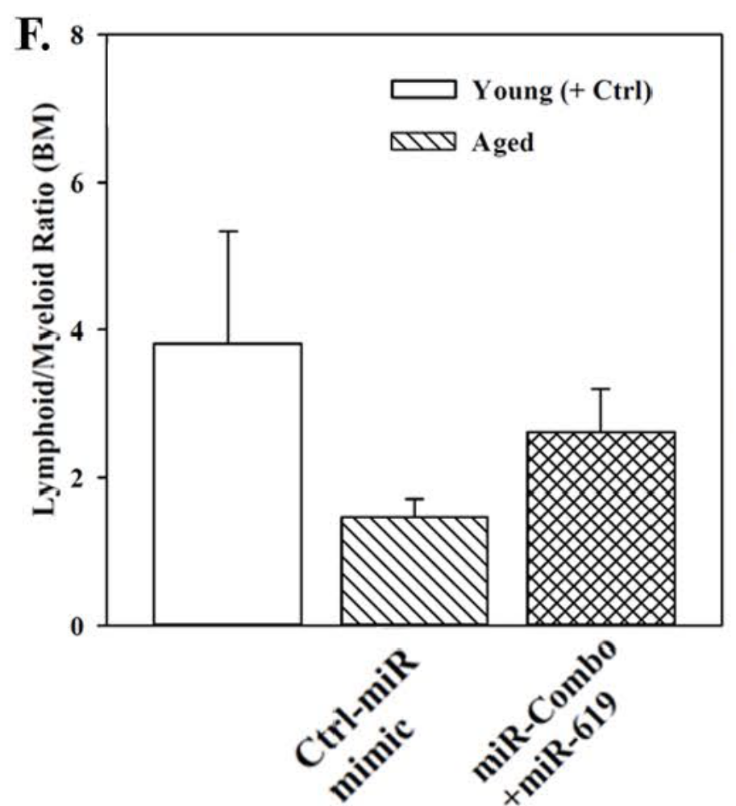
MiRNA within Exosomal Cargo of Heterochronic Cultures in Restoration
www.healincsummit.com

Slide 21
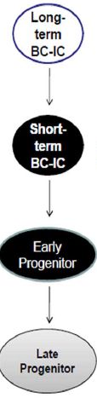
Central Sinus
Cartilage
Cartilage
Bone
Bone
Notes:
Exosome exposed breast cancer cells induce stroma to release cytokines

Slide 22
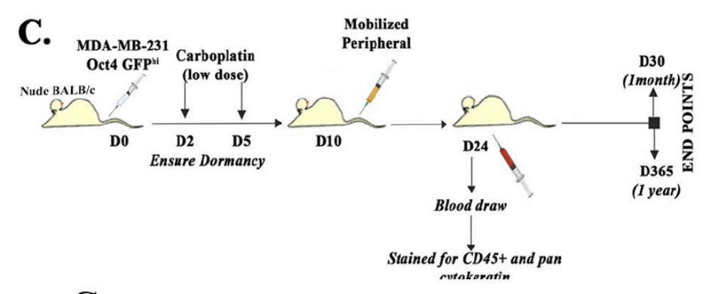
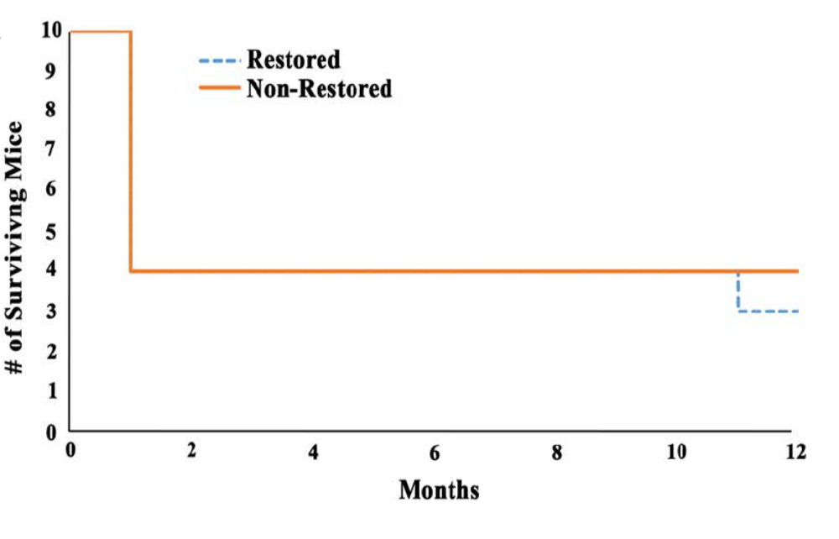
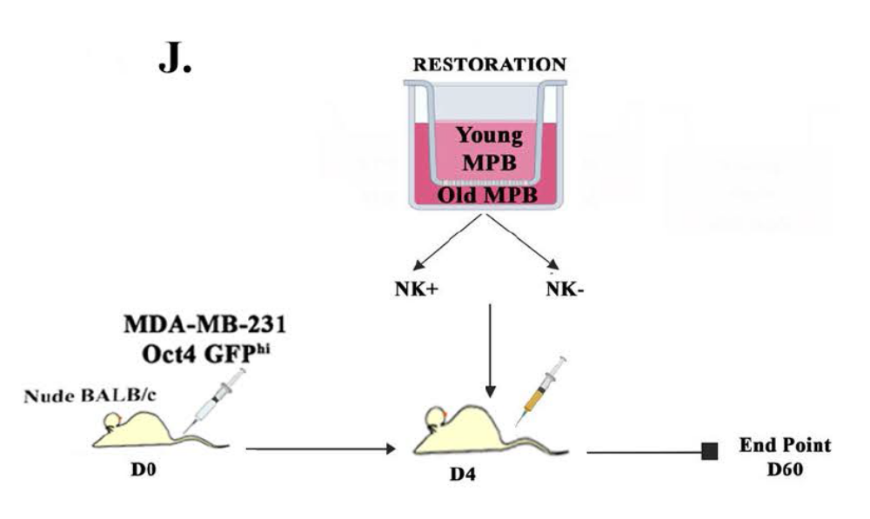
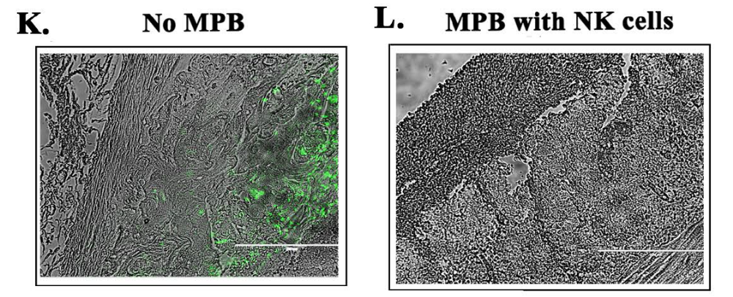
Improved Natural Killer cells cleared residual Breast Cancer Cells

Slide 23
TRANSLATION TO PATIENTS
www.healincsummit.com
Notes:
Exosome exposed breast cancer cells induce stroma to release cytokines

Slide 24
Initiative by Dr. Marc Penn
FOUNDERS –OWNER OF THE TECHNOLOGY
STRINGENT REVIEW BY THE REGULATORY
AGENCY IN THE BAHAMAS (NOT BY RUTGERS)
Visit to Rutgers Lab to Validate the Research
STRICT OVERSIGHT TO TRANSPLANT AGED INDIVIDUALS
WITH AUTOLOGOUS RESTORED CELLS
www.healincsummit.com
Notes:
Exosome exposed breast cancer cells induce stroma to release cytokines

Slide 25
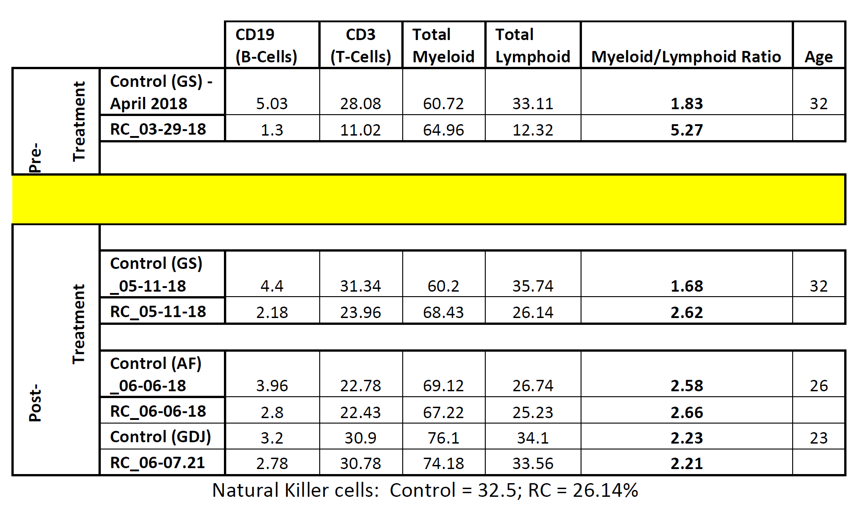
In Preparation (by Dr. Cox)
www.healincsummit.com
Notes:
Exosome exposed breast cancer cells induce stroma to release cytokines

Slide 26
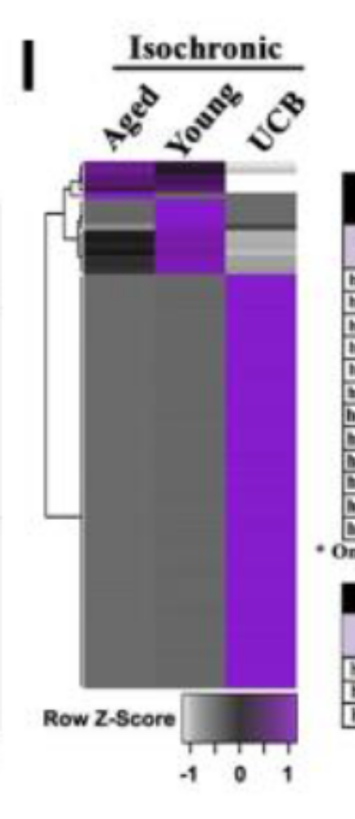
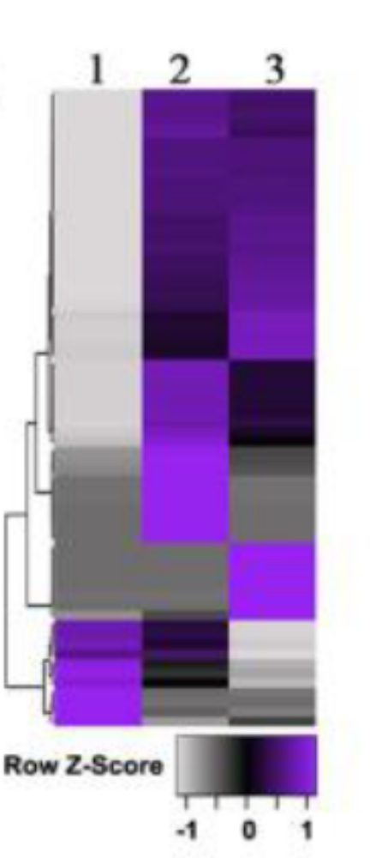
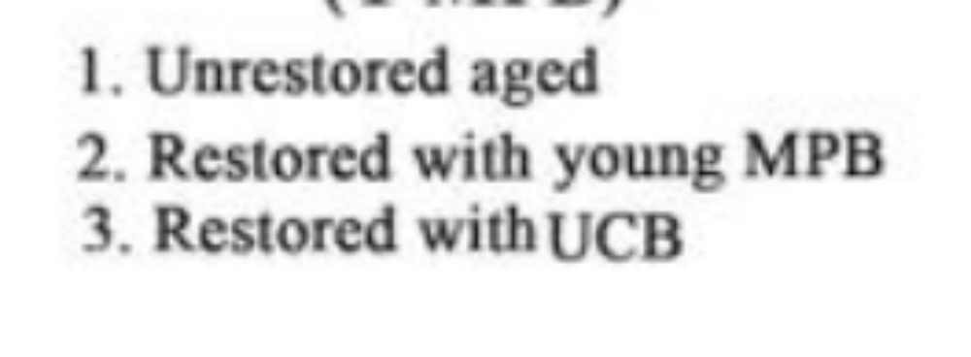
www.healincsummit.com
Notes:
Exosome exposed breast cancer cells induce stroma to release cytokines

Slide 27
Moving Forward
Cost Effective Technology
Established Info:
Requires mobilization of the aged donor
GMP facility for in vitro restoration
Transplant
Ongoing:
THROUGH OTHER PARTNERS – THE RUTGERS LAB HAS DEVELOPED A COST-EFFECTIVE TECHNOLOGY
NOT INVASIVE
www.healincsummit.com
Notes:
Exosome exposed breast cancer cells induce stroma to release cytokines

Slide 28

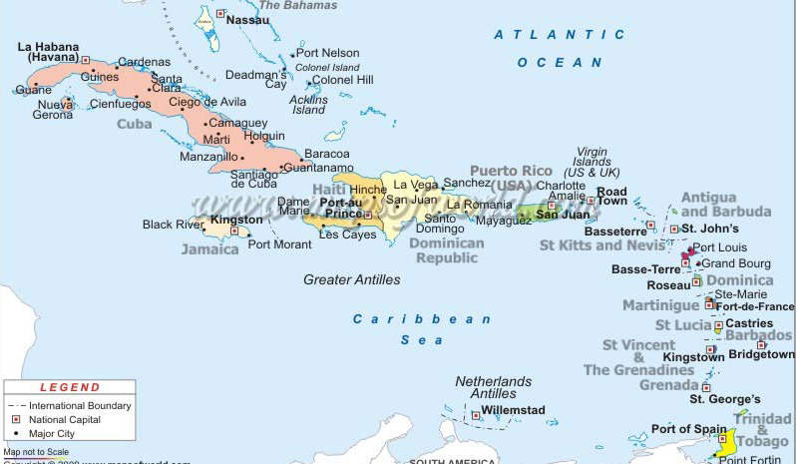
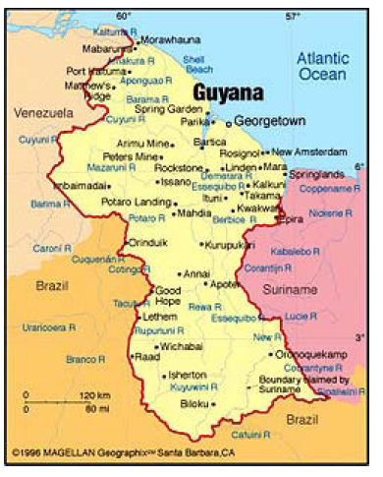
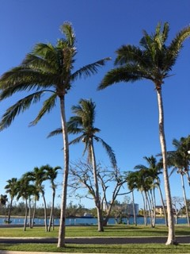

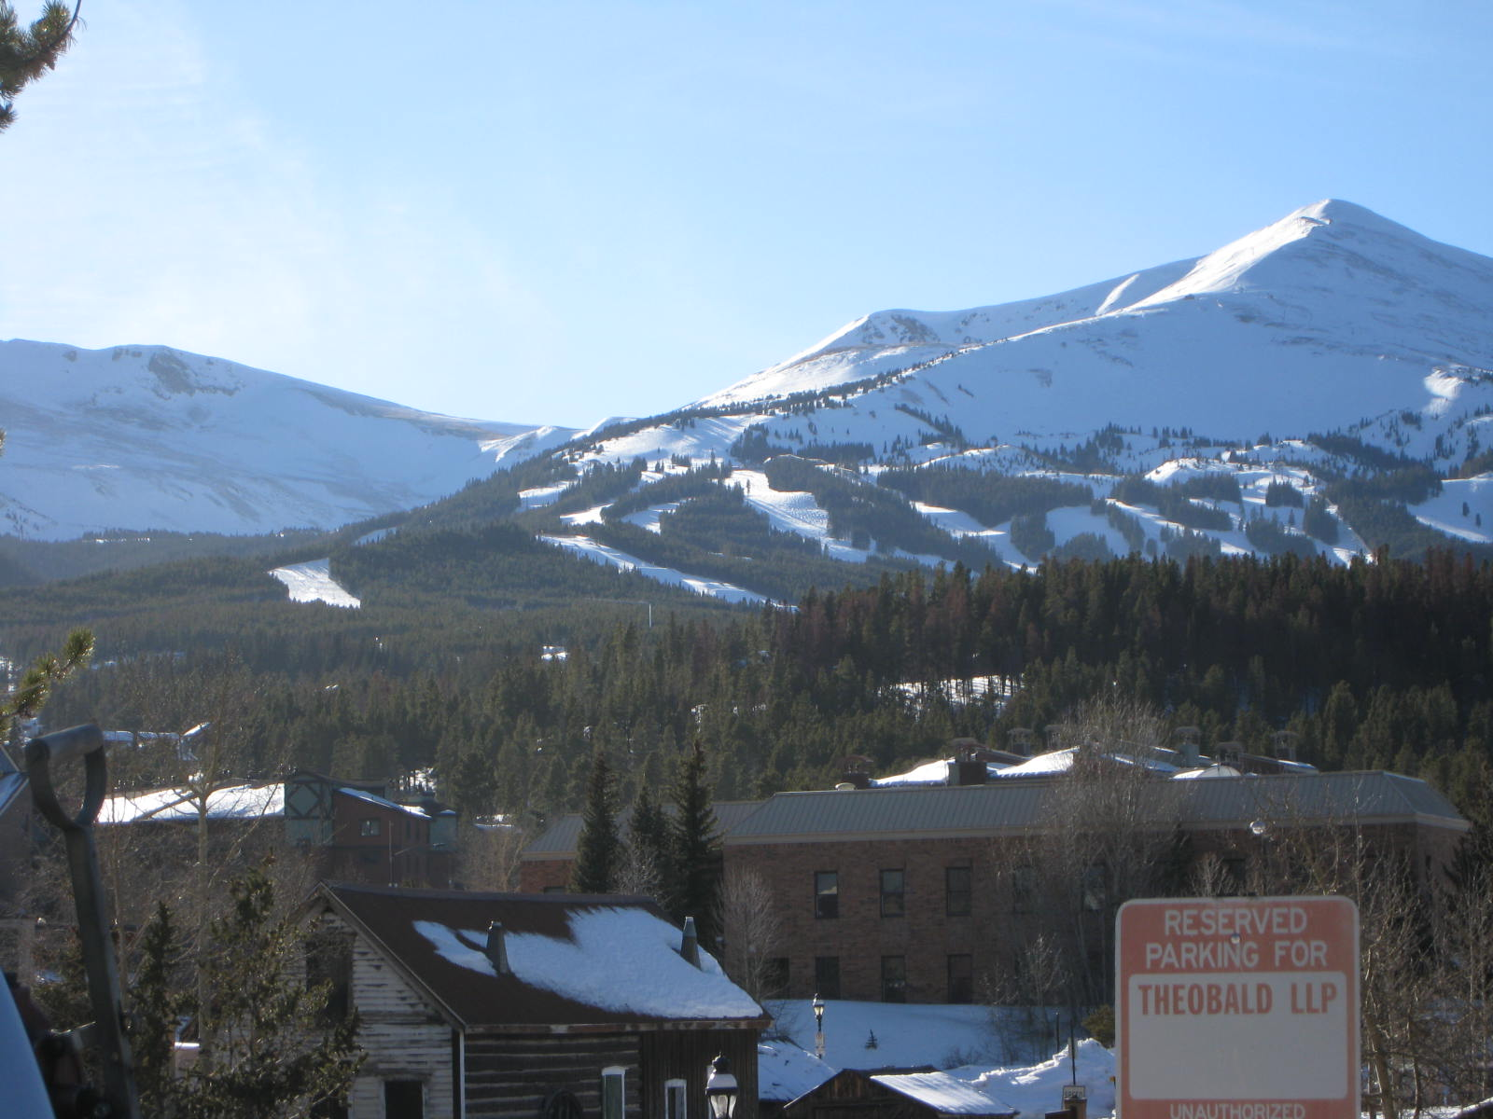



Slide 29
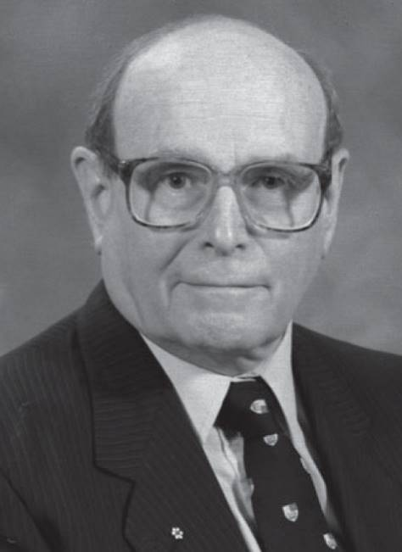
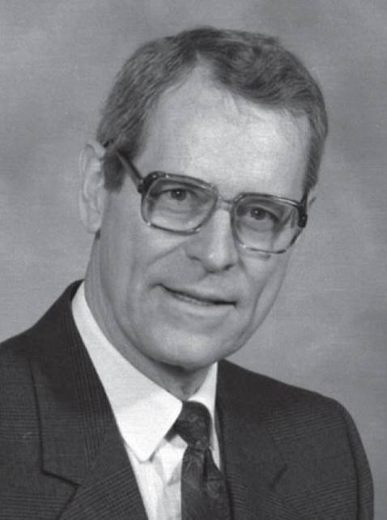
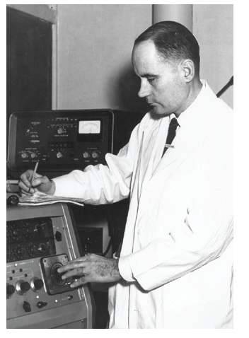
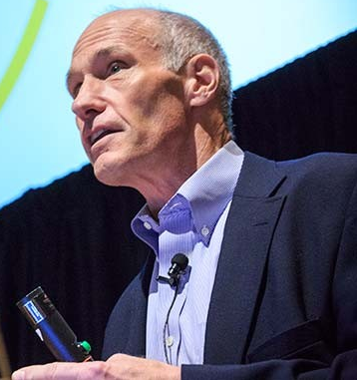
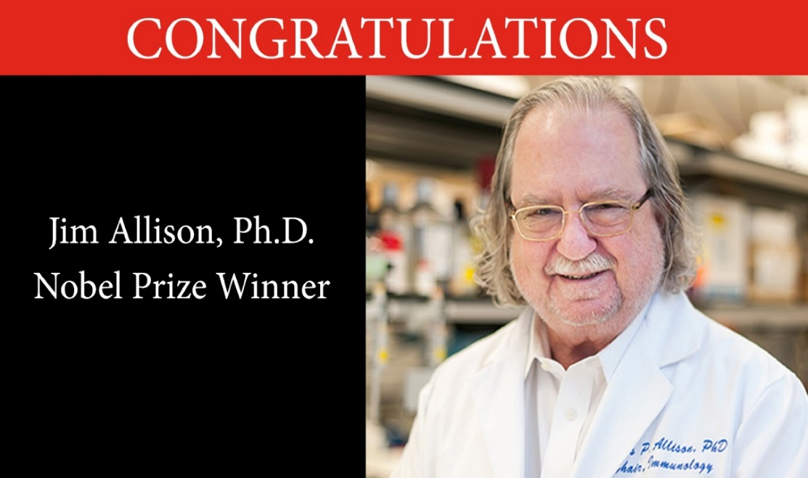
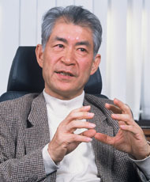
Edward Donnall Thomas (1920-2012)
Nobel prize for bone-marrow transplants
Immune-Hematopoietic Restoration
Ernest A. Mulloch & James E. Till, Nat Med 2005;11:1026
Tasuku Honjo
Jim Allison
Dr. Carl June, CAR-T expert

Slide 30
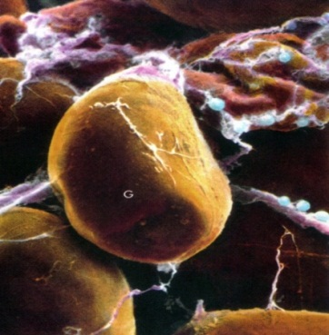
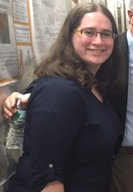



BM Aspirate
Adipose Tissue
PLACENTA
Maternal
portion
Umbilical arteries
Chorionic
plate
Umbilical vein

Slide 31




Stem Cell Dev (2007
Stem Cell Dev 2012
J Neurochem 2009

Slide 32






MSCs as Drug Delivery for miRNA
Cancer Res 2016

Slide 33





I.V.

Slide 34

Leveraging the Hierarchy on Health Disparity
METAvivor Health Disparity Funds
Standard Care
Carboplatin
No residual
CSC
Cell Death
Differentiation
Prolonged
Remission
CSC
Proliferation
Metastatic BC
Bortezomib

Slide 35



















